Slide 1
Docker Essentials

Slide 2

Course Agenda
Day 1
Introduction to Class
Docker Containers
Application Sever in Docker Container
Containerizing Applications
Docker Networking and Stateful Containers
Day 2
Docker Hub and Creating a Registry
Dockerfile and Compose
Docker on the Cloud
A Taste of Docker Swarm

Slide 3
Docker Containers
Discovering Docker Containers

Slide 4
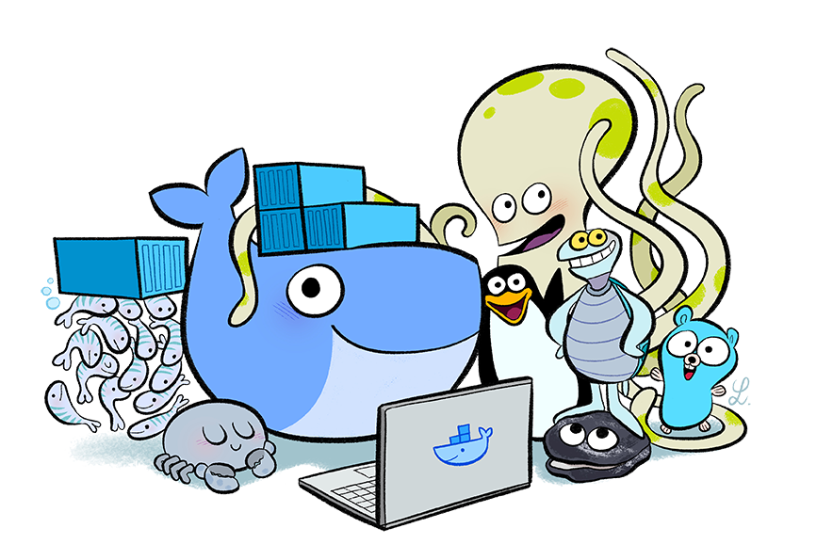
Getting to Know Each Other
Welcome!
A little about myself...
Tell me about yourself...

Slide 5
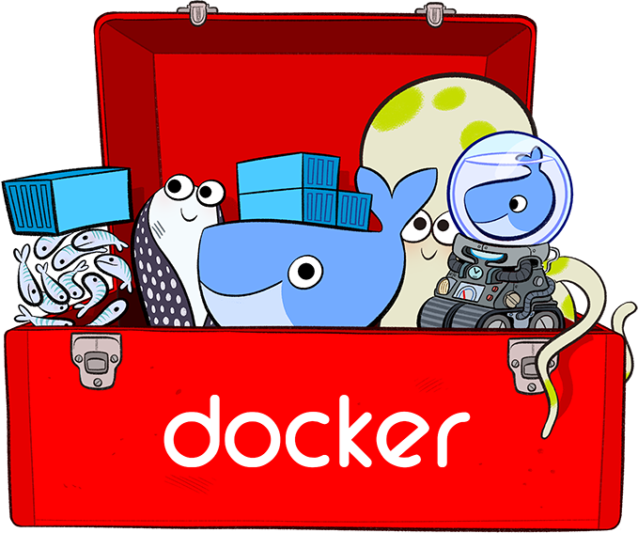
Course Logistics
Lecture Time
Lab Time
Lab Environment
Short Breaks
Time to eat!
Bathroom Breaks

Slide 6
End of Chapter

Slide 7
Docker Containers
Discovering Docker Containers

Slide 8
Installing Docker Platform
Docker is available in two editions:
Community Edition (CE)
Docker Community Edition (CE) is ideal for developers and small teams looking to get started
Docker CE has two update channels, stable and edge:
Stable gives you reliable updates every quarter
Edge gives you new features every month
Enterprise Edition (EE)
Docker Enterprise Edition (EE) is designed for enterprise grade development
IT teams who build, ship, and run business critical applications in production at scale
Notes:
Install Docker
Docker is available in two editions:
Community Edition (CE)
Docker Community Edition (CE) is ideal for developers and small teams looking to get started with Docker and experimenting with container-based apps.
Docker CE has two update channels, stable and edge:
Stable gives you reliable updates every quarter
Edge gives you new features every month
Enterprise Edition (EE)
Docker Enterprise Edition (EE) is designed for enterprise development and IT teams who build, ship, and run business critical applications in production at scale

Slide 9
What’s Included?
Docker for Mac and Docker for Windows
Compose - included with Docker install (since Docker 1.12+)
Swarm - included with Docker install (since Docker 1.12+)
Machine - included with Docker install (since Docker 1.12+)
Docker Linux Distributions
Compose - installed separately
Swarm - included with Docker install (since Docker 1.12+)
Machine - installed separately

Slide 10
About DockerHub
Docker Hub is a cloud-based registry service
Allowing you to link to code repositories, build your images and test them, storing manually pushed images
Also, link to Docker Cloud so you can deploy images to your hosts
It provides a centralized resource for container image discovery, distribution and change management, user and team collaboration, and workflow automation throughout the development pipeline
Notes:
Overview of Docker Hub
Docker Hub is a cloud-based registry service which allows you to link to code repositories, build your images and test them, stores manually pushed images, and links to Docker Cloud so you can deploy images to your hosts.
It provides a centralized resource for container image discovery, distribution and change management, user and team collaboration, and workflow automation throughout the development pipeline.

Slide 11
Docker Hub Major Features
Image Repositories: Find and pull images from community and official libraries, and manage, push to, and pull from private image libraries to which you have access
Automated Builds: Automatically create new images when you make changes to a source code repository
Webhooks: A feature of Automated Builds, Webhooks let you trigger actions after a successful push to a repository
Organizations: Create work groups to manage access to image repositories
GitHub and Bitbucket Integration: Add the Hub and your Docker Images to your current workflows.
Notes:
Docker Hub provides the following major features:
Image Repositories: Find and pull images from community and official libraries, and manage, push to, and pull from private image libraries to which you have access.
Automated Builds: Automatically create new images when you make changes to a source code repository.
Webhooks: A feature of Automated Builds, Webhooks let you trigger actions after a successful push to a repository.
Organizations: Create work groups to manage access to image repositories.
GitHub and Bitbucket Integration: Add the Hub and your Docker Images to your current workflows.

Slide 12
Creating a Docker ID
Logging into Docker Hub and Docker Cloud require a Docker ID
Your Docker ID becomes your user namespace for hosted Docker services, and becomes your username on the Docker Forums; register like this:
Go to the Docker Cloud sign up page.
Enter a username that is also your Docker ID.
Your Docker ID must be between 4 and 30 characters long, and can only contain numbers and lowercase letters.
Enter a unique, valid email address.
Enter a password between 6 and 128 characters long.
Click Sign up.
Docker sends a verification email to the address you provided.
Click the link in the email to verify your address.
Notes:
Create aDocker ID
Log in to Docker Hub and Docker Cloud using your free Docker ID.
To explore Docker Hub, you need to create an account by following the directions in Your Docker ID.
SHARE:
Note: You can search for and pull Docker images from Hub without logging in, however to push images you must log in.
Your Docker ID gives you one private Docker Hub repository for free. If you need more private repositories, you can upgrade from your free account to a paid plan. To learn more, log in to Docker Hub and go to Billing & Plans, in the Settings menu.

Slide 13
More on Docker Hub
You can find public repositories and images from Docker Hub in two ways:
You can “Search” from the Docker Hub website
Use the Docker CLI to run the docker search command
For example if you were looking for an ubuntu image, you might run the following command line search:
You can configure Docker Hub repositories in two ways:
Repositories, which allow you to push images from a local Docker daemon to Docker Hub
Automated Builds, which link to a source code repository and trigger an image rebuild process on Docker Hub when changes are detected in the source code
$ docker search ubuntu
Notes:
Explore repositories
You can find public repositories and images from Docker Hub in two ways. You can “Search” from the Docker Hub website, or you can use the Docker command line tool to run the docker searchcommand.
For example if you were looking for an ubuntu image, you might run the following command line search:
$ docker search ubuntu
SHARE:
Both methods list the available public repositories on Docker Hub which match the search term.
Private repositories do not appear in the repository search results. To see all the repositories you can access and their status, view your “Dashboard” page on Docker Hub.
You can configure Docker Hub repositories in two ways:
Repositories, which allow you to push images from a local Docker daemon to Docker Hub, and
Automated Builds, which link to a source code repository and trigger an image rebuild process on Docker Hub when changes are detected in the source code.

Slide 14

Working with Docker Images
Docker images are the basis of containers
An Image is an ordered collection of root filesystem changes and the corresponding execution parameters for use within a container runtime
An image typically contains a union of layered filesystems stacked on top of each other
An image does not have state and it never changes
But, how do we work with them?
Notes:
docker images
Docker images are the basis of containers.
An Image is an ordered collection of root filesystem changes and the corresponding execution parameters for use within a container runtime.
An image typically contains a union of layered filesystems stacked on top of each other.
An image does not have state and it never changes.
Basic Docker Commands
List images
Usage
docker images [OPTIONS] [REPOSITORY[:TAG]] Options
Name, shorthandDefaultDescription--all , -aShow all images (default hides intermediate images)--digestsShow digests--filter , -fFilter output based on conditions provided--formatPretty-print images using a Go template--no-truncDon’t truncate output--quiet , -qOnly show numeric IDs
Parent command
CommandDescriptiondockerThe base command for the Docker CLI.Extended description
The default docker images will show all top level images, their repository and tags, and their size.
Docker images have intermediate layers that increase reusability, decrease disk usage, and speed up docker build by allowing each step to be cached. These intermediate layers are not shown by default.
The SIZE is the cumulative space taken up by the image and all its parent images. This is also the disk space used by the contents of the Tar file created when you docker save an image.
An image will be listed more than once if it has multiple repository names or tags. This single image (identifiable by its matching IMAGE ID) uses up the SIZE listed only once.
Examples
List the most recently created images
$ docker images REPOSITORY TAG IMAGE ID CREATED SIZE <none> <none> 77af4d6b9913 19 hours ago 1.089 GB committ latest b6fa739cedf5 19 hours ago 1.089 GB <none> <none> 78a85c484f71 19 hours ago 1.089 GB docker latest 30557a29d5ab 20 hours ago 1.089 GB <none> <none> 5ed6274db6ce 24 hours ago 1.089 GB postgres 9 746b819f315e 4 days ago 213.4 MB postgres 9.3 746b819f315e 4 days ago 213.4 MB postgres 9.3.5 746b819f315e 4 days ago 213.4 MB postgres latest 746b819f315e 4 days ago 213.4 MB
List images by name and tag
The docker images command takes an optional [REPOSITORY[:TAG]] argument that restricts the list to images that match the argument. If you specify REPOSITORYbut no TAG, the docker imagescommand lists all images in the given repository.
For example, to list all images in the “java” repository, run this command :
$ docker images java REPOSITORY TAG IMAGE ID CREATED SIZE java 8 308e519aac60 6 days ago 824.5 MB java 7 493d82594c15 3 months ago 656.3 MB java latest 2711b1d6f3aa 5 months ago 603.9 MB
The [REPOSITORY[:TAG]] value must be an “exact match”. This means that, for example,docker images jav does not match the image java.
If both REPOSITORY and TAG are provided, only images matching that repository and tag are listed. To find all local images in the “java” repository with tag “8” you can use:
$ docker images java:8 REPOSITORY TAG IMAGE ID CREATED SIZE java 8 308e519aac60 6 days ago 824.5 MB
If nothing matches REPOSITORY[:TAG], the list is empty.
$ docker images java:0 REPOSITORY TAG IMAGE ID CREATED SIZE
https://docs.docker.com/engine/reference/commandline/images/
docker image
Description
Manage images
Usage
docker image COMMAND
Child commands
CommandDescription
docker image build Build an image from a Dockerfile
docker image history Show the history of an image
docker image import Import the contents from a tarball to create a filesystem image
docker image inspect Display detailed information on one or more images
docker image load Load an image from a tar archive or STDIN
docker image ls List images
docker image prune Remove unused images
docker image pull Pull an image or a repository from a registry
docker image push Push an image or a repository to a registry
docker image rm Remove one or more images
docker image save Save one or more images to a tar archive (streamed to STDOUT by default)
docker image tag Create a tag TARGET_IMAGE that refers to SOURCE_IMAGE

Slide 15
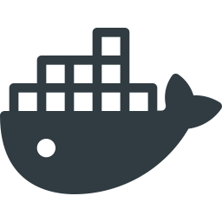
Working with Docker Images
We can see the available image commands, by using the following command:
So, of the most common commands though are listed below:
$ docker image
docker image build Build an image from a Dockerfile
docker image history Show the history of an image
docker image inspect Display detailed information on one or more images
docker image ls List images
docker image pull Pull an image or a repository from a registry
docker image push Push an image or a repository to a registry
docker image rm Remove one or more images
Notes:
Basic Docker Images Commands
docker image build Build an image from a Dockerfile
docker image history Show the history of an image
docker image import Import the contents from a tarball to create a filesystem image
docker image inspect Display detailed information on one or more images
docker image load Load an image from a tar archive or STDIN
docker image ls List images
docker image prune Remove unused images
docker image pull Pull an image or a repository from a registry
docker image push Push an image or a repository to a registry
docker image rm Remove one or more images
docker image save Save one or more images to a tar archive (streamed to STDOUT by default)
docker image tag Create a tag TARGET_IMAGE that refers to SOURCE_IMAGE

Slide 16
Ways to Create an Image
Dockerfile is the most common way to create a base image, and there’s two ways to do that:
Utilizing a parent image referenced by the FROM directive in the Dockerfile
A base image, either has no FROM line in its Dockerfile, or has FROM scratch
(We will learn much more about Dockerfiles in the coming lectures!)
Also, images can be saved using image save command to a .tar file:
These tar files can then be imported using load command:
$ docker image save helloworld > helloworld.tar
$ docker image load -i helloworld.tar
Notes:
Dockerfile
Most Dockerfiles start from a parent image. If you need to completely control the contents of your image, you might need to create a base image instead.
Here’s the difference:
A parent image is the image that your image is based on.
SHARE:
It refers to the contents of the FROM directive in the Dockerfile. Each subsequent declaration in the Dockerfile modifies this parent image. Most Dockerfiles start from a parent image, rather than a base image. However, the terms are sometimes used interchangeably.
A base image either has no FROM line in its Dockerfile, or has FROM scratch.
Import and export images
Docker images can be saved using image save command to a .tar file:
docker image save helloworld > helloworld.tar
These tar files can then be imported using load command:
docker image load -i helloworld.tar

Slide 17
Basic Commands
See local repository of images
Check to see if containers are running
Pull a container down
Check system-wide information
Or course, if you want to see all the available Docker commands:
$ docker images
$ docker ps
$ docker pull <reponame/imagename:tag>
$ docker info
$ docker

Slide 18
Basic Commands
How do we “get in” our container?
By spinning off an image using ‘run’:
$ docker run <image-name, or image-id>
Container is running, but where is it?
Enter active containers with ‘exec -it’:
$ docker exec -it <image-name, or image-id>

Slide 19

Basic Commands
You know you are “in” when you see something, like this:
root@<container-name, or container-id>
Now that we are “in” the container, we can use all our trusty Linux commands like, ll, cd, vi, and apt-get…
Look around and update your system using apt-get

Slide 20
Basic Commands
When you first run an image you can:
Add ports, name the container, set hostname, select a network and more
We can also use ‘-it’ to “get in” to our container immediately
An example of how that might look:
$ docker run -it —-network networkname -p 8000 \
—-name name-container \
—-hostname name-host \
reponame/image-name:tag

Slide 21

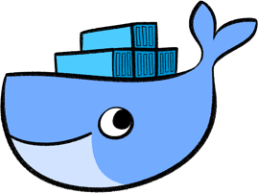
Pulling Our First Container
Let’s pull a Centos 7 image from DockerHub, like this:
Output:
docker pull centos:7
Pulling from library/centos
fa5be2806d4c: Pull complete
0cd86ce0a197: Pull complete
e9407f1d4b65: Pull complete
c9853740aa05: Pull complete
e9fa5d3a0d0e: Pull complete
Digest: sha256:xxxxxxxxxxxxx...
Status: Downloaded newer image for centos:7

Slide 22
List Docker Images
Now, let’s list all our locally installed images, like:
Output:
docker images
REPOSITORY TAG IMAGE ID CREATED VIRTUAL SIZE
centos 7 e9fa5d3a0d0e 2 days ago 172.3 MB

Slide 23
List Docker Images
We can pass the images command (-a) option to see all images, past and present:
Output:
docker images -a
REPOSITORY TAG IMAGE ID CREATED VIRTUAL SIZE
centos 7 e9fa5d3a0d0e 2 days ago 172.3 MB
<none> <none> c9853740aa05 2 days ago 172.3 MB
<none> <none> e9407f1d4b65 2 days ago 172.3 MB
<none> <none> 0cd86ce0a197 2 days ago 172.3 MB
<none> <none> fa5be2806d4c 5 weeks ago 0 B

Slide 24
Running Our First Docker Container
Here’s how we can then run a Linux command inside a Docker container:
Output:
Woah, what happened? It just printed "hello, world"? So what?
docker run –rm centos:7 echo “hello world”
hello world

Slide 25
Running Our First Docker Container
Let’s run a Linux shell inside a Docker container, from the inside:
Output:
It’s just that easy!
docker run --it --rm centos:7 bash
[root@d7dfcc490cbe /]# _

Slide 26
Inside Our Container
Now from inside the Docker container itself, we’ll issue commands, like this:
Output:
# ll /etc/*-release
-rw-r--r-- 1 root root 38 Mar 31 2015 /etc/centos-release
-rw-r--r-- 1 root root 393 Mar 31 2015 /etc/os-release
lrwxrwxrwx 1 root root 14 Aug 14 21:00 /etc/redhat-release -> centos-release
lrwxrwxrwx 1 root root 14 Aug 14 21:00 /etc/system-release -> centos-release

Slide 27
Inside Our Container
We can now play around with Linux commands within the container:
If it looks like Linux and it works like Linux...
# hostname -f
# cat /etc/hosts
# ps aux
# yum -y install vim
# ip a

Slide 28
Let’s Make a Mess
Now, lets pretend we do some destructive stuff, on purpose:
And now say we delete this, too:
Now, if we tried to issue any commands, like ls, ps, or cd we’d get:
Whoops… cannot ls, cd or do anything useful anymore. What’d we’d do?
# rm –fr /usr/sbin
# rm –fr /usr/bin
bash: /usr/bin/ls: No such file or directory

Slide 29
How Easy Is Starting Over
In the last slide we pretended to destroy all our hard work.
Now, how easy is it to start over?
Just exit the container and fire up a new one:
And everything is back! Wow… right?
docker run --it --rm centos:7 bash

Slide 30
Hands-on Exercise(s)

Slide 31
End of Chapter

Slide 32
Application Server in a Docker Container
Making containers application servers

Slide 33
What is an Application Server?
In this lesson, you’ll be using a Tomcat, but what is a application server?
Docker provides Tomcat images on Docker Hub to do this with
We’ll look at port-mapping, container parameters, and more!
Wikipedia says:
“An application server is a software framework that provides both facilities to create web applications and a server environment to run them.”

Slide 34

Understanding Tomcat
Apache Tomcat (or simply Tomcat) is an open source web server and servlet container developed by the Apache Software Foundation (ASF).
Tomcat implements the Java Servlet and the JavaServer Pages (JSP) specifications from Oracle.
It provides a "pure Java" HTTP web server environment for Java code to run in.

Slide 35
Understanding Tomcat
In the simplest configuration Tomcat runs in a single operating system process
The process runs a Java virtual machine (JVM)
Every single HTTP request from a browser to Tomcat is processed in the Tomcat process in a separate thread

Slide 36
Deploy Apache Tomcat in Docker
Now let’s run a JVM based application like Apache Tomcat:
Output:
docker run --rm –p 8888:8080 tomcat:8.0
16-Oct-2016 18:30:51.541 INFO [localhost-startStop-1] org.apache.catalina.startup.HostConfig.deployDirectory Deployment of web application directory /usr/local/tomcat/webapps/manager has finished in 28 ms
16-Oct-2016 18:30:51.542 INFO [localhost-startStop-1] org.apache.catalina.startup.HostConfig.deployDirectory Deploying web application directory /usr/local/tomcat/webapps/examples
16-Oct-2016 18:30:52.108 INFO [localhost-startStop-1] org.apache.catalina.startup.HostConfig.deployDirectory Deployment of web application directory /usr/local/tomcat/webapps/examples has finished in 566 ms
16-Oct-2016 18:30:52.117 INFO [localhost-startStop-1] org.apache.catalina.startup.HostConfig.deployDirectory Deploying web application directory /usr/local/tomcat/webapps/ROOT
16-Oct-2016 18:30:52.161 INFO [localhost-startStop-1] org.apache.catalina.startup.HostConfig.deployDirectory Deployment of web application directory /usr/local/tomcat/webapps/ROOT has finished in 45 ms
16-Oct-2016 18:30:52.176 INFO [main] org.apache.coyote.AbstractProtocol.start Starting ProtocolHandler ["http-nio-8080"]
16-Oct-2016 18:30:52.206 INFO [main] org.apache.coyote.AbstractProtocol.start Starting ProtocolHandler ["ajp-nio-8009"]
16-Oct-2016 18:30:52.208 INFO [main] org.apache.catalina.startup.Catalina.start Server startup in 1589 ms

Slide 37
Deploy Apache Tomcat
Let’s explore that command for a quick sec:
The option (--rm) tells Docker we want to remove the container when it’s done running.
We are exposing ports 8888:8080 with (-p), which tells Docker we want to map the container’s port 8080 to the host port of 8888
If we were to connect to http://localhost:8888 we should be able to reach our tomct server.
docker run --rm -p 8888:8080 tomcat:8.0

Slide 38


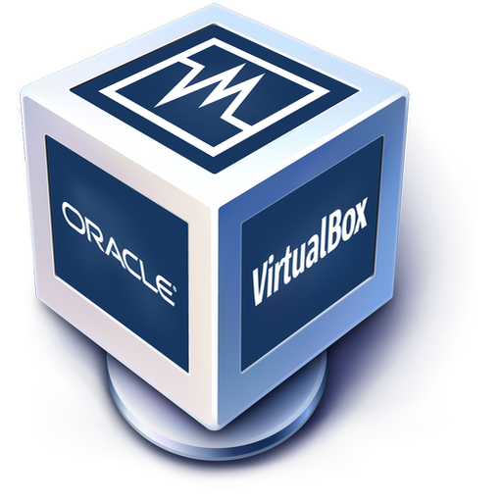
Deploy Apache Tomcat VM
If we are operating Docker from inside a VM image, there is some additional work to be done. Here’s a look at the problem:
Virtual Machine OS
Docker Host
8888
Client
8080
Tomcat
Notes:
Our Docker Host has been mapped properly, but we cannot reach it from our host (Windows/MacOSX) because the VM does not expose those ports.

Slide 39
Deploy Apache Tomcat VM
Our Docker Host has been mapped properly, but we cannot reach it from our host (Windows/MacOSX) because the VM does not expose those ports.
Virtual Machine OS
Docker Host
8888
Client
8080
Tomcat
Notes:
Our Docker Host has been mapped properly, but we cannot reach it from our host (Windows/MacOSX) because the VM does not expose those ports.

Slide 40
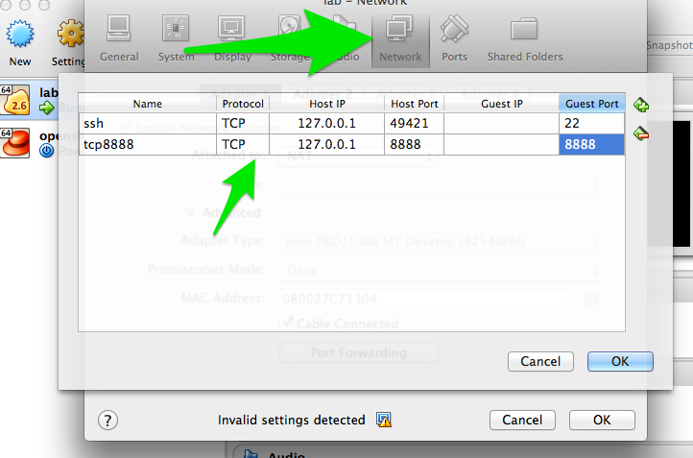
Map Ports for Tomcat VM
Enable port forwarding between the VM Host (windows/Mac) and the VM Guest (Docker host):

Slide 41
Map Ports for Tomcat
The outcome is represented in the diagram below:
Virtual Machine OS
8888
Docker Host
8888
Client
8080
Tomcat
Notes:
Exposing the ports solves the problem.
SHARE:
We will look at some better breakdown examples of this in 06-Docker Networking

Slide 42
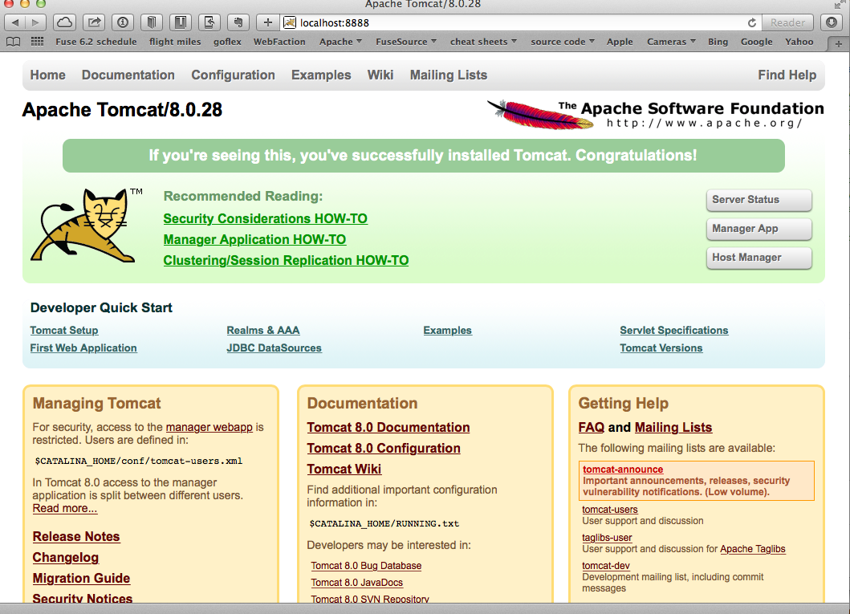
Deploy Apache Tomcat
Now, when we navigate to http://localhost:8888 in our browser, we see:
Notes:
Our Docker Host has been mapped properly, but we cannot reach it from our host (Windows/MacOSX) because the VM does not expose those ports.

Slide 43
Deploy Apache Tomcat
We now have a running container that has tomcat in it.
Let’s explore the tomcat container really quick.
Let’s fire up a new shell window and observe Tomcat’s processes, like this:
Output:
docker ps
CONTAINER ID IMAGE COMMAND
xxxxxxxxxxxx tomcat:8.0 ...
Notes:
We have a running container that has tomcat in it! WooHoo! Let’s explore the tomcat container really quick.
Fire up a new shell window (separate than the running tomcat docker container from previous)

Slide 44
Explore Inside Tomcat Container
Let’s log into the container to explore:
We should now be at the bash prompt for the tomcat container.
We can navigate around like we would normally.
docker exec –it <container_id> bash
Notes:
We have a running container that has tomcat in it! WooHoo! Let’s explore the tomcat container really quick.
Fire up a new shell window (separate than the running tomcat docker container from previous)

Slide 45
Deploy Apache Tomcat
We can exit out of the Tomcat container, like this:
If we then switch back to the other window where Tomcat is running, we can exit by issuing the CTR+C command.
We then have no containers running and we can verify that, with:
NOTE: Because of the (--rm) option, the container removed itself when finished.
# exit
docker ps -a

Slide 46
Common Key Container Parameters
Here are some other useful Docker run flags:
--name Gives containers a unique name
-d Runs containers in daemon mode (in the background)
--dns Gives containers a different name server from the host
-it Interactive with tty (caution using this with -d)
-e Passes in environment variables to the container
--expose Exposes ports from the Docker container
-P Exposes all published ports on containers
-p Map a specific port from the container to the host (host:container)

Slide 47
Deploy Apache Tomcat as a Daemon
Let’s use some of those previous run command-line flags and start tomcat in the background:
NOTE: We also gave this container a name, so we can refer to it by name instead of container id
docker run -d --name="tomcat8" -p 8888:8080 tomcat:8.0
Notes:
MORE MATERIAL:
https://docs.docker.com/engine/reference/run/#operator-exclusive-options

Slide 48
Print Apache Tomcat Logs
With Tomcat running as a daemon (-d) in the background, we can print it’s logs, like this:
Output:
docker logs tomcat8
16-Oct-2016 19:19:20.441 INFO [localhost-startStop-1] org.apache.catalina.startup.HostConfig.deployDirectory Deployment of web application directory /usr/local/tomcat/webapps/examples has finished in 526 ms
16-Oct-2016 19:19:20.447 INFO [localhost-startStop-1] org.apache.catalina.startup.HostConfig.deployDirectory Deploying web application directory /usr/local/tomcat/webapps/ROOT
16-Oct-2016 19:19:20.507 INFO [localhost-startStop-1] org.apache.catalina.startup.HostConfig.deployDirectory Deployment of web application directory /usr/local/tomcat/webapps/ROOT has finished in 60 ms
16-Oct-2016 19:19:20.515 INFO [main] org.apache.coyote.AbstractProtocol.start Starting ProtocolHandler ["http-nio-8080"]
16-Oct-2016 19:19:20.527 INFO [main] org.apache.coyote.AbstractProtocol.start Starting ProtocolHandler ["ajp-nio-8009"]
16-Oct-2016 19:19:20.547 INFO [main] org.apache.catalina.startup.Catalina.start Server startup in 1497 ms

Slide 49
Print Apache Tomcat Processes
Let’s use a couple of interesting Docker commands with our tomcat8 container:
[Output] Instead of the normal Linux top container, it just displays the processes running in the container:
docker top tomcat8
PID USER COMMAND
5301 root /usr/bin/java -Djava.util.logging.config.file=/usr/local/tomcat/conf/logging.properties -Djava.util.logging.manager=org.apache.juli.ClassLoaderLogManager -Djava.endorsed.dirs=/usr/local/tomcat/endorsed -classpath /usr/local/tomcat/bin/bootstrap.jar:/usr/local/tomcat/bin/tomcat-juli.jar -Dcatalina.base=/usr/local/tomcat -Dcatalina.home=/usr/local/tomcat -Djava.io.tmpdir=/usr/local/tomcat/temp org.apache.catalina.startup.Bootstrap start

Slide 50
Inspect Apache Tomcat Daemon
Let’s say we want to ”inspect” tomcat8, we can do that like this:
We can also use a --format template to pick out specific info from that output :
Output:
docker inspect tomcat8
docker inspect --format='{{.Config.Env}}' tomcat8
root@server(~) $ docker inspect --format='{{.Config.Env}}' tomcat8
[PATH=/usr/local/tomcat/bin:/usr/local/sbin:/usr/local/bin:/usr/sbin:/usr/bin:/sbin:/bin LANG=C.UTF-8 JAVA_VERSION=7u79 JAVA_DEBIAN_VERSION=7u79-2.5.6-1~deb8u1 CATALINA_HOME=/usr/local/tomcat TOMCAT_MAJOR=8 TOMCAT_VERSION=8.0.28 TOMCAT_TGZ_URL=https://www.apache.org/dist/tomcat/tomcat-8/v8.0.28/bin/apache-tomcat-8.0.28.tar.gz]

Slide 51
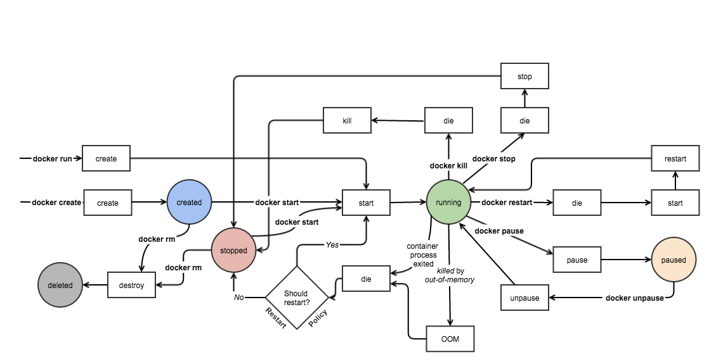
Lifecycle of a Container
Many things can be done with containers, but how long does it last?
Here’s a diagram of a container’s lifecycle:
Image Source and Credits: http://www.slideshare.net/w_akram/docker-introduction-59904719
Notes:
Image Source and Credits: http://www.slideshare.net/w_akram/docker-introduction-59904719
SOURCE:
https://medium.com/@nagarwal/lifecycle-of-docker-container-d2da9f85959
POSSIBLE MATERIAL:
Keep containers alive during daemon downtime
https://docs.docker.com/config/containers/live-restore/

Slide 52
Lifecycle of a Container
Create Container
Create a container to run it later on with required image:
Run Container
Run the docker container with the required image and specified command/ process; ‘-d’ flag is used for running the container in background:
Pause Container
Used to pause the processes running inside the container.
$ docker create --name <container-name> <image-name>
$ docker run -it -d --name <container-name> <image-name> bash
$ docker pause <container-id/name>
Notes:
SHARE:
Though the above pic is self explanatory, we’ll just discuss the basics / CLI commands for working with docker containers.
Create container
Create a container to run it later on with required image.
docker create --name <container-name> <image-name>
Run docker container
Run the docker container with the required image and specified command / process. ‘-d’ flag is used for running the container in background.
docker run -it -d --name <container-name> <image-name> bash
Pause container
Used to pause the processes running inside the container.
docker pause <container-id/name>
SHARE:
Unpause container
Used to unpause the processes inside the container.
docker unpause <container-id/name>
SOURCE:
https://medium.com/@nagarwal/lifecycle-of-docker-container-d2da9f85959
POSSIBLE MATERIAL:
Keep containers alive during daemon downtime
https://docs.docker.com/config/containers/live-restore/

Slide 53
Lifecycle of a Container
Stop Container
To stop the container and processes running inside the container:
To stop all the running Docker containers:
Start Container
Start the container, if present in stopped state:
$ docker stop <container-id/name>
$ docker stop $(docker ps -a -q)
$ docker start <container-id/name>
Notes:
Stop container
To stop the container and processes running inside the container:
docker stop <container-id/name>
To stop all the running docker containers
docker stop $(docker ps -a -q)
Start container
Start the container, if present in stopped state.
docker start <container-id/name>
SOURCE:
https://medium.com/@nagarwal/lifecycle-of-docker-container-d2da9f85959
POSSIBLE MATERIAL:
Keep containers alive during daemon downtime
https://docs.docker.com/config/containers/live-restore/

Slide 54
Lifecycle of a Container
Restart Container
It is used to restart the container as well as processes running inside the container:
Kill Container
We can kill the running container:
$ docker restart <container-id/name>
$ docker kill <container-id/name>
Notes:
Restart container
It is used to restart the container as well as processes running inside the container.
docker restart <container-id/name>
Kill container
We can kill the running container.
docker kill <container-id/name>
SOURCE:
https://medium.com/@nagarwal/lifecycle-of-docker-container-d2da9f85959
POSSIBLE MATERIAL:
Keep containers alive during daemon downtime
https://docs.docker.com/config/containers/live-restore/

Slide 55
Stop and Remove Container
We know how to stop it, but how do we completely destroy it?
Destroy Container
Its preferred to destroy container, only if present in stopped state instead of forcefully destroying the running container:
NOTE: To destroy the parent image of a container, just add an “i”, like (rmi)
To remove all the stopped Docker containers
$ docker rm <container-id/name>
$ docker rm $(docker ps -q -f status=exited)
Notes:
Destroy container
Its preferred to destroy container, only if present in stopped state instead of forcefully destroying the running container.
docker rm <container-id/name>
To remove all the stopped docker containers
docker rm $(docker ps -q -f status=exited)

Slide 56
Hands-on Exercise(s)

Slide 57
End of Chapter

Slide 58
Containerizing Java EE Application
Docker and java work great together
Notes:
POSSIBLE MATERIAL:
9 Docker recipes for Java EE Applications – Tech Tip #80 (2015) - http://blog.arungupta.me/9-docker-recipes-javaee-applications-techtip80/
Step-by-Step High Availability with Docker and Java EE (2016) - https://community.oracle.com/docs/DOC-998210 (THIS!)

Slide 59
Understanding Structure of a Modern Java EE App

Slide 60
Understanding Java EE App Server
Wikipedia says: “An application server is a software framework that provides both facilities to create web applications and a server environment to run them.”
Java Platform, Enterprise Edition or Java EE (was J2EE) defines the core set of API and features of Java Application Servers
Java application servers behave like an extended virtual machine for running applications
It transparently handles connections to the database on one side, and, often, connections to the Web client on the other
Open source Java application servers that support Java EE include: JOnAS from Object Web, WildFly (formerly JBoss AS) from JBoss, TomEE from Apache, and more.
Notes:
Split into multiple slides
NEED MORE?

Slide 61
Introduction to Dockerfile
Docker build images by reading instructions from a Dockerfile
A Dockerfile is a text document that contains all the commands a user could call on the command line to assemble an image
docker image build command uses this file and executes all the commands in succession to create an image
build command is also passed a context that is used during image creation
This context can be a path on your local filesystem or a URL to a Git repository
Notes:
Dockerfile
Docker build images by reading instructions from a Dockerfile.
A Dockerfile is a text document that contains all the commands a user could call on the command line to assemble an image.
docker image build command uses this file and executes all the commands in succession to create an image.
build command is also passed a context that is used during image creation.
This context can be a path on your local filesystem or a URL to a Git repository.
SOURCE:
https://github.com/docker/labs/blob/master/developer-tools/java/chapters/ch03-build-image.adoc

Slide 62
Introduction to Dockerfile
The common commands are listed below:
Command | Purpose | Example
FROM | First non-comment instruction in Dockerfile | FROM ubuntu
COPY | Copies mulitple source files from the context to the file system of the container at the specified path | COPY .bash_profile /home
ENV | Sets the environment variable | ENV HOSTNAME=test
RUN | Executes a command | RUN apt-get update
CMD | Defaults for an executing container | CMD ["/bin/echo", "hello world"]
EXPOSE | Informs the network ports that the container will listen on | EXPOSE 8093
Notes:
The common commands are listed below:
Command Purpose Example
FROM
First non-comment instruction in Dockerfile
FROM ubuntu
COPY
Copies mulitple source files from the context to the file system of the container at the specified path
COPY .bash_profile /home
ENV
Sets the environment variable
ENV HOSTNAME=test
RUN
Executes a command
RUN apt-get update
CMD
Defaults for an executing container
CMD ["/bin/echo", "hello world"]
EXPOSE
Informs the network ports that the container will listen on
EXPOSE 8093
SOURCE:
https://github.com/docker/labs/blob/master/developer-tools/java/chapters/ch03-build-image.adoc

Slide 63

Create Our First Dockerfile Image
Create a new directory hellodocker
In that directory, create a new text file Dockerfile, using the following:
Build the image using the command:
(.) in this command is the context for the command docker image build
-t adds a tag to the image
The following output is shown...
FROM ubuntu:latest
CMD ["/bin/echo", "hello world"]
$ docker image build . -t helloworld
Next,
Slide
Notes:
Create your first image
Create a new directory hellodocker.
In that directory, create a new text file Dockerfile. Use the following contents:
FROM ubuntu:latest
CMD ["/bin/echo", "hello world"]
SHARE:
This image uses ubuntu as the base image.
CMD command defines the command that needs to run.
It provides a different entry point of /bin/echo and gives the argument “hello world”.
Build the image using the command:
docker image build . -t helloworld
(.) in this command is the context for the command docker image build.
-t adds a tag to the image.
The following output is shown:
Sending build context to Docker daemon 2.048kB Step 1/2 : FROM ubuntu:latest latest: Pulling from library/ubuntu 9fb6c798fa41: Pull complete 3b61febd4aef: Pull complete 9d99b9777eb0: Pull complete d010c8cf75d7: Pull complete 7fac07fb303e: Pull complete Digest: sha256:31371c117d65387be2640b8254464102c36c4e23d2abe1f6f4667e47716483f1 Status: Downloaded newer image for ubuntu:latest ---> 2d696327ab2e Step 2/2 : CMD /bin/echo hello world ---> Running in 9356a508590c ---> e61f88f3a0f7 Removing intermediate container 9356a508590c Successfully built e61f88f3a0f7
Successfully tagged helloworld:latest
List the images available using docker image ls:
REPOSITORY TAG IMAGE ID CREATED SIZE helloworld latest e61f88f3a0f7 3 minutes ago 122MB ubuntu latest 2d696327ab2e 4 days ago 122MB
Other images may be shown as well but we are interested in these two images for now.
Run the container using the command:
docker container run helloworld
to see the output:
hello world
If you do not see the expected output, check your Dockerfile that the content exactly matches as shown above. Build the image again and now run it.
Change the base image from ubuntu to busybox in Dockerfile. Build the image again:
docker image build -t helloworld:2 .
and view the images using docker image ls command:
REPOSITORY TAG IMAGE ID CREATED SIZE helloworld 2 7fbedda27c66 3 seconds ago 1.13MB helloworld latest e61f88f3a0f7 5 minutes ago 122MB ubuntu latest 2d696327ab2e 4 days ago 122MB busybox latest 54511612f1c4 9 days ago 1.13MB
helloworld:2 is the format that allows to specify the image name and assign a tag/version to it separated by :.
SOURCE:
https://github.com/docker/labs/blob/master/developer-tools/java/chapters/ch03-build-image.adoc

Slide 64
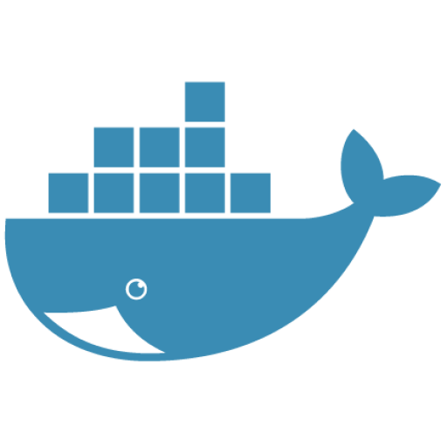
Create Our First Dockerfile Image
Sending build context to Docker daemon 2.048kB
Step 1/2 : FROM ubuntu:latest
latest: Pulling from library/ubuntu
9fb6c798fa41: Pull complete
3b61febd4aef: Pull complete
9d99b9777eb0: Pull complete
d010c8cf75d7: Pull complete
7fac07fb303e: Pull complete
Digest: sha256:31371c117d65387be2640b8254464102c36c4e23d2abe1f6f4667e47716483f1
Status: Downloaded newer image for ubuntu:latest
---> 2d696327ab2e
Step 2/2 : CMD /bin/echo hello world
---> Running in 9356a508590c
---> e61f88f3a0f7
Removing intermediate container 9356a508590c
Successfully built e61f88f3a0f7
Successfully tagged helloworld:latest
Notes:
The following output is shown:
Sending build context to Docker daemon 2.048kB
Step 1/2 : FROM ubuntu:latest
latest: Pulling from library/ubuntu
9fb6c798fa41: Pull complete
3b61febd4aef: Pull complete
9d99b9777eb0: Pull complete
d010c8cf75d7: Pull complete
7fac07fb303e: Pull complete
Digest: sha256:31371c117d65387be2640b8254464102c36c4e23d2abe1f6f4667e47716483f1
Status: Downloaded newer image for ubuntu:latest
---> 2d696327ab2e
Step 2/2 : CMD /bin/echo hello world
---> Running in 9356a508590c
---> e61f88f3a0f7
Removing intermediate container 9356a508590c
Successfully built e61f88f3a0f7
Successfully tagged helloworld:latest
SOURCE:
https://github.com/docker/labs/blob/master/developer-tools/java/chapters/ch03-build-image.adoc

Slide 65
Create Our First Dockerfile Image
List the images available using docker image ls:
Now, run the container our Dockerfile created by using the run command:
Output confirms that it works!
REPOSITORY TAG IMAGE ID CREATED SIZE
helloworld latest e61f88f3a0f7 3 minutes ago 122MB
ubuntu latest 2d696327ab2e 4 days ago 122MB
$ docker container run helloworld
hello world
Notes:
List the images available using docker image ls:
REPOSITORY TAG IMAGE ID CREATED SIZE
helloworld latest e61f88f3a0f7 3 minutes ago 122MB ubuntu latest 2d696327ab2e 4 days ago 122MB
SHARE:
Other images may be shown as well but we are interested in these two images for now.
Run the container using the command:
docker container run helloworld
to see the output:
hello world
SHARE (extra):
If you do not see the expected output, check your Dockerfile that the content exactly matches as shown above. Build the image again and now run it.
We could also change the base image from ubuntu to busybox in Dockerfile. Build the image again:
docker image build -t helloworld:2 .
and view the images using docker image ls command:
REPOSITORY TAG IMAGE ID CREATED SIZE helloworld 2 7fbedda27c66 3 seconds ago 1.13MB helloworld latest e61f88f3a0f7 5 minutes ago 122MB ubuntu latest 2d696327ab2e 4 days ago 122MB busybox latest 54511612f1c4 9 days ago 1.13MB
helloworld:2 is the format that allows to specify the image name and assign a tag/version to it separated by :.
SOURCE:
https://github.com/docker/labs/blob/master/developer-tools/java/chapters/ch03-build-image.adoc

Slide 66
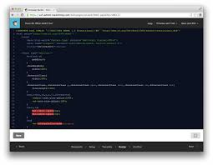
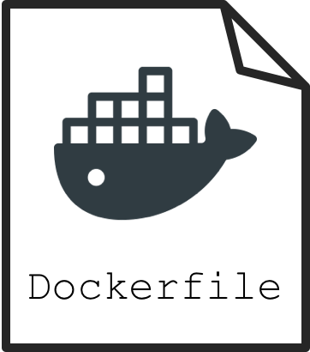
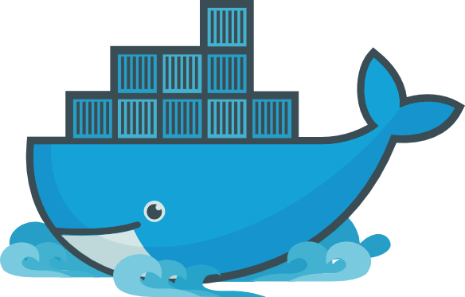
Understanding Dockerization
Dockerizing an application is the process of converting an application to run within a Docker container
While Dockerizing most applications is straight-forward, there are a few problems that need to be worked around each time

Slide 67
Stay Mindful of the Cons
Two common problems that occur during Dockerization are:
Making an application use environment variables when it relies on configuration files
Sending application logs to STDOUT/STDERR when it defaults to files in the container’s file system
Remember both of these as we make our way through this course!

Slide 68
Create a Simple Java Application
Create a new Java project:
Build the project:
Run the Java class:
This shows the output:
Now, let’s package this application as a Docker image!
$ mvn archetype:generate -DgroupId=org.examples.java \ c -DartifactId=helloworld -DinteractiveMode=false
$ cd helloworld mvn package
$ java -cp target/helloworld-1.0-SNAPSHOT.jar org.examples.java.App
Hello World!
Notes:
Create a new Java project:
mvn archetype:generate -DgroupId=org.examples.java -DartifactId=helloworld -DinteractiveMode=false
Build the project:
cd helloworld mvn package
Run the Java class:
java -cp target/helloworld-1.0-SNAPSHOT.jar org.examples.java.App
This shows the output:
Hello World!
Let’s package this application as a Docker image.

Slide 69
Java Docker image
Run the OpenJDK container in an interactive manner:
This will open a terminal in the container; check the version of Java:
Output:
NOTE: A different JDK version may be shown.
Exit out of the container by typing exit in the container shell.
$ docker container run -it openjdk
$ root@8d0af9da5258:/# java -version
openjdk version "1.8.0_141"
OpenJDK Runtime Environment (build 1.8.0_141-8u141-b15-1~deb9u1-b15)
OpenJDK 64-Bit Server VM (build 25.141-b15, mixed mode)
Notes:
Java Docker image
Run the OpenJDK container in an interactive manner:
docker container run -it openjdk
This will open a terminal in the container. Check the version of Java:
root@8d0af9da5258:/# java -version
openjdk version "1.8.0_141"
OpenJDK Runtime Environment (build 1.8.0_141-8u141-b15-1~deb9u1-b15)
OpenJDK 64-Bit Server VM (build 25.141-b15, mixed mode)
A different JDK version may be shown in your case.
Exit out of the container by typing exit in the container shell.

Slide 70
Package and Run Java App as Docker Image
Create a new Dockerfile in helloworld directory and use the following content:
Build the image:
Output:
This shows the exactly same output that was printed when the Java class was invoked using Java CLI.
FROM openjdk:latest
COPY target/helloworld-1.0-SNAPSHOT.jar /usr/src/helloworld-1.0-SNAPSHOT.jar
CMD java -cp /usr/src/helloworld-1.0-SNAPSHOT.jar org.examples.java.App
Don’t
Forget
Me!
$ docker image build -t hello-java:latest .
Hello World!
Notes:
Package and run Java application as Docker image
Create a new Dockerfile in helloworld directory and use the following content:
FROM openjdk:latest
COPY target/helloworld-1.0-SNAPSHOT.jar /usr/src/helloworld-1.0-SNAPSHOT.jar
CMD java -cp /usr/src/helloworld-1.0-SNAPSHOT.jar org.examples.java.App
Build the image:
docker image build -t hello-java:latest .
Run the image:
docker container run hello-java:latest
This displays the output:
Hello World!
This shows the exactly same output that was printed when the Java class was invoked using Java CLI.
.

Slide 71
Difference Between CMD and ENTRYPOINT
CMD will work for most of the cases
Default entry point for a container is /bin/sh, the default shells
Running a container as docker container run -it ubuntu uses that command and starts the default shell
The output is shown as:
$ docker container run -it ubuntu
root@88976ddee107:/#
Notes:
Difference between CMD and ENTRYPOINT
CMD will work for most of the cases.
Default entry point for a container is /bin/sh, the default shell.
Running a container as docker container run -it ubuntu uses that command and starts the default shell.
The output is shown as:
$ docker container run -it ubuntu
root@88976ddee107:/#

Slide 72
Difference Between CMD and ENTRYPOINT
ENTRYPOINT allows to override the entry point to some other command, and even customize it
For example, a container can be started as:
This command overrides the entry point to the container to /bin/cat
The argument(s) passed to the CLI are used by the entry point.
$ docker container run -it --entrypoint=/bin/cat \ ubuntu /etc/passwd root:x:0:0:root:/root:/bin/bash \ daemon:x:1:1:daemon:/usr/sbin:/usr/sbin/nologin \ bin:x:2:2:bin:/bin:/usr/sbin/nologin \ sys:x:3:3:sys:/dev:/usr/sbin/nologin . . .
root@88976ddee107:/#
Notes:
Difference between CMD and ENTRYPOINT
ENTRYPOINT allows to override the entry point to some other command, and even customize it.
For example, a container can be started as:
$ docker container run -it --entrypoint=/bin/cat ubuntu /etc/passwd root:x:0:0:root:/root:/bin/bash daemon:x:1:1:daemon:/usr/sbin:/usr/sbin/nologin bin:x:2:2:bin:/bin:/usr/sbin/nologin sys:x:3:3:sys:/dev:/usr/sbin/nologin . . .
This command overrides the entry point to the container to /bin/cat.
The argument(s) passed to the CLI are used by the entry point.

Slide 73
Difference Between ADD and COPY
COPY will work for most of the cases
ADD has all capabilities of COPY and has the following additional features:
Allows tar file auto-extraction in the image
For example:
Allows files to be downloaded from a remote URL
ADD app.tar.gz /opt/var/myapp
Notes:
Difference between ADD and COPY
COPY will work for most of the cases.
ADD has all capabilities of COPY and has the following additional features:
1. Allows tar file auto-extraction in the image, for example, ADD app.tar.gz /opt/var/myapp
2. Allows files to be downloaded from a remote URL
SHARE:
However, the downloaded files will become part of the image. This causes the image size to bloat. So its recommended to use curl or wget to download the archive explicitly, extract, and remove the archive.

Slide 74
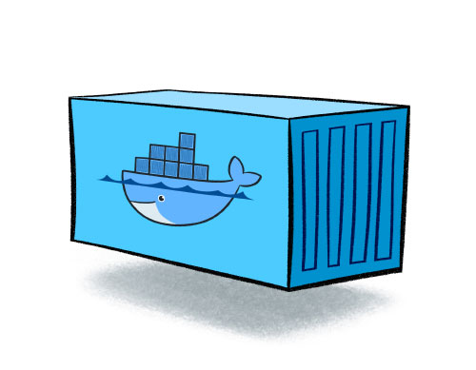
Import and Export Images
Docker images can be saved using image save command to a .tar file:
These tar files can then be imported using load command:
docker image save helloworld > helloworld.tar
docker image load -i helloworld.tar
Notes:
Import and export images
Docker images can be saved using image save command to a .tar file:
docker image save helloworld > helloworld.tar
These tar files can then be imported using load command:
docker image load -i helloworld.tar

Slide 75
Starting Our Application Server - Interactively
Run WildFly container in an interactive mode, like this:
This will show the output as:
$ docker container run -it jboss/wildfly
=========================================================================
JBoss Bootstrap Environment
JBOSS_HOME: /opt/jboss/wildfly
JAVA: /usr/lib/jvm/java/bin/java
. . .
00:26:27,455 INFO [org.jboss.as] (Controller Boot Thread) WFLYSRV0060: Http management interface listening on http://127.0.0.1:9990/management
00:26:27,456 INFO [org.jboss.as] (Controller Boot Thread) WFLYSRV0051: Admin console listening on http://127.0.0.1:9990
00:26:27,457 INFO [org.jboss.as] (Controller Boot Thread) WFLYSRV0025: WildFly Full 10.1.0.Final
Notes:
Interactively
Run WildFly container in an interactive mode
docker container run -it jboss/wildfly
This will show the output as:
=========================================================================
JBoss Bootstrap Environment
JBOSS_HOME: /opt/jboss/wildfly
JAVA: /usr/lib/jvm/java/bin/java
. . .
00:26:27,455 INFO [org.jboss.as] (Controller Boot Thread) WFLYSRV0060: Http management interface listening on http://127.0.0.1:9990/management
00:26:27,456 INFO [org.jboss.as] (Controller Boot Thread) WFLYSRV0051: Admin console listening on http://127.0.0.1:9990 00:26:27,457 INFO [org.jboss.as] (Controller Boot Thread) WFLYSRV0025: WildFly Full 10.1.0.Final (WildFly Core 2.2.0.Final) started in 3796ms - Started 331 of 577 services (393 services are lazy, passive or on-demand)
SHARE:
This shows that the server started correctly, congratulations!
By default, Docker runs in the foreground. -i allows to interact with the STDIN and -t attach a TTY to the process. Switches can be combined together and used as -it.
Hit Ctrl+C to stop the container.
Detached container
Restart the container in detached mode:
docker container run -d jboss/wildfly 254418caddb1e260e8489f872f51af4422bc4801d17746967d9777f565714600
-d, instead of -it, runs the container in detached mode.
The output is the unique id assigned to the container. Logs of the container can be seen using the command docker container logs <CONTAINER_ID>, where <CONTAINER_ID> is the id of the container.
Status of the container can be checked using the docker container ls command:
CONTAINER ID IMAGE COMMAND CREATED STATUS PORTS NAMES 254418caddb1 jboss/wildfly "/opt/jboss/wildfl..." 2 minutes ago Up 2 minutes 8080/tcp gifted_haibt
Also try docker container ls -a to see all the containers on this machine.

Slide 76

Starting Our Application Server - Interactively
By default, Docker runs in the foreground!
-i allows to interact with the STDIN and -t attach a TTY to the process
Switches can be combined together and used as -it, as we’ve seen already
Hit Ctrl+C to stop the container
Notes:
Interactively
By default, Docker runs in the foreground.
-i allows to interact with the STDIN and -t attach a TTY to the process.
Switches can be combined together and used as -it.
Hit Ctrl+C to stop the container.

Slide 77
Starting Our Application Server - Detached Mode
Unique
ID
Restart the container in detached mode:
-d, instead of -it, runs the container in detached mode
The output is the unique id assigned to the container
This “container ID” can be used in lots of commands!
$ docker container run -d jboss/wildfly
254418caddb1e260e8489f872f51af4422bc4801d17746967d9777f565714600
Notes:
Detached container
Restart the container in detached mode:
docker container run -d jboss/wildfly
254418caddb1e260e8489f872f51af4422bc4801d17746967d9777f565714600
-d, instead of -it, runs the container in detached mode.
The output is the unique id assigned to the container.

Slide 78
Starting Our Application Server - Detached Mode
Logs of the container can be seen using the following command:
Remember, status of a container can be checked using the docker container ls command, which gives us:
Normally, there would be many listed and our ID is a way we could find it!
Also remember docker container ls -a shows all the containers
$ docker container logs <CONTAINER_ID>
Unique
ID
CONTAINER ID IMAGE COMMAND CREATED STATUS PORTS NAMES
254418caddb1 jboss/wildfly "/opt/jboss/wildfl..." 2 minutes ago Up 2 minutes 8080/tcp gifted_haibt
Notes:
Logs of the container can be seen using the command docker container logs <CONTAINER_ID>, where <CONTAINER_ID> is the id of the container.
Status of the container can be checked using the docker container ls command:
CONTAINER ID IMAGE COMMAND CREATED STATUS PORTS NAMES
254418caddb1 jboss/wildfly "/opt/jboss/wildfl...” 2 minutes ago Up 2 minutes 8080/tcp gifted_haibt
Also try docker container ls -a to see all the containers on this machine.

Slide 79
Starting Our Application Server - Default Ports
To accept incoming connections requires providing port options when invoking docker run
The container, we just started, can’t be accessed by our browser
We need to stop it again and restart with different options
Restart the container as:
-P map any exposed ports inside the image to a random port on Docker host
$ docker container stop `docker container ps | grep wildfly | awk '{print $1}'`
$ docker container run -d -P --name wildfly jboss/wildfly
Notes:
With default port
If you want the container to accept incoming connections, you will need to provide special options when invoking docker run.
The container, we just started, can’t be accessed by our browser.
We need to stop it again and restart with different options.
docker container stop `docker container ps | grep wildfly | awk '{print $1}'`
Restart the container as:
docker container run -d -P --name wildfly jboss/wildfly
-P map any exposed ports inside the image to a random port on Docker host.

Slide 80
Starting Our Application Server - Default Ports
In addition, --name option is used to give this container a name
This name can then later be used to get more details about the container or stop it
Of course, this can be verified using docker container ls command:
The port mapping is shown in the PORTS column
CONTAINER ID IMAGE COMMAND CREATED STATUS PORTS NAMES
89fbfbceeb56 jboss/wildfly "/opt/jboss/wildfl..." 9 seconds ago Up 8 seconds 0.0.0.0:32768->8080/tcp wildfly
Notes:
(cont.)
In addition, --name option is used to give this container a name.
This name can then later be used to get more details about the container or stop it.
This can be verified using docker container ls command:
CONTAINER ID IMAGE COMMAND CREATED STATUS PORTS NAMES
89fbfbceeb56 jboss/wildfly "/opt/jboss/wildfl..." 9 seconds ago Up 8 seconds 0.0.0.0:32768->8080/tcp wildfly
The port mapping is shown in the PORTS column.

Slide 81
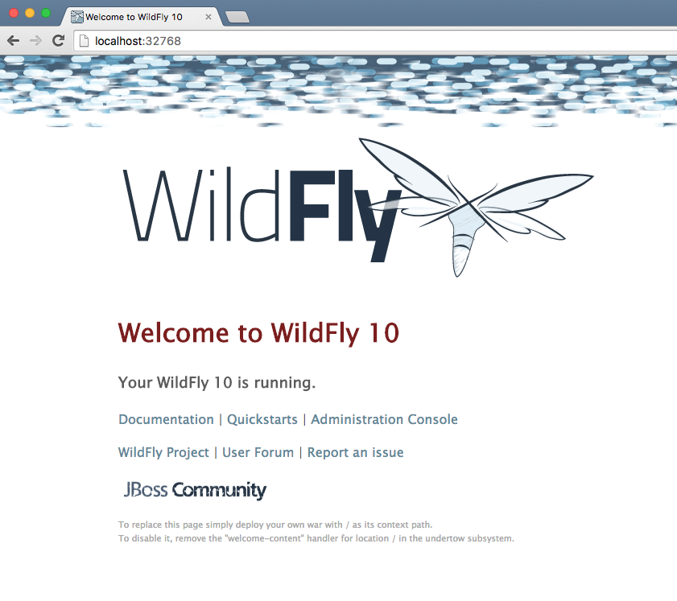
Starting Our Application Server - Default Ports
Now, we can access our server’s welcome page, via localhost!
We will access WildFly server at http://localhost:32768
Cool, huh?
Notes:
Access WildFly server at http://localhost:32768.
Make sure to use the correct port number as shown in your case.
SHARE:
Note-Exact port number may be different in your case.

Slide 82
Deploy a WAR File
Now that your application server is running, lets deploy a WAR file to it!
Create a new directory hellojavaee
Create a new text file and name it Dockerfile
Use the following contents:
Now, what do you think comes next?
FROM jboss/wildfly:latest
RUN curl -L https://github.com/javaee-samples/javaee7-simple-sample/releases/download/v1.10/javaee7-simple-sample-1.10.war -o /opt/jboss/wildfly/standalone/deployments/javaee-simple-sample.war
Notes:
Deploy a WAR file to application server
Now that your application server is running, lets see how to deploy a WAR file to it.
Create a new directory hellojavaee.
Create a new text file and name it Dockerfile.
Use the following contents:
FROM jboss/wildfly:latest
RUN curl -L https://github.com/javaee-samples/javaee7-simple-sample/releases/download/v1.10/javaee7-simple-sample-1.10.war -o /opt/jboss/wildfly/standalone/deployments/javaee-simple-sample.war

Slide 83
Deploy a WAR File
Create an image:
Start the container:
Access the endpoint:
See the output:
Don’t
Forget
Me!
$ docker image build -t javaee-sample .
$ docker container run -d -p 8080:8080 --name wildfly javaee-sample
$ url http://localhost:8080/javaee-simple-sample/resources/persons
Refrence: cs_05-output.bash
Notes:
Deploy a WAR file to application server
Create an image:
docker image build -t javaee-sample .
Start the container:
docker container run -d -p 8080:8080 --name wildfly javaee-sample
Access the endpoint:
curl http://localhost:8080/javaee-simple-sample/resources/persons
Optional: brew install XML-Coreutils will install XML formatting utility on Mac. This output can then be piped to xml-fmt to display a formatted result.
See the output:
Refrence: cs_05-output.bash
NOTE: This is found inside the code_snippet folder.

Slide 84
Stopping and Removing Application
Stop a specific container by id or name:
Stop all running containers:
Stop only the exited containers:
$ docker container stop <CONTAINER ID>
$ docker container stop <NAME>
$ docker container stop $(docker container ps -q)
$ docker container ps -a -f "exited=-1”
Notes:
Stop container
Stop a specific container by id or name:
docker container stop <CONTAINER ID>
docker container stop <NAME>
Stop all running containers:
docker container stop $(docker container ps -q)
Stop only the exited containers:
docker container ps -a -f "exited=-1”
Remove container
Remove a specific container by id or name:
docker container rm <CONTAINER_ID> docker container rm <NAME>
Remove containers meeting a regular expression
docker container ps -a | grep wildfly | awk '{print $1}' | xargs docker container rm
Remove all containers, without any criteria
docker container rm $(docker container ps -aq)

Slide 85
Stopping and Removing Application
Remove a specific container by id or name:
Remove containers meeting a regular expression:
Remove all containers, without any criteria:
$ docker container rm <CONTAINER ID>
$ docker container rm <NAME>
$ docker container ps -a | grep wildfly |
awk '{print $1}' | xargs docker container rm
$ docker container rm $(docker container ps -aq)
Notes:
Remove container
Remove a specific container by id or name:
docker container rm <CONTAINER_ID>
docker container rm <NAME>
Remove containers meeting a regular expression
docker container ps -a | grep wildfly | awk '{print $1}' | xargs docker container rm
Remove all containers, without any criteria
docker container rm $(docker container ps -aq)

Slide 86
Hands-on Exercise(s)

Slide 87
End of Chapter

Slide 88
Docker Linking and Stateful Containers
How we Link and create stateful containers
Notes:
POSSIBLE RESOURCES:
The following link provides a GREAT article on advanced networking!
https://success.docker.com/article/Docker_Reference_Architecture-_Designing_Scalable,_Portable_Docker_Container_Networks

Slide 89
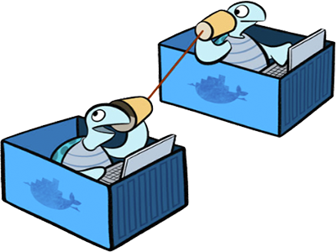
Understanding Networking Overview
Docker containers and services can connect together or non-Docker workloads
Containers and services do not need to be aware they are deployed on Docker, or whether their peers are also Docker workloads or not
No matter the OS, or a mix of, you can use Docker to manage them in a platform-agnostic way.
Notes:
Overview
One of the reasons Docker containers and services are so powerful is that you can connect them together,
or connect them to non-Docker workloads.
Docker containers and services do not even need to be aware that they are deployed on Docker,
or whether their peers are also Docker workloads or not.
Whether your Docker hosts run Linux, Windows, or a mix of the two, you can use Docker to manage them in a platform-agnostic way.
SHARE:
This topic defines some basic Docker networking concepts and prepares you to design and deploy your applications to take full advantage of these capabilities.
Most of this content applies to all Docker installations. However, a few advanced features are only available to Docker EE customers.

Slide 90
Docker Network Drivers
Docker’s networking subsystem is pluggable, using drivers
Several drivers exist by default, and provide core networking functionality:
bridge:
The default network driver. If you don’t specify a driver, this is the type of network you are creating. Bridge networks are usually used when your applications run in standalone containers that need to communicate.
host:
For standalone containers, remove network isolation between the container and the Docker host, and use the host’s networking directly. host is only available for swarm services on Docker 17.06 and higher.
Notes:
Docker Network drivers
Docker’s networking subsystem is pluggable, using drivers.
Several drivers exist by default, and provide core networking functionality:
bridge:
The default network driver. If you don’t specify a driver, this is the type of network you are creating. Bridge networks are usually used when your applications run in standalone containers that need to communicate. See bridge networks.
https://docs.docker.com/network/bridge/
host:
For standalone containers, remove network isolation between the container and the Docker host, and use the host’s networking directly. host is only available for swarm services on Docker 17.06 and higher. See use the host network.
https://docs.docker.com/network/host/

Slide 91
Docker Network Drivers
overlay:
Overlay networks connect multiple Docker daemons together and enable swarm services to communicate with each other. You can also use overlay networks to facilitate communication between a swarm service and a standalone container, or between two standalone containers on different Docker daemons. This strategy removes the need to do OS-level routing between these containers.
macvlan:
Macvlan networks allow you to assign a MAC address to a container, making it appear as a physical device on your network. The Docker daemon routes traffic to containers by their MAC addresses. Using the macvlan driver is sometimes the best choice when dealing with legacy applications that expect to be directly connected to the physical network, rather than routed through the Docker host’s network stack.
Notes:
Docker Network drivers
overlay:
Overlay networks connect multiple Docker daemons together and enable swarm services to communicate with each other. You can also use overlay networks to facilitate communication between a swarm service and a standalone container, or between two standalone containers on different Docker daemons. This strategy removes the need to do OS-level routing between these containers. See overlay networks.
https://docs.docker.com/network/overlay/
macvlan:
Macvlan networks allow you to assign a MAC address to a container, making it appear as a physical device on your network. The Docker daemon routes traffic to containers by their MAC addresses. Using the macvlan driver is sometimes the best choice when dealing with legacy applications that expect to be directly connected to the physical network, rather than routed through the Docker host’s network stack. See Macvlan networks.
https://docs.docker.com/network/macvlan/
none: For this container, disable all networking. Usually used in conjunction with a custom network driver. none is not available for swarm services.
See disable container networking.
Network plugins: You can install and use third-party network plugins with Docker. These plugins are available from Docker Store or from third-party vendors. See the vendor’s documentation for installing and using a given network plugin.
to all Docker installations. However, a few advanced features are only available to Docker EE customers.

Slide 92

Docker Network Drivers
none:
For this container, disable all networking. Usually used in conjunction with a custom network driver. none is not available for swarm services.
Network Plugins:
You can install and use third-party network plugins with Docker. These plugins are available from Docker Store or from third-party vendors.
Notes:
Docker Network drivers
none:
For this container, disable all networking. Usually used in conjunction with a custom network driver. none is not available for swarm services.
Network plugins:
You can install and use third-party network plugins with Docker.
These plugins are available from Docker Store or from third-party vendors.
See the vendor’s documentation for installing and using a given network plugin.

Slide 93
Network Driver Summary
User-defined bridge networks are best when you need multiple containers to communicate on the same Docker host.
Host networks are best when the network stack should not be isolated from the Docker host, but you want other aspects of the container to be isolated.
Overlay networks are best when you need containers running on different Docker hosts to communicate, or when multiple applications work together using swarm services.
Macvlan networks are best when you are migrating from a VM setup or need your containers to look like physical hosts on your network, each with a unique MAC address.
Third-party network plugins allow you to integrate Docker with specialized network stacks.
Notes:
Network driver summary
User-defined bridge networks
are best when you need multiple containers to communicate on the same Docker host.
Host networks
are best when the network stack should not be isolated from the Docker host, but you want other aspects of the container to be isolated.
Overlay networks
are best when you need containers running on different Docker hosts to communicate, or when multiple applications work together using swarm services.
Macvlan networks
are best when you are migrating from a VM setup or need your containers to look like physical hosts on your network, each with a unique MAC address.
Third-party network plugins
sallow you to integrate Docker with specialized network stacks.

Slide 94
Docker EE Networking Features
The following two features are only possible when using Docker EE and managing your Docker services using Universal Control Plane (UCP):
The HTTP routing mesh allows you to share the same network IP address and port among multiple services. UCP routes the traffic to the appropriate service using the combination of hostname and port, as requested from the client.
Session stickiness allows you to specify information in the HTTP header which UCP uses to route subsequent requests to the same service task, for applications which require stateful sessions.
Notes:
Docker EE networking features
The following two features are only possible when using Docker EE and managing your Docker services using Universal Control Plane (UCP):
The HTTP routing mesh allows you to share the same network IP address and port among multiple services. UCP routes the traffic to the appropriate service using the combination of hostname and port, as requested from the client.
Session stickiness allows you to specify information in the HTTP header which UCP uses to route subsequent requests to the same service task, for applications which require stateful sessions.

Slide 95
Container Networking Specific
Type of network a container uses, whether it is a bridge, an overlay, a macvlan network, or a custom network plugin, is transparent from within the container.
From the container’s point of view, it has:
A network interface with an IP address
A gateway
A routing table
DNS services
and other networking details (assuming the container is not using the none network driver)
This topic is about networking concerns from the point of view of the container
Notes:
Container networking
type of network a container uses, whether it is a bridge, an overlay, a macvlan network, or a custom network plugin, is transparent from within the container.
From the container’s point of view, it has a network interface with an IP address, a gateway, a routing table, DNS services, and other networking details (assuming the container is not using the none network driver).
This topic is about networking concerns from the point of view of the container.

Slide 96
Published Ports
By default, when you create a container, it does not publish any of its ports to the outside world
To make a port available to services outside of Docker, or to Docker containers which are not connected to the container’s network, use --publish (-p) flag
This creates a firewall rule which maps a container port to a port on the Docker host, like we saw in Docker Registry
Let’s breakdown some examples of this in the next slide...
Next,
Slide!
Notes:
Published ports
By default, when you create a container, it does not publish any of its ports to the outside world.
To make a port available to services outside of Docker, or to Docker containers which are not connected to the container’s network, use the --publish or -p flag.
This creates a firewall rule which maps a container port to a port on the Docker host.

Slide 97
Published Ports
Here are some examples:
Flag Value | Description
-p 8080:80 | Map TCP port 80 in the container to port 8080 on the Docker host.
-p 8080:80/udp | Map UDP port 80 in the container to port 8080 on the Docker host.
-p 8080:80/tcp -p 8080:80/udp | Map TCP port 80 in the container to TCP port 8080 on the Docker host, and map UDP port 80 in the container to UDP port 8080 on the Docker host.
Notes:
Here are some examples.
Flag value Description
-p 8080:80 Map TCP port 80 in the container to port 8080 on the Docker host.
-p 8080:80/udp Map UDP port 80 in the container to port 8080 on the Docker host.
-p 8080:80/tcp -p 8080:80/udp Map TCP port 80 in the container to TCP port 8080 on the Docker host, and map UDP port 80 in the container to UDP port 8080 on the Docker host.

Slide 98
Additional Ways to Find Port Mapping Details
The exact mapped port can also be found using docker port command:
This shows the output as:
Port mapping can be also be found using docker inspect command:
$ docker container port <CONTAINER_ID> or <NAME>
8080/tcp -> 0.0.0.0:8080
docker container inspect --format='{{(index (index . NetworkSettings.Ports "8080/tcp") 0).HostPort}}' <CONTAINER ID>
Notes:
Additional ways to find port mapping
The exact mapped port can also be found using docker port command:
docker container port <CONTAINER_ID> or <NAME>
This shows the output as:
8080/tcp -> 0.0.0.0:8080
Port mapping can be also be found using docker inspect command:
docker container inspect --format='{{(index (index .NetworkSettings.Ports "8080/tcp") 0).HostPort}}' <CONTAINER ID>

Slide 99

IP Address and Hostname
By default, the container is assigned an IP address for every Docker network it connects to
The IP address is assigned from the pool assigned to the network
Each network also has a default subnet mask and gateway
When the container starts, it can only be connected to a single network, using --network
However, you can connect a running container to multiple networks using docker network connect
Notes:
IP address and hostname
By default, the container is assigned an IP address for every Docker network it connects to.
The IP address is assigned from the pool assigned to the network,
so the Docker daemon effectively acts as a DHCP server for each container.
Each network also has a default subnet mask and gateway.
When the container starts, it can only be connected to a single network, using --network.
However, you can connect a running container to multiple networks using docker network connect.
When you start a container using the --network flag, you can specify the IP address assigned to the container on that network using the --ip or --ip6 flags.
When you connect an existing container to a different network using docker network connect, you can use the --ip or --ip6 flags on that command to specify the container’s IP address on the additional network.
In the same way, a container’s hostname defaults to be the container’s name in Docker. You can override the hostname using --hostname. When connecting to an existing network using docker network connect, you can use the --alias flag to specify an additional network alias for the

Slide 100
IP Address and Hostname
When starting containers using --network, you can specify the IP address using the --ip or --ip6 flags
When you connect an existing container to a different network using docker network connect, you can use --ip or --ip6 flags to specify the container’s IP address on the additional network
In the same way, a container’s hostname defaults to be the container’s name in Docker
You can override the hostname using --hostname
When connecting to an existing network using docker network connect, you can use the --alias flag to specify an additional network alias for the
Notes:
IP address and hostname
By default, the container is assigned an IP address for every Docker network it connects to.
The IP address is assigned from the pool assigned to the network,
so the Docker daemon effectively acts as a DHCP server for each container.
Each network also has a default subnet mask and gateway.
When the container starts, it can only be connected to a single network, using --network.
However, you can connect a running container to multiple networks using docker network connect.
When you start a container using the --network flag, you can specify the IP address assigned to the container on that network using the --ip or --ip6 flags.
When you connect an existing container to a different network using docker network connect, you can use the --ip or --ip6 flags on that command to specify the container’s IP address on the additional network.
In the same way, a container’s hostname defaults to be the container’s name in Docker.
You can override the hostname using --hostname.
When connecting to an existing network using docker network connect, you can use the --alias flag to specify an additional network alias for the container on that network.

Slide 101
DNS Services
By default, a container inherits the DNS settings of the Docker daemon, including the /etc/hosts and /etc/resolv.conf
You can override these settings on a per-container basis
Let’s look at a few example options...
Next,
Slide!
Notes:
By default, a container inherits the DNS settings of the Docker daemon, including the /etc/hosts and /etc/resolv.conf.
You can override these settings on a per-container basis.

Slide 102
DNS Services
Flag Value | Description
--dns | The IP address of a DNS server. To specify multiple DNS servers, use multiple --dns flags. If the container cannot reach any of the IP addresses you specify, Google’s public DNS server 8.8.8.8 is added, so that your container can resolve internet domains.
--dns-search | A DNS search domain to search non-fully-qualified hostnames. To specify multiple DNS search prefixes, use multiple --dns-search flags.
--dns-opt | A key-value pair representing a DNS option and its value. See your operating system’s documentation for resolv.conf for valid options.
--hostname | The hostname a container uses for itself. Defaults to the container’s name if not specified.
Notes:
Flag Description
--dns The IP address of a DNS server. To specify multiple DNS servers, use multiple --dns flags. If the container cannot reach any of the IP addresses you specify, Google’s public DNS server 8.8.8.8 is added, so that your container can resolve internet domains.
--dns-search A DNS search domain to search non-fully-qualified hostnames. To specify multiple DNS search prefixes, use multiple --dns-search flags.
--dns-opt A key-value pair representing a DNS option and its value. See your operating system’s documentation for resolv.conf for valid options.
--hostname The hostname a container uses for itself. Defaults to the container’s name if not specified.

Slide 103
User-defined Bridge
When you create a new container, you can specify one or more network flags
This example connects a Nginx container to the my-net network
Also, it publishes port 80 in the container to port 8080 on the Docker host, so external clients can access that port
Any other container connected to the my-net network has access to all ports on the my-nginx container, and vice versa:
$ docker create --name my-nginx \
--network my-net \
--publish 8080:80 \
nginx:latest
Notes:
Connect a container to a user-defined bridge
When you create a new container, you can specify one or more --network flags.
This example connects a Nginx container to the my-net network.
It also publishes port 80 in the container to port 8080 on the Docker host, so external clients can access that port.
Any other container connected to the my-net network has access to all ports on the my-nginx container, and vice versa.
$ docker create --name my-nginx \
--network my-net \
--publish 8080:80 \
nginx:latest

Slide 104
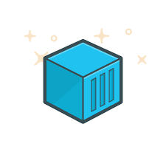
User-defined Bridge
To connect a running container to an existing user-defined bridge, use the docker network connect command
The following command connects an already-running my-nginx container to an already-existing my-net network:
$ docker network connect my-net my-nginx
Notes:
Connect a container to a user-defined bridge
To connect a running container to an existing user-defined bridge, use thedocker network connect command.
The following command connects an already-running my-nginx container to an already-existing my-net network:
$ docker network connect my-net my-nginx

Slide 105
Quick Look at Docker Networking
Docker
Container
Docker
Container
Docker
Container
Docker
Container
eth0
eth0
eth0
eth0
veth
veth
veth
veth
Docker Bridge

Slide 106
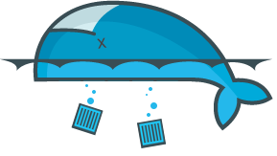
Docker Containers Die
Containers are ephemeral
Nothing is saved from a container if it goes away
Containers get new IP addresses
Don’t treat containers like VMs: They are NOT
But what about stateful applications?

Slide 107
Managing Data in Docker
It is possible to store data within the writable layer of a container, but there are some downsides:
The data doesn’t persist when that container is no longer running
A container’s writable layer is tightly coupled to the host machine where the container is running
Writing into a container’s writable layer requires a storage driver to manage the filesystem.
Docker offers three different ways to mount data into a container from the Docker host:
volumes
bind mounts
tmpfs volumes
Notes:
Manage data in Docker
It is possible to store data within the writable layer of a container, but there are some downsides:
1.The data doesn’t persist when that container is no longer running,
SHARE:
and it can be difficult to get the data out of the container if another process needs it.
2. A container’s writable layer is tightly coupled to the host machine where the container is running.
SHARE:
You can’t easily move the data somewhere else.
3. Writing into a container’s writable layer requires a storage driver to manage the filesystem.
SHARE:
The storage driver provides a union filesystem, using the Linux kernel. This extra abstraction reduces performance as compared to using data volumes, which write directly to the host filesystem.
Docker offers three different ways to mount data into a container from the Docker host:
1. volumes
2. bind mounts
3. tmpfs volumes.
SHARE:
When in doubt, volumes are almost always the right choice. Keep reading for more information about each mechanism for mounting data into containers.

Slide 108
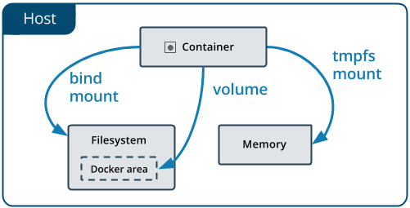
Choosing the Right Mount Type
No matter which type of mount you choose the data looks the same
To visualize the difference, think about where the data lives on the Docker host
Notes:
No matter which type of mount you choose to use, the data looks the same from within the container.
SHARE:
It is exposed as either a directory or an individual file in the container’s filesystem.
An easy way to visualize the difference among volumes, bind mounts, and tmpfs mounts is to think about where the data lives on the Docker host.
SHARE:
Volumes are stored in a part of the host filesystem which is managed by Docker(/var/lib/docker/volumes/ on Linux). Non-Docker processes should not modify this part of the filesystem. Volumes are the best way to persist data in Docker.
Bind mounts may be stored anywhere on the host system. They may even be important system files or directories. Non-Docker processes on the Docker host or a Docker container can modify them at any time.
tmpfs mounts are stored in the host system’s memory only, and are never written to the host system’s filesystem.

Slide 109
Concept of Volumes
Volumes are the preferred mechanism for persisting data, generally
Bind mounts are dependent on the directory structure of the host
Volumes have several advantages over bind mounts:
Volumes are easier to back up or migrate
You can manage volumes using Docker CLI commands or the Docker API
Volumes work on both Linux and Windows containers
Volumes can be more safely shared among multiple containers
Volume drivers allow you to store volumes on remote hosts or cloud providers, to encrypt the contents of volumes, or to add other functionality
A new volume’s contents can be pre-populated by a container
Notes:
Use volumes
Volumes are the preferred mechanism for persisting data generated by and used by Docker containers.
While bind mounts are dependent on the directory structure of the host machine,
SHARE:
volumes are completely managed by Docker.
Volumes have several advantages over bind mounts:
1. Volumes are easier to back up or migrate than bind mounts.
2. You can manage volumes using Docker CLI commands or the Docker API.
3. Volumes work on both Linux and Windows containers.
4. Volumes can be more safely shared among multiple containers.
5. Volume drivers allow you to store volumes on remote hosts or cloud providers, to encrypt the contents of volumes, or to add other functionality.
6. A new volume’s contents can be pre-populated by a container.

Slide 110
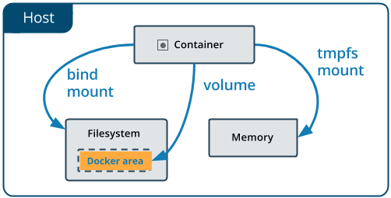
Concept of Volumes
Volumes are also a better choice than persisting data in a container’s writable layer, because using a volume does not increase the size of containers
And, the volume’s contents exist outside the lifecycle of a given container!
Notes:
Use volumes
In addition, volumes are often a better choice than persisting data in a container’s writable layer, because using a volume does not increase the size of containers using it, and the volume’s contents exist outside the lifecycle of a given container.
If your container generates non-persistent state data, consider using a tmpfs mount to avoid storing the data anywhere permanently, and to increase the container’s performance by avoiding writing into the container’s writable layer.
Volumes use rprivate bind propagation, and bind propagation is not configurable for volumes.

Slide 111
Concept of Volumes
If your container generates non-persistent state data, consider a tmpfs mount
Avoid storing the data anywhere permanently
Increase the container’s performance by avoiding writing into the container’s writable layer
Volumes use rprivate bind propagation, and bind propagation is not configurable for volumes
Notes:
Use volumes
If your container generates non-persistent state data, consider using a tmpfs mount to
avoid storing the data anywhere permanently,
and to increase the container’s performance by avoiding writing into the container’s writable layer.
Volumes use rprivate bind propagation, and bind propagation is not configurable for volumes.

Slide 112
Confronting the Stateful Challenge
Docker volumes to the rescue of all our stateful containers
Volumes create persistent data outside of the container
Can be mapped directly to host locations
Can also be deployed independently of hosts
Example:
docker run -d -P --name web -v /webapp training/webapp python app.py
d

Slide 113

Docker Data Volume
Example:
Host
Container
docker run -d -P --name web -v /webapp training/webapp python app.py
/var/lib/docker/.../tmp
/wabapp

Slide 114
Direct Host Volumes
We can also map volumes directly to host specific locations:
Useful for known locations on host
Can use NFS mounts
Files are visible outside of the container and are persisted
Can restart new containers up with same location

Slide 115
Docker Host Volumes Direct Location
Example:
docker run -d -P --name web -v /src/webapp:/opt/webapp training/webapp python app.py
Host
Container
known/file/location
/wabapp

Slide 116
Containers as Data Volumes
Start a container that will manage the volume:
Now other containers can use that container so they’re not tied directly to the volumes (mounting them, etc):
docker create -v /dbdata --name dbdata training/postgres /bin/true
docker run -d --volumes-from dbdata --name db1 training/postgres

Slide 117
Containers as Data Volumes
Here’s a diagram of what that might look like:
Host
Container
Container
Container
/wabapp
known/file/location

Slide 118
Inspect Volumes
How can we inspect our volumes? Let’s first list our current volumes:
Now, pulling from the list that prints out, we can plugin a volume id, like this:
docker volume ls
docker volume inspect <name-or-id>

Slide 119
Choose the -v or --mount Flag
Originally, the -v or --volume flag was used for standalone containers and the --mount flag was used for swarm services
However, starting with Docker 17.06, you can also use --mount with standalone containers
In general, --mount is more explicit and verbose
The biggest difference is that the -v syntax combines all the options together in one field, while the --mount syntax separates them
Notes:
Originally, the -v or --volume flag was used for standalone containers and the --mount flag was used for swarm services.
However, starting with Docker 17.06, you can also use --mount with standalone containers.
In general, --mount is more explicit and verbose.
The biggest difference is that the -v syntax combines all the options together in one field, while the --mount syntax separates them.
SHARE:
Tip: New users should use the --mount syntax. Experienced users may be more familiar with the -v or --volume syntax, but are encouraged to use --mount, because research has shown it to be easier to use.
MORE MATERIAL TO POSSIBLE ADD IN THE FUTURE:
Here is a comparison of the syntax for each flag.
If you need to specify volume driver options, you must use --mount.
-v or --volume: Consists of three fields, separated by colon characters (:). The fields must be in the correct order, and the meaning of each field is not immediately obvious.
In the case of named volumes, the first field is the name of the volume, and is unique on a given host machine. For anonymous volumes, the first field is omitted.
The second field is the path where the file or directory are mounted in the container.
The third field is optional, and is a comma-separated list of options, such as ro. These options are discussed below.
--mount: Consists of multiple key-value pairs, separated by commas and each consisting of a <key>=<value> tuple. The --mount syntax is more verbose than -v or --volume, but the order of the keys is not significant, and the value of the flag is easier to understand.
The type of the mount, which can be bind, volume, or tmpfs. This topic discusses volumes, so the type is always volume.
The source of the mount. For named volumes, this is the name of the volume. For anonymous volumes, this field is omitted. May be specified as source or src.
The destination takes as its value the path where the file or directory is mounted in the container. May be specified as destination, dst, or target.
The readonly option, if present, causes the bind mount to be mounted into the container as read-only.
The volume-opt option, which can be specified more than once, takes a key-value pair consisting of the option name and its value.
The examples below show both the --mount and -v syntax where possible, and --mount is presented first.

Slide 120
Differences Between -v and --mount Behavior
Because volume flags have been a part of Docker for a long time, their behavior can’t be changed
This means that there’s only one behavior that’s different between the two
If you use -v or --volume to bind-mount a file or directory that does not yet exist on the Docker host, -v creates the endpoint for you
If you use --mount to bind-mount a file or directory that does not exist on the host, Docker does not automatically create it for you
Notes:
Differences between -v and --mount behavior
Because the -v and --volume flags have been a part of Docker for a long time, their behavior cannot be changed.
This means that there is one behavior that is different between -v and --mount.
If you use -v or --volume to bind-mount a file or directory that does not yet exist on the Docker host, -v creates the endpoint for you.
SHARE:
It is always created as a directory.
If you use --mount to bind-mount a file or directory that does not yet exist on the Docker host, Docker does not automatically create it for you,
SHARE:
but generates an error.

Slide 121
Bind Mounts
Bind mounts have been around since the early days of Docker
Bind mounts have limited functionality compared to volumes
When you use a bind mount, a file or directory on the host machine is mounted into a container
The file or directory is referenced by its full or relative path on the host machine
By contrast, with volumes, a new directory is created within Docker’s storage directory on the host machine
Notes:
Use bind mounts
Bind mounts have been around since the early days of Docker.
Bind mounts have limited functionality compared to volumes.
When you use a bind mount, a file or directory on the host machine is mounted into a container.
The file or directory is referenced by its full or relative path on the host machine.
By contrast, when you use a volume, a new directory is created within Docker’s storage directory on the host machine,
SHARE:
and Docker manages that directory’s contents.

Slide 122
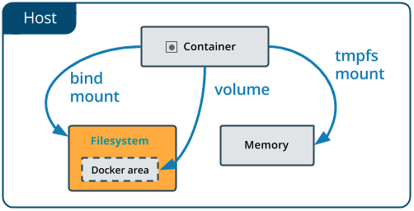
Bind Mounts
The file or directory does not need to exist on the Docker host already!
Bind mounts are very performant, but they rely on the host machine’s filesystem having a specific directory structure available
If developing new Docker applications, consider using named volumes instead
Notes:
BIND MOUNTS
The file or directory does not need to exist on the Docker host already.
SHARE:
It is created on demand if it does not yet exist.
Bind mounts are very performant, but they rely on the host machine’s filesystem having a specific directory structure available.
If you are developing new Docker applications, consider using named volumes instead.
SHARE:
You can’t use Docker CLI commands to directly manage bind mounts.
IMAGE HERE

Slide 123
Start a Container Using a Bind Mount
Consider a case where...
You have a directory source and that when you build the source code, the artifacts are saved into another directory source/target/
You want the artifacts to be available to the container at /app/, and you want the container to get access to a new build each time you build the source on your development host
Use the following command to bind-mount the target/ directory into your container at /app/
$ docker run -d \
-it \
--name devtest \
--mount type=bind,source="$(pwd)"/target,target=/app \
nginx:latest
Notes:
Start a container with a bind mount
Consider a case where...
you have a directory source and that when you build the source code, the artifacts are saved into another directory source/target/.
You want the artifacts to be available to the container at /app/, and you want the container to get access to a new build each time you build the source on your development host.
Use the following command to bind-mount the target/ directory into your container at /app/.
SHARE:
Run the command from within the source directory.
$ docker run -d \ -it \ --name devtest \ --mount type=bind,source="$(pwd)"/target,target=/app \ nginx:latest
SHARE:
The $(pwd) sub-command expands to the current working directory on Linux or macOS hosts.
The --mount and -v examples below produce the same result.
You can’t run them both unless you remove the devtest container after running the first one.

Slide 124
Start a Container Using a Bind Mount
Use docker inspect devtest to verify that the bind mount was created correctly
Look for the Mounts section:
"Mounts": [
{
"Type": "bind",
"Source": "/tmp/source/target",
"Destination": "/app",
"Mode": "",
"RW": true,
"Propagation": "rprivate"
}
],
Notes:
Use docker inspect devtest to verify that the bind mount was created correctly.
Look for the Mounts section:
"Mounts": [
{
"Type": "bind",
"Source": "/tmp/source/target",
"Destination": "/app",
"Mode": "",
"RW": true,
"Propagation": "rprivate"
}
],
SHARE:
This shows that the mount is a bind mount, it shows the correct source and destination, it shows that the mount is read-write, and that the propagation is set to rprivate.
Stop the container:
$ docker container stop devtest
$ docker container rm devtest

Slide 125
About Storage Drivers
To use storage drivers effectively, it’s important to know how Docker builds and stores images
Use this information to make informed choices about the best way to persist data from your applications and avoid performance problems
Storage drivers allow you to persist data in the writable layer of your container
This is the least efficient way to persist data!
Notes:
About storage drivers
To use storage drivers effectively, it’s important to know how Docker builds and stores images, how these images are used by containers.
You can use this information to make informed choices about the best way to persist data from your applications and avoid performance problems along the way.
Storage drivers allow you to persist data in the writable layer of your container.
This is the least efficient way to persist data.
SHARE:
Note:
Volumes or bind mounts provide much better read and write performance, and volumes provide more security and isolation than either storage drivers or bind mounts.
Neither volumes nor bind mounts use most of the concepts described in this topic.

Slide 126
Images and Layers
A Docker image is built up from a series of layers
Each layer represents an instruction in the image’s Dockerfile.
Each layer except the very last one is read-only
Consider the following Dockerfile:
Finally, the last layer specifies what command to run within the container
FROM ubuntu:15.04
COPY . /app
RUN make /app
CMD python /app/app.py
FROM creates a layer; ubuntu:15.04 image
COPY command adds some files from (.)
The RUN command builds your application
CMD specifies what to run in the container
Notes:
A Docker image is built up from a series of layers.
Each layer represents an instruction in the image’s Dockerfile.
Each layer except the very last one is read-only.
Consider the following Dockerfile:
FROM ubuntu:15.04
COPY . /app
RUN make /app
CMD python /app/app.py
SHARE:
This Dockerfile contains four commands, each of which creates a layer.
The FROM statement starts out by creating a layer from the ubuntu:15.04 image.
The COPY command adds some files from your Docker client’s current directory.
The RUN command builds your application using the makecommand.
Finally, the last layer specifies what command to run within the container.

Slide 127
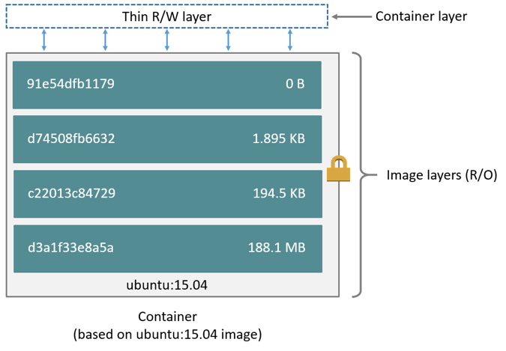
Images and Layers
Each layer is only a set of differences from the layer before it
When you create a new container, you add a new writable layer on top of the underlying layers
All changes made are written to this thin writable container layer
The diagram below shows a container based on the Ubuntu 15.04 image:
A storage driver handles the details about the way these layers interact with each other
Notes:
Each layer is only a set of differences from the layer before it.
SHARE
The layers are stacked on top of each other.
When you create a new container, you add a new writable layer on top of the underlying layers.
SHARE
This layer is often called the “container layer”.
All changes made to the running container, such as writing new files, modifying existing files, and deleting files, are written to this thin writable container layer.
The diagram below shows a container based on the Ubuntu 15.04 image:
IMAGE
A storage driver handles the details about the way these layers interact with each other.
SHARE:
Different storage drivers are available, which have advantages and disadvantages in different situations.

Slide 128
Containers and Layers
The major difference between a container and an image is the top writable layer
When the container is deleted, the writable layer is also deleted
The underlying image remains unchanged
Multiple containers can share access to the same underlying image and yet have their own data state
Notes:
The major difference between a container and an image is the top writable layer.
SHARE:
Like we just learned all writes to the container that add new or modify existing data are stored in this writable layer.
When the container is deleted, the writable layer is also deleted.
The underlying image remains unchanged
Because each container has its own writable container layer, and all changes are stored in this container layer, multiple containers can share access to the same underlying image and yet have their own data state.

Slide 129
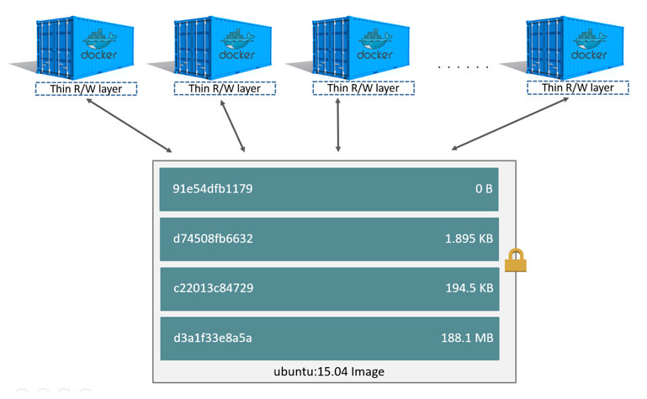
Containers and Layers
The diagram below shows multiple containers sharing a Ubuntu 15.04 image:
Notes:
The diagram below shows multiple containers sharing the same Ubuntu 15.04 image.
SHARE:
- If you need multiple images to have shared access to the exact same data, store this data in a Docker volume and mount it into your containers.
- Docker uses storage drivers to manage the contents of the image layers and the writable container layer.
- Each storage driver handles the implementation differently, but all drivers use stackable image layers and the copy-on-write (CoW) strategy.

Slide 130
Data Volumes and Storage Drivers
Any data written to the container, not stored in a data volume is deleted!
A data volume is a directory or file in the Docker host’s filesystem that is mounted directly into a container
Data volumes are not controlled by the storage driver
Reads and writes to data volumes bypass the storage driver and operate at native host speeds
You can mount any number of data volumes into a container
Multiple containers can also share one or more data volumes.
Notes:
When a container is deleted,
any data written to the container that is not stored in a data volume is deleted along with the container.
A data volume is a directory or file in the Docker host’s filesystem that is mounted directly into a container.
Data volumes are not controlled by the storage driver.
Reads and writes to data volumes bypass the storage driver and operate at native host speeds.
You can mount any number of data volumes into a container.
Multiple containers can also share one or more data volumes.

Slide 131
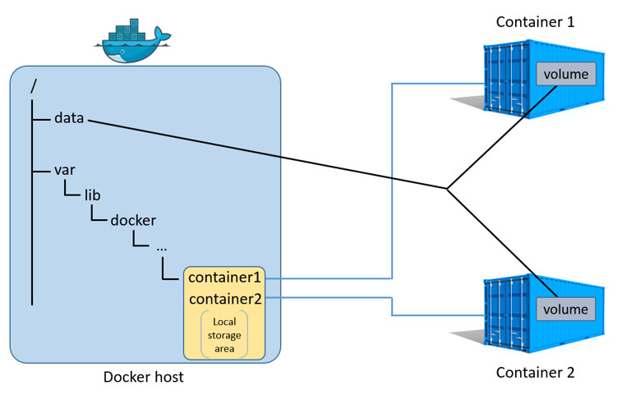
Data Volumes and Storage Drivers
The diagram below shows a single Docker host running two containers:
Data volumes reside outside of the local storage area on the Docker host
Any data stored in data volumes persists on the Docker host
Notes:
The diagram below shows a single Docker host running two containers.
SHARE:
Each container exists inside of its own address space within the Docker host’s local storage area (/var/lib/docker/...).
There is also a single shared data volume located at /data on the Docker host.
This is mounted directly into both containers.
Data volumes reside outside of the local storage area on the Docker host,
SHARE:
further reinforcing their independence from the storage driver’s control.
When a container is deleted, any data stored in data volumes persists on the Docker host.

Slide 132
Hands-on Exercise(s)

Slide 133
End of Chapter

Slide 134
Docker Registry
Create a local and external registry

Slide 135
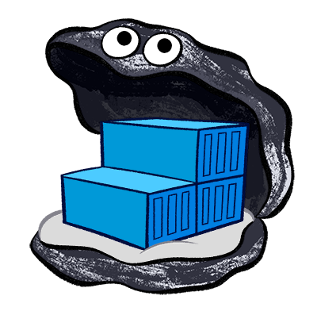
Docker Registry Introduction
Docker says:
“Docker Trusted Registry (DTR) is a commercial product that enables complete image management workflow, featuring LDAP integration, image signing, security scanning, and integration with Universal Control Plane. DTR is offered as an add-on to Docker Enterprise subscriptions of Standard or higher.”
Notes:
Docker Registry
Estimated reading time: 1 minuteLooking for Docker Trusted Registry?
Docker Trusted Registry (DTR) is a commercial product that enables complete image management workflow, featuring LDAP integration, image signing, security scanning, and integration with Universal Control Plane. DTR is offered as an add-on to Docker Enterprise subscriptions of Standard or higher.

Slide 136
What & Why
What it is:
The Registry is a stateless, highly scalable server side application that stores and lets you distribute Docker images. The Registry is open-source, under the permissive Apache license.
Why use it:
You should use the Registry if you want to:
Tightly control where your images are being stored
Fully own your images distribution pipeline
Integrate image storage and distribution tightly into your in-house development workflow
Notes:
What it is
The Registry is a stateless, highly scalable server side application that stores and lets you distribute Docker images. The Registry is open-source, under the permissive Apache license.
Why use it
You should use the Registry if you want to:
tightly control where your images are being stored
fully own your images distribution pipeline
integrate image storage and distribution tightly into your in-house development workflow

Slide 137
Alternatives & Requirements
Users looking for a zero maintenance, ready-to-go solution are encouraged to head-over to the Docker Hub, which provides a free-to-use, hosted Registry, plus additional features (organization accounts, automated builds, and more).
Users looking for a commercially supported version of the Registry should look into Docker Trusted Registry.
The Registry is compatible with Docker engine version 1.6.0 or higher.
Now, we’ve looked at DockerHub, so let’s look now at Docker Trusted Registry!
Notes:
Alternatives
Users looking for a zero maintenance, ready-to-go solution are encouraged to head-over to the Docker Hub, which provides a free-to-use, hosted Registry, plus additional features (organization accounts, automated builds, and more).
Users looking for a commercially supported version of the Registry should look into Docker Trusted Registry.
Requirements
The Registry is compatible with Docker engine version 1.6.0 or higher.

Slide 138
Basic Commands
Start Registry
Pull Image From DockerHub
Tag Image to Point to the Registry
$ docker run -d -p 5000:5000 --name registry registry:2
$ docker pull ubuntu
$ docker image tag ubuntu localhost:5000/myfirstimage
Notes:
Basic commands
Start your registry
docker run -d -p 5000:5000 --name registry registry:2
Pull (or build) some image from the hub
docker pull ubuntu
Tag the image so that it points to your registry
docker image tag ubuntu localhost:5000/myfirstimage

Slide 139
Basic Commands
Push it
Pull it Back
Now Stop the Registry and Remove All Data
$ docker push localhost:5000/myfirstimage
$ docker pull localhost:5000/myfirstimage
$ docker image tag ubuntu localhost:5000/myfirstimage
Notes:
Push it
docker push localhost:5000/myfirstimage
Pull it back
docker pull localhost:5000/myfirstimage
Now stop your registry and remove all data
docker container stop registry && docker container rm -v registry

Slide 140
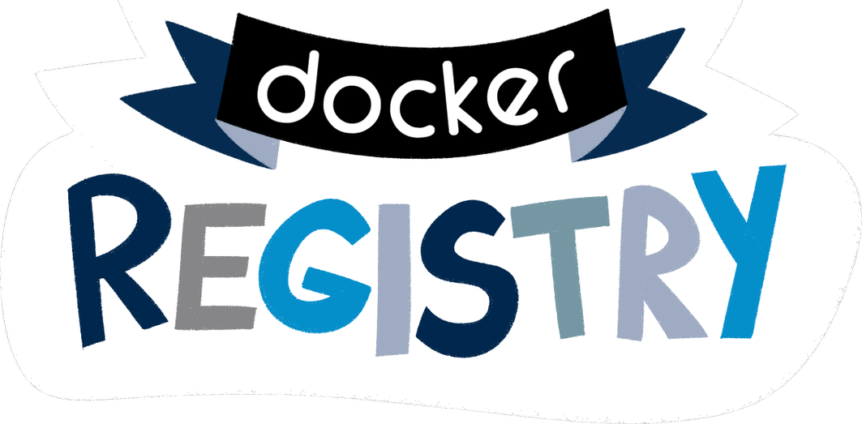
Docker Trusted Registry
Docker says:
“Docker Trusted Registry* (DTR) is the enterprise-grade image storage solution from Docker. You install it behind your firewall so that you can securely store and manage the Docker images you use in your applications.”
Trusted
*The following slides are based on DTR 2.4.1
Notes:
Docker Trusted Registry (DTR) is the enterprise-grade image storage solution from Docker.
You install it behind your firewall so that you can securely store and manage the Docker images you use in your applications.

Slide 141
Image Management
DTR can be installed on-premises, or on a virtual private cloud.
You can store your Docker images securely, behind your firewall
You can use DTR as part of your CI and CD processes
DTR has a web based user interface, too!
Notes:
DTR can be installed on-premises, or on a virtual private cloud.
And with it, you can store your Docker images securely, behind your firewall.
You can use DTR as part of your continuous integration, and continuous delivery processes to build, ship, and run your applications.
DTR has a web based user interface that:
- allows authorized users in your organization to
- browse docker images.
- It provides information about who pushed what image at what time.
- It even allows you to see what dockerfile lines were used to produce the image and, if security scanning is enabled, to see a - list of all of the software installed in your images.

Slide 142
Availability & Efficiency
Availability
DTR is highly available through the use of multiple replicas of all containers and metadata such that if a machine fails, DTR continues to operate and can be repaired
Efficiency
DTR has the ability to cache images closer to users to reduce the amount of bandwidth used during docker pulls DTR has the ability to clean up unreferenced manifests and layers
Notes:
Availability
DTR is highly available through the use of multiple replicas of all containers and metadata such that if a machine fails, DTR continues to operate and can be repaired.
Efficiency
DTR has the ability to cache images closer to users to reduce the amount of bandwidth used during docker pulls.
DTR has the ability to clean up unreferenced manifests and layers.

Slide 143
Built-in Access Control
DTR uses the same authentication mechanism as Docker Universal Control Plane
Users can be managed manually or synched from LDAP or Active Directory
DTR uses Role Based Access Control (RBAC) to allow you to implement fine-grained access control policies for who has access to your Docker images
Notes:
Built-in access control
DTR uses the same authentication mechanism as Docker Universal Control Plane.
Users can be managed manually or synched from LDAP or Active Directory.
DTR uses Role Based Access Control (RBAC) to allow you to implement fine-grained access control policies for who has access to your Docker images.

Slide 144
Security Scanning
DTR’s built in security scanner can be used to discover versions of software
It scans each layer and aggregates the results to give you a complete picture
Vulnerable databases are kept up to date through periodic updates
This serves to give you unprecedented insight into your exposure
Notes:
Security scanning
DTR has a built in security scanner that can be used to discover what versions of software are used in your images.
It scans each layer and aggregates the results to give you a complete picture of what you are shipping as a part of your stack.
Most importantly, it co-relates this information with a vulnerability database that is kept up to date through periodic updates.
This gives you unprecedented insight into your exposure to known security threats.

Slide 145
Deploy Docker Registry Server

Slide 146
Deploy Registry Server
Before you can deploy a registry, you need to install Docker on the host
A registry is an instance of the registry image, and runs within Docker
This topic provides basic information about deploying and configuring a registry
Notes:
Deploy a registry server
Before you can deploy a registry, you need to install Docker on the host.
A registry is an instance of the registry image, and runs within Docker.
This topic provides basic information about deploying and configuring a registry.
For an exhaustive list of configuration options, see the configuration reference.
https://docs.docker.com/registry/configuration/
If you have an air-gapped datacenter, see Considerations for air-gapped registries.
https://docs.docker.com/registry/deploying/#considerations-for-air-gapped-registries

Slide 147
Run a Local Registry
Use a command like the following to start the registry container:
That’s it. No, seriously!
$ docker run -d -p 5000:5000 --restart=always --name registry registry:2
Notes:
Run a local registry
Use a command like the following to start the registry container:
$ docker run -d -p 5000:5000 --restart=always --name registry registry:2
The registry is now ready to use.
Warning: These first few examples show registry configurations that are only appropriate for testing. A production-ready registry must be protected by TLS and should ideally use an access-control mechanism. Keep reading and then continue to the configuration guide to deploy a production-ready registry.

Slide 148
Interacting with a Registry

Slide 149
From Docker Hub to Registry
You can pull an image from Docker Hub and push it to your registry
The following example pulls the ubuntu:16.04 image from Docker Hub and re-tags it as my-ubuntu, then pushes it to the local registry
Finally, the ubuntu:16.04 and my-ubuntu images are deleted locally and the my-ubuntuimage is pulled from the local registry
To get started, we’ll pull the ubuntu:16.04 image down from Docker Hub
$ docker pull ubuntu:16.04
Notes:
You can pull an image from Docker Hub and push it to your registry.
The following example pulls the ubuntu:16.04 image from Docker Hub and re-tags it as my-ubuntu, then pushes it to the local registry.
Finally, the ubuntu:16.04 and my-ubuntu images are deleted locally and the my-ubuntuimage is pulled from the local registry.
Pull the ubuntu:16.04 image from Docker Hub.
$ docker pull ubuntu:16.04

Slide 150
From Docker Hub to Registry
Tag the image as localhost:5000/my-ubuntu
This creates an additional tag for the existing image!
When the first part of the tag is a hostname and port, Docker interprets this as the location of a registry, when pushing:
Push the image to the local registry running at localhost:5000:
$ docker tag ubuntu:16.04 localhost:5000/my-ubuntu
$ docker push localhost:5000/my-ubuntu
Notes:
Tag the image as localhost:5000/my-ubuntu.
This creates an additional tag for the existing image.
When the first part of the tag is a hostname and port,
Docker interprets this as the location of a registry, when pushing.
SHARE:
We are first tagging our image here, and tagging it specifically with a hostname and port, so that when we push it, it goes to our registry, not DockerHub.
$ docker tag ubuntu:16.04 localhost:5000/my-ubuntu
Push the image to the local registry running at localhost:5000:
$ docker push localhost:5000/my-ubuntu

Slide 151
From Docker Hub to Registry
Tag the image as localhost:5000/my-ubuntu
This creates an additional tag for the existing image
When the first part of the tag is a hostname and port, Docker interprets this as the location of a registry, when pushing
Push the image to the local registry running at localhost:5000:
$ docker image remove ubuntu:16.04
$ docker image remove localhost:5000/my-ubuntu
$ docker pull localhost:5000/my-ubuntu
Notes:
Remove the locally-cached ubuntu:16.04 and localhost:5000/my-ubuntu images,
so that you can test pulling the image from your registry.
This does not remove the localhost:5000/my-ubuntu image from your registry.
$ docker image remove ubuntu:16.04
$ docker image remove localhost:5000/my-ubuntu
Pull the localhost:5000/my-ubuntu image from your local registry.
$ docker pull localhost:5000/my-ubuntu

Slide 152
Stop a Local Registry
To stop the registry, use the same docker container stop command as with any other container
It’s that easy!
To remove the container, use docker container rm:
$ docker container stop registry
$ docker container stop registry && docker container rm -v registry
Notes:
Stop a local registry
To stop the registry, use the same docker container stop command as with any other container.
$ docker container stop registry
To remove the container, use docker container rm.
$ docker container stop registry && docker container rm -v registry

Slide 153
Basic Configuration

Slide 154
Start the Registry Automatically
To configure the container, you can pass additional or modified options to the docker run command
If you want to use the registry as part of your permanent infrastructure, you should set it to restart automatically when Docker restarts or if it exits
This example uses the --restart always flag to set a restart policy for the registry:
$ docker run -d \
-p 5000:5000 \
--restart=always \
--name registry \
registry:2
Restart!
Notes:
To configure the container, you can pass additional or modified options to the docker run command.
The following sections provide basic guidelines for configuring your registry.
For more details, see the registry configuration reference.
Start the registry automatically
If you want to use the registry as part of your permanent infrastructure, you should set it to restart automatically when Docker restarts or if it exits.
This example uses the --restart always flag to set a restart policy for the registry.
$ docker run -d \
-p 5000:5000 \
--restart=always \
--name registry \
registry:2

Slide 155
Customize the Published Port
If you are already using port 5000, or you want to run multiple local registries to separate areas of concern, you can customize the registry’s port settings
This example runs the registry on port 5001 and names it registry-test
Remember, the first part of the -p value is the host port and the second part is the port within the container
Within the container, the registry listens on port 5000 by default
$ docker run -d \
-p 5001:5000 \
--name registry-test \
registry:2
Notes:
If you are already using port 5000, or you want to run multiple local registries to separate areas of concern, you can customize the registry’s port settings.
This example runs the registry on port 5001 and also names it registry-test.
Remember, the first part of the -p value is the host port and the second part is the port within the container.
Within the container, the registry listens on port 5000 by default.
$ docker run -d \ -p 5001:5000 \ --name registry-test \ registry:2

Slide 156
Customize the Published Port
If you want to change the port the registry listens on within the container, you can use the environment variable REGISTRY_HTTP_ADDR to change it
This command causes the registry to listen on port 5001 within the container:
$ docker run -d \
-e REGISTRY_HTTP_ADDR=0.0.0.0:5001 \
-p 5001:5001 \
--name registry-test \
registry:2
Not secure!
Notes:
If you want to change the port the registry listens on within the container, you can use the environment variable REGISTRY_HTTP_ADDR to change it.
This command causes the registry to listen on port 5001 within the container:
$ docker run -d \
-e REGISTRY_HTTP_ADDR=0.0.0.0:5001 \
-p 5001:5001 \
--name registry-test \
registry:2

Slide 157
Customize the Storage Location
Registry data is persisted as a docker volume on the host filesystem
If you want to store your registry contents at a specific location on your host filesystem, you might decide to use a bind mount instead
A bind mount is more dependent on the filesystem layout of the Docker host, but more performant in many situations
The following example bind mounts the host directory /mnt/registry into the registry container at /var/lib/registry/
$ docker run -d -p 5000:5000 \
--restart=always --name registry \
-v /mnt/registry:/var/lib/registry \
registry:2
Notes:
By default, your registry data is persisted as a docker volume on the host filesystem.
If you want to store your registry contents at a specific location on your host filesystem, such as if you have an SSD or SAN mounted into a particular directory, you might decide to use a bind mount instead.
A bind mount is more dependent on the filesystem layout of the Docker host, but more performant in many situations.
The following example bind-mounts the host directory /mnt/registry into the registry container at /var/lib/registry/.
$ docker run -d \ -p 5000:5000 \ --restart=always \ --name registry \ -v /mnt/registry:/var/lib/registry \ registry:2
MAYBE SHARE:
You can customize the storage back-end, but that is a little advanced for this class.
By default, the registry stores its data on the local filesystem, whether you use a bind mount or a volume.
You can store the registry data in an Amazon S3 bucket, Google Cloud Platform, or on another storage back-end by using storage drivers.
For more information, see storage configuration options.

Slide 158
Run Externally Accessible Registry

Slide 159
Run Externally Accessible Registry
Running a registry only accessible on localhost has limited usefulness
In order to make a registry accessible to external hosts, you must first secure it using Transport Layer Security (TLS)
This example is extended in Run a registry as a service below.
Notes:
Running a registry only accessible on localhost has limited usefulness.
In order to make your registry accessible to external hosts, you must first secure it using TLS.
SHARE:
Transport Layer Security (TLS) – and its predecessor, Secure Sockets Layer (SSL), which is now prohibited from use by the Internet Engineering Task Force (IETF) – are cryptographic protocols that provide communications security over a computer network.
This example is extended in Run a registry as a service below.

Slide 160

Get a Certificate
These examples assume the following:
Your registry URL is https://myregistry.domain.com/
Your DNS, routing, and firewall settings allow access to the registry’s host on 5000
You have already obtained a certificate from a certificate authority (CA)
Notes:
Get a certificate
These examples assume the following:
Your registry URL is https://myregistry.domain.com/.
Your DNS, routing, and firewall settings allow access to the registry’s host on port 5000.
You have already obtained a certificate from a certificate authority (CA).
If you have been issued an intermediate certificate instead, see use an intermediate certificate.
FUNNY JOKE: You’re certificate won’t look like at! So, don’t be looking for it!

Slide 161
Get a Certificate
Firstly, we’ll create a certs directory:
Copy the .crt and .key files from the CA into the certs directory.
The following steps assume that the files are named:
domain.crt
domain.key
In this situation, we’ll stop any registry currently running before we proceed
$ mkdir -p certs
Notes:
Create a certs directory.
$ mkdir -p certs
Copy the .crt and .key files from the CA into the certs directory.
The following steps assume that the files are named domain.crt and domain.key.
Stop the registry if it is currently running.
$ docker container stop registry

Slide 162
Get a Certificate
Restart the registry, directing it to use the TLS certificate
This command bind-mounts the certs/directory into the container at /certs/, and sets environment variables
The registry runs on port 443, the default HTTPS port:
$ docker run -d \
--restart=always \
--name registry \
-v `pwd`/certs:/certs \
-e REGISTRY_HTTP_ADDR=0.0.0.0:443 \
-e REGISTRY_HTTP_TLS_CERTIFICATE=/certs/domain.crt \
-e REGISTRY_HTTP_TLS_KEY=/certs/domain.key \
-p 443:443 \
registry:2
Notes:
Restart the registry, directing it to use the TLS certificate.
This command bind-mounts the certs/directory into the container at /certs/, and sets environment variables that tell the container where to find the domain.crt and domain.key file.
The registry runs on port 443, the default HTTPS port.
$ docker run -d \ --restart=always \ --name registry \ -v `pwd`/certs:/certs \ -e REGISTRY_HTTP_ADDR=0.0.0.0:443 \ -e REGISTRY_HTTP_TLS_CERTIFICATE=/certs/domain.crt \ -e REGISTRY_HTTP_TLS_KEY=/certs/domain.key \ -p 443:443 \ registry:2
Docker clients can now pull from and push to your registry using its external address.
The following commands demonstrate this:
$ docker pull ubuntu:16.04
$ docker tag ubuntu:16.04 myregistrydomain.com/my-ubuntu
$ docker push myregistrydomain.com/my-ubuntu
$ docker pull myregistrydomain.com/my-ubuntu

Slide 163
Get a Certificate
Docker clients can now pull from and push to your registry using its external address
The following commands demonstrate this:
$ docker pull ubuntu:16.04
$ docker tag ubuntu:16.04 myregistrydomain.com/my-ubuntu
$ docker push myregistrydomain.com/my-ubuntu
$ docker pull myregistrydomain.com/my-ubuntu
Notes:
Docker clients can now pull from and push to your registry using its external address.
The following commands demonstrate this:
$ docker pull ubuntu:16.04
$ docker tag ubuntu:16.04 myregistrydomain.com/my-ubuntu
$ docker push myregistrydomain.com/my-ubuntu
$ docker pull myregistrydomain.com/my-ubuntu

Slide 164
Run the Registry as a Service

Slide 165
Run the Registry as a Service
Swarm services provide several advantages over standalone containers
They use a declarative model, which means that you define the desired state and Docker works to keep your service in that state
Services provide automatic load balancing scaling, and the ability to control the distribution of your service, among other advantages.
Services also allow you to store sensitive data such as TLS certificates in secrets.
Notes:
Swarm services provide several advantages over standalone containers.
They use a declarative model, which means that you define the desired state and Docker works to keep your service in that state.
Services provide automatic load balancing scaling, and the ability to control the distribution of your service, among other advantages.
Services also allow you to store sensitive data such as TLS certificates in secrets.

Slide 166
Run the Registry as a Service
The storage back-end you use determines whether you use a fully scaled service or a service with either only a single node or a node constraint
If you use a distributed storage driver, such as Amazon S3, you can use a fully replicated service
Each worker can write to the storage back-end without causing write conflicts
If you use a local bind mount or volume, each worker node writes to its own storage location, which means that each registry contains a different data set
You can solve this problem by using a single-replica service and a node constraint to ensure that only a single worker is writing to the bind mount
The following example starts a registry as a single-replica service, which is accessible on any swarm node on port 80
It assumes you are using the same TLS certificates as in the previous examples
Notes:
The storage back-end you use determines whether you use a fully scaled service or a service with either only a single node or a node constraint.
If you use a distributed storage driver, such as Amazon S3, you can use a fully replicated service.
Each worker can write to the storage back-end without causing write conflicts.
If you use a local bind mount or volume, each worker node writes to its own storage location, which means that each registry contains a different data set.
You can solve this problem by using a single-replica service and a node constraint to ensure that only a single worker is writing to the bind mount.
The following example starts a registry as a single-replica service, which is accessible on any swarm node on port 80.
It assumes you are using the same TLS certificates as in the previous examples.
First, save the TLS certificate and key as secrets:
$ docker secret create domain.crt certs/domain.crt $ docker secret create domain.key certs/domain.key
Next, add a label to the node where you want to run the registry.
To get the node’s name, use docker node ls.
Substitute your node’s name for node1 below.
$ docker node update --label-add registry=true node1
Next, create the service, granting it access to the two secrets and constraining it to only run on nodes with the label registry=true. Besides the constraint, you are also specifying that only a single replica should run at a time. The example bind-mounts /mnt/registry on the swarm node to /var/lib/registry/ within the container. Bind mounts rely on the pre-existing source directory, so be sure /mnt/registry exists on node1. You might need to create it before running the following docker service create command.
By default, secrets are mounted into a service at /run/secrets/<secret-name>.
$ docker service create \ --name registry \ --secret domain.crt \ --secret domain.key \ --constraint 'node.labels.registry==true' \ --mount type=bind,src=/mnt/registry,dst=/var/lib/registry \ -e REGISTRY_HTTP_ADDR=0.0.0.0:80 \ -e REGISTRY_HTTP_TLS_CERTIFICATE=/run/secrets/domain.crt \ -e REGISTRY_HTTP_TLS_KEY=/run/secrets/domain.key \ --publish published=80,target=80 \ --replicas 1 \ registry:2
You can access the service on port 80 of any swarm node. Docker sends the requests to the node which is running the service.

Slide 167
Run the Registry as a Service
First, save the TLS certificate and key as secrets:
Next, add a label to the node where you want to run the registry
To get the node’s name, use docker node ls
Substitute your node’s name for node1 below:
$ docker secret create domain.crt certs/domain.crt
$ docker secret create domain.key certs/domain.key
$ docker node update --label-add registry=true node1
Notes:
First, save the TLS certificate and key as secrets:
$ docker secret create domain.crt certs/domain.crt
$ docker secret create domain.key certs/domain.key
Next, add a label to the node where you want to run the registry.
To get the node’s name, use docker node ls.
Substitute your node’s name for node1 below.
$ docker node update --label-add registry=true node1

Slide 168
Run the Registry as a Service
Next, create the service, granting it access to the two secrets and constraining it to only run on nodes with the label registry=true
Besides the constraint, you are also specifying that only a single replica should run at a time
The example bind-mounts /mnt/registry on the swarm node to /var/lib/registry/ within the container
Bind mounts rely on the pre-existing source directory, so be sure /mnt/registry exists on node1
You might need to create it before running the following docker service create command
Notes:
Next, create the service, granting it access to the two secrets and constraining it to only run on nodes with the label registry=true.
Besides the constraint, you are also specifying that only a single replica should run at a time.
The example bind-mounts /mnt/registry on the swarm node to /var/lib/registry/ within the container.
Bind mounts rely on the pre-existing source directory, so be sure /mnt/registry exists on node1.
You might need to create it before running the following docker service create command.

Slide 169
Run the Registry as a Service
By default, secrets are mounted at /run/secrets/<secret-name>
You can access the service on port 80 of any swarm node
$ docker service create \
--name registry \
--secret domain.crt \
--secret domain.key \
--constraint 'node.labels.registry==true' \
--mount type=bind,src=/mnt/registry,dst=/var/lib/registry \
-e REGISTRY_HTTP_ADDR=0.0.0.0:80 \
-e REGISTRY_HTTP_TLS_CERTIFICATE=/run/secrets/domain.crt \
-e REGISTRY_HTTP_TLS_KEY=/run/secrets/domain.key \
--publish published=80,target=80 \
--replicas 1 \
registry:2
Notes:
By default, secrets are mounted into a service at /run/secrets/<secret-name>.
$ docker service create \ --name registry \ --secret domain.crt \ --secret domain.key \ --constraint 'node.labels.registry==true' \ --mount type=bind,src=/mnt/registry,dst=/var/lib/registry \ -e REGISTRY_HTTP_ADDR=0.0.0.0:80 \ -e REGISTRY_HTTP_TLS_CERTIFICATE=/run/secrets/domain.crt \ -e REGISTRY_HTTP_TLS_KEY=/run/secrets/domain.key \ --publish published=80,target=80 \ --replicas 1 \ registry:2
You can access the service on port 80 of any swarm node.
Docker sends the requests to the node which is running the service.

Slide 170
Restricting Access

Slide 171

Restricting Access
Except for registries running on secure local networks, registries should always implement access restrictions
The simplest way to achieve access restriction is through basic authentication
This example uses native basic authentication using htpasswd to store the secrets.
Notes:
Except for registries running on secure local networks, registries should always implement access restrictions.
Native basic auth
The simplest way to achieve access restriction is through basic authentication
(this is very similar to other web servers’ basic authentication mechanism).
This example uses native basic authentication using htpasswd to store the secrets.
Warning: You cannot use authentication with authentication schemes that send credentials as clear text.
You must configure TLS first for authentication to work.
Create a password file with one entry for the user testuser, with password testpassword:
$ mkdir auth
$ docker run \
--entrypoint htpasswd \
registry:2 -Bbn testuser testpassword > auth/htpasswd
Stop the registry.
$ docker container stop registry
Start the registry with basic authentication.
$ docker run -d \ -p 5000:5000 \ --restart=always \ --name registry \ -v `pwd`/auth:/auth \ -e "REGISTRY_AUTH=htpasswd" \ -e "REGISTRY_AUTH_HTPASSWD_REALM=Registry Realm" \ -e REGISTRY_AUTH_HTPASSWD_PATH=/auth/htpasswd \ -v `pwd`/certs:/certs \ -e REGISTRY_HTTP_TLS_CERTIFICATE=/certs/domain.crt \ -e REGISTRY_HTTP_TLS_KEY=/certs/domain.key \ registry:2
Try to pull an image from the registry, or push an image to the registry.
These commands fail.
Log in to the registry.
$ docker login myregistrydomain.com:5000
Provide the username and password from the first step.
Test that you can now pull an image from the registry or push an image to the registry.
X509 errors: X509 errors usually indicate that you are attempting to use a self-signed certificate without configuring the Docker daemon correctly. See run an insecure registry.

Slide 172
Restricting Access
Create a password file with one entry for the user testuser, with password testpassword:
Stop the previous registry:
Now, let’s start our registry with the basic authentication!
$ mkdir auth
$ docker run \
--entrypoint htpasswd \
registry:2 -Bbn testuser testpassword > auth/htpasswd
$ docker container stop registry
Notes:
Create a password file with one entry for the user testuser, with password testpassword:
$ mkdir auth
$ docker run \
--entrypoint htpasswd \
registry:2 -Bbn testuser testpassword > auth/htpasswd
Stop the registry.
$ docker container stop registry
Now, let’s start it up!

Slide 173
Restricting Access
Start the registry with basic authentication
Try to pull an image from the registry, or push an image to the registry
$ docker run -d \
-p 5000:5000 \
--restart=always \
--name registry \
-v `pwd`/auth:/auth \
-e "REGISTRY_AUTH=htpasswd" \
-e "REGISTRY_AUTH_HTPASSWD_REALM=Registry Realm" \
-e REGISTRY_AUTH_HTPASSWD_PATH=/auth/htpasswd \
-v `pwd`/certs:/certs \
-e REGISTRY_HTTP_TLS_CERTIFICATE=/certs/domain.crt \
-e REGISTRY_HTTP_TLS_KEY=/certs/domain.key \
registry:2
Notes:
Start the registry with basic authentication.
$ docker run -d \ -p 5000:5000 \ --restart=always \ --name registry \ -v `pwd`/auth:/auth \ -e "REGISTRY_AUTH=htpasswd" \ -e "REGISTRY_AUTH_HTPASSWD_REALM=Registry Realm" \ -e REGISTRY_AUTH_HTPASSWD_PATH=/auth/htpasswd \ -v `pwd`/certs:/certs \ -e REGISTRY_HTTP_TLS_CERTIFICATE=/certs/domain.crt \ -e REGISTRY_HTTP_TLS_KEY=/certs/domain.key \ registry:2
Try to pull an image from the registry, or push an image to the registry.

Slide 174
Restricting Access
These commands fail! But, why?
Because it works! We have got to log in...
Log in to the registry
Provide the username and password from the first step
Now we can pull an image from the registry or push an image to the registry
$ docker login myregistrydomain.com:5000
Notes:
These commands fail.
Log in to the registry.
$ docker login myregistrydomain.com:5000
Provide the username and password from the first step.
Test that you can now pull an image from the registry or push an image to the registry.
X509 errors: X509 errors usually indicate that you are attempting to use a self-signed certificate without configuring the Docker daemon correctly. See run an insecure registry.

Slide 175
Deploy Using a Compose File

Slide 176
Deploy Using a Compose File
If your registry invocation is advanced, it may be easier to Docker Compose
Use the following example docker-compose.yml as a template:
registry:
restart: always
image: registry:2
ports:
- 5000:5000
environment:
REGISTRY_HTTP_TLS_CERTIFICATE: /certs/domain.crt
REGISTRY_HTTP_TLS_KEY: /certs/domain.key
REGISTRY_AUTH: htpasswd
REGISTRY_AUTH_HTPASSWD_PATH: /auth/htpasswd
REGISTRY_AUTH_HTPASSWD_REALM: Registry Realm
volumes:
- /path/data:/var/lib/registry
- /path/certs:/certs
- /path/auth:/auth
Notes:
If your registry invocation is advanced, it may be easier to use a Docker compose file to deploy it,
rather than relying on a specific docker run invocation.
Use the following example docker-compose.yml as a template.
registry:
restart: always
image: registry:2
ports:
- 5000:5000
environment:
REGISTRY_HTTP_TLS_CERTIFICATE: /certs/domain.crt
REGISTRY_HTTP_TLS_KEY: /certs/domain.key REGISTRY_AUTH: htpasswd
REGISTRY_AUTH_HTPASSWD_PATH: /auth/htpasswd
REGISTRY_AUTH_HTPASSWD_REALM: Registry Realm
volumes:
- /path/data:/var/lib/registry
- /path/certs:/certs
- /path/auth:/auth
SHARE:
Replace /path with the directory which contains the certs/ and auth/ directories.

Slide 177

Deploy Using a Compose File
Start it up by issuing the following in the directory containing the docker-compose.yml file:
$ docker-compose up -d
daemon
mode
Notes:
Start your registry by issuing the following command in the directory containing the docker-compose.yml file:
$ docker-compose up -d

Slide 178
Hands-on Exercise(s)

Slide 179
End of Chapter

Slide 180
Docker Compose
Managing multi-container Docker applications

Slide 181
Overview

Slide 182
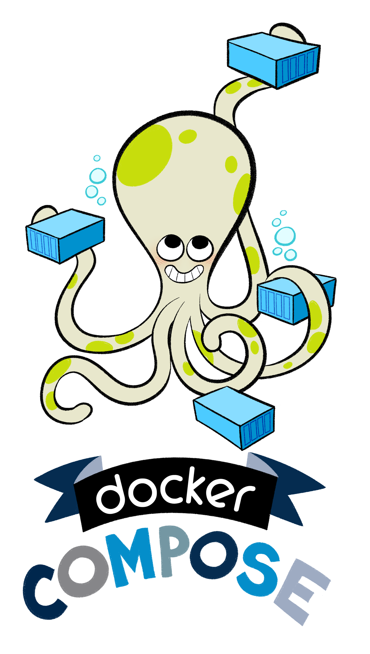
Overview
So, we’ve seen a bit of it already, but what is Docker Compose?
“Docker Compose is a tool for defining and running complex applications with Docker. With Compose, you define a multi-container application in a single file, then spin your application up in a single command which does everything that needs to be done to get it running.”
— github.com/docker/compose
Notes:
Docker Compose is a tool for defining and running complex applications with Docker.
With Compose, you define a multi-container application in a single file, then spin your application up in a single command which does everything that needs to be done to get it running.
— github.com/docker/compose

Slide 183
Compose Introduction
When working with multiple containers, it can be difficult to manage starting, along with the configuration, of variables and links.
To solve this problem, Docker has a tool called Docker Compose, to manage the orchestration and launching of containers.
Notes:
We have two good ways to group components for development purposes and then clean them up when you want to start over.
This approach works fine for local development and grouping. In shared environments the best approach is to properly label your components (services, RCs, pods, etc) and delete them using labels, as above.

Slide 184
Compose Introduction
Docker Compose is based on a docker-compose.yml file.
This file defines all of the containers and settings you need to launch your set of clusters.
The properties map onto how you use the docker run commands, however, are now stored in source control and shared along with your code.
Notes:
We have two good ways to group components for development purposes and then clean them up when you want to start over.
This approach works fine for local development and grouping. In shared environments the best approach is to properly label your components (services, RCs, pods, etc) and delete them using labels, as above.

Slide 185
Getting to Know Compose
An application using Docker containers will typically consist of multiple containers
With Docker Compose, there is no need to write shell scripts to start your containers
All the containers are defined in a configuration file
Services, and then docker-compose script is used to start, stop, and restart the application
And all the services in that application, and all the containers within that service
Notes:
An application using Docker containers will typically consist of multiple containers.
With Docker Compose, there is no need to write shell scripts to start your containers.
All the containers are defined in a configuration file using
services, and then docker-compose script is used to start, stop, and restart the application and all the services in that application,
and all the containers within that service.
The complete list of commands is:

Slide 186
Compose Commands
Command | Description | Command | Description
build | Build or rebuild services | restart | Restart services
help | Get help on a command | rm | Remove stopped containers
kill | Kill containers | run | Run a one-off command
logs | View output from containers | scale | Set number of containers for services
port | Print the public port for a port binding | start | Start services
ps | List containers | stop | Stop services
pull | Pulls service images | up | Create and start containers
Notes:
The complete list of commands is:

Slide 187
Compose Commands
An application using Docker containers will typically consist of multiple containers
With Docker Compose, there is no need to write shell scripts to start your containers
All the containers are defined in a configuration file
Services, and then docker-compose script is used to start, stop, and restart the application
And all the services in that application, and all the containers within that service
Notes:
The complete list of commands is:

Slide 188
Installation of Docker Compose

Slide 189
Installation of Docker Compose
You can run Compose on macOS, Windows, and 64-bit Linux
Prerequisites
Docker Compose relies on Docker Engine for any meaningful work, so make sure you have Docker Engine installed either locally or remote, depending on your setup
On desktop systems like Docker for Mac and Windows, Docker Compose is included as part of those desktop installs
On Linux systems, first install the Docker for your OS as described on the Get Docker page, then come back here for instructions on installing Compose on Linux systems
To run Compose as a non-root user, see ”Manage Docker as a non-root user”
Notes:
Install Docker Compose
You can run Compose on macOS, Windows, and 64-bit Linux.
Prerequisites
Docker Compose relies on Docker Engine for any meaningful work, so make sure you have Docker Engine installed either locally or remote, depending on your setup.
On desktop systems like Docker for Mac and Windows, Docker Compose is included as part of those desktop installs.
On Linux systems, first install the Docker for your OS as described on the Get Docker page, then come back here for instructions on installing Compose on Linux systems.
To run Compose as a non-root user, see Manage Docker as a non-root user.
SOURCE:
https://docs.docker.com/compose/install/

Slide 190
Installation of Docker Compose on Linux
On Linux, you can download the Docker Compose binary
Run this command to download the latest version of Docker Compose:
Apply executable permissions to the binary:
Optionally, install command completion for the bash and zsh shell.
Test the installation.
$ sudo curl -L https://github.com/docker/compose/releases/download/1.19.0/docker
-compose-`uname -s`-`uname -m` -o /usr/local/bin/docker-compose
$ sudo chmod +x /usr/local/bin/docker-compose
$ docker-compose --version
docker-compose version 1.19.0, build 1719ceb
Notes:
On Linux, you can download the Docker Compose binary
from the Compose repository release page on GitHub.
Run this command to download the latest version of Docker Compose:
sudo curl -L https://github.com/docker/compose/releases/download/1.19.0/docker-compose-`uname -s`-`uname -m` -o /usr/local/bin/docker-compose
SHARE:
Use the latest Compose release number in the download command.
The above command is an example, and it may become out-of-date. To ensure you have the latest version, check the Compose repository release page on GitHub.
If you have problems installing with curl, see Alternative Install Options tab above.
Apply executable permissions to the binary:
sudo chmod +x /usr/local/bin/docker-compose
Optionally, install command completion for the bash and zsh shell.
Test the installation.
$ docker-compose --version
Output:
docker-compose version 1.19.0, build 1719ceb
SOURCE:
https://docs.docker.com/compose/install/

Slide 191
Docker Compose Configuration File

Slide 192
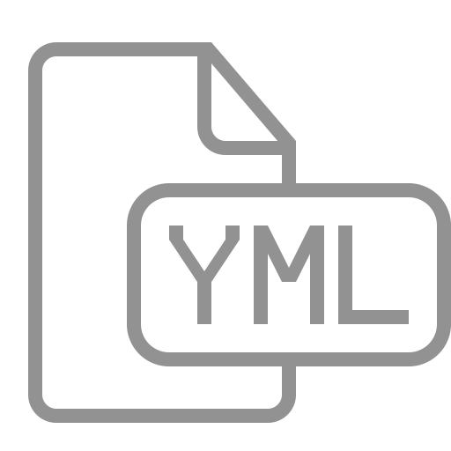
YAML Format
The format of YAML (Yet Another Markup Language), looks like this:
container_name:
property: value
- or options
Notes:
We have two good ways to group components for development purposes and then clean them up when you want to start over.
This approach works fine for local development and grouping. In shared environments the best approach is to properly label your components (services, RCs, pods, etc) and delete them using labels, as above.

Slide 193
Defining Our First Container
In this example, let’s say we have a Node.js application, which requires connecting to Redis.
To start, we need to define our docker-compose.yml file to launch the Node.js application.
Current Directory (.)
./
Dockerfile
Makerfile
docker-compose.yaml
node_modules/
redis/
.npmignore
README.md
connection_breaker.js
index.js
lib/
package.json
package.json
server.js
Notes:
We have two good ways to group components for development purposes and then clean them up when you want to start over.
This approach works fine for local development and grouping. In shared environments the best approach is to properly label your components (services, RCs, pods, etc) and delete them using labels, as above.

Slide 194
Formatting Basic
Given the format shared previously, the file needs to name the container 'web' and set the build property to the current directory.
web:
build: .
Copying the following code into our YAML file, will define a container called web, which is based on the build of the current directory.
NOTE: Remember we have a Node.js app in our current directory.
Notes:
We have two good ways to group components for development purposes and then clean them up when you want to start over.
This approach works fine for local development and grouping. In shared environments the best approach is to properly label your components (services, RCs, pods, etc) and delete them using labels, as above.

Slide 195
Defining Container Properties
Docker Compose supports all of the properties which can be defined using docker run.
To link two containers together to specify a links property and list required connections.
For example, the following would link to the redis source container defined in the same file and assign the same name to the alias.
links:
- redis
Notes:
We have two good ways to group components for development purposes and then clean them up when you want to start over.
This approach works fine for local development and grouping. In shared environments the best approach is to properly label your components (services, RCs, pods, etc) and delete them using labels, as above.

Slide 196
Defining Container Properties
The same format is used for other properties, such as ports:
ports:
- "3000”
- “3001”
- "8000"
Notes:
We have two good ways to group components for development purposes and then clean them up when you want to start over.
This approach works fine for local development and grouping. In shared environments the best approach is to properly label your components (services, RCs, pods, etc) and delete them using labels, as above.

Slide 197
First Container Overview
So, after all that, our yaml file would look something like this
This is just the very beginning!
web:
build: .
links:
- redis
ports:
- "3000"
- "3001"
- "8000"
Pretty
Cool, huh?
Notes:
We have two good ways to group components for development purposes and then clean them up when you want to start over.
This approach works fine for local development and grouping. In shared environments the best approach is to properly label your components (services, RCs, pods, etc) and delete them using labels, as above.

Slide 198
Building a Multi-Container Application

Slide 199
Defining a Second Container
In the previous step, we used the Dockerfile in the current directory (.) as the base for our container
In this step, we want to use an existing image from Docker Hub as a second container
To define the second container you simply use the same format as before on a new line
The YAML format is flexible enough to define multiple containers within the same file
Notes:
We have two good ways to group components for development purposes and then clean them up when you want to start over.
This approach works fine for local development and grouping. In shared environments the best approach is to properly label your components (services, RCs, pods, etc) and delete them using labels, as above.

Slide 200
Second Container Properties
Defining the second container with the name redis, which will use the image redis. Following the YAML format, the container details would be:
redis:
image: redis:alpine
volumes: - /var/redis/data:/data
Notes:
We have two good ways to group components for development purposes and then clean them up when you want to start over.
This approach works fine for local development and grouping. In shared environments the best approach is to properly label your components (services, RCs, pods, etc) and delete them using labels, as above.

Slide 201
Starting Compose Up
With the docker-compose.yml file we created in place, you can launch all the applications with a single command of up, like this:
If you wanted to bring up a single container, then we could use up <name>.
docker compose up
docker compose up <name>
Notes:
We have two good ways to group components for development purposes and then clean them up when you want to start over.
This approach works fine for local development and grouping. In shared environments the best approach is to properly label your components (services, RCs, pods, etc) and delete them using labels, as above.

Slide 202
Docker Compose Management
Docker Compose starts containers, but it also provides a commands to manage all the containers.
To see the details of the launched containers we could use:
To access all the logs via a single snapshot stream we could use:
Other commands follow the same pattern, and as always can be seen by typing the command itself: docker-compose.
docker-compose ps
docker-compose logs
Notes:
We have two good ways to group components for development purposes and then clean them up when you want to start over.
This approach works fine for local development and grouping. In shared environments the best approach is to properly label your components (services, RCs, pods, etc) and delete them using labels, as above.

Slide 203
Scaling With Compose
Let’s talk about how Compose can also be used to scale up the number of running containers.
The scale option allows you to specify the service and then the number of instances you want.
If the number is greater than the instances already running, it will launch additional containers.
And if the number is less, it will stop the unrequired containers.
Notes:
We have two good ways to group components for development purposes and then clean them up when you want to start over.
This approach works fine for local development and grouping. In shared environments the best approach is to properly label your components (services, RCs, pods, etc) and delete them using labels, as above.

Slide 204
Scaling With Compose
To scale the number of web containers we're running we’d use this command:
And we could scale it back down using:
docker-compose scale web=3
docker-compose scale web=1
App
Notes:
We have two good ways to group components for development purposes and then clean them up when you want to start over.
This approach works fine for local development and grouping. In shared environments the best approach is to properly label your components (services, RCs, pods, etc) and delete them using labels, as above.

Slide 205
Stop and Remove
As when we launch an application with start, to stop a set of containers we can use the command:
And to remove all the containers we can use the command:
docker-compose stop
docker-compose rm
Notes:
We have two good ways to group components for development purposes and then clean them up when you want to start over.
This approach works fine for local development and grouping. In shared environments the best approach is to properly label your components (services, RCs, pods, etc) and delete them using labels, as above.

Slide 206
Multi-Container Application Management
manage apps spanning Multiple Containers

Slide 207
Multi-Container Application Using Compose

Slide 208
Multi-Container Application Using Compose
The application used in this section is a Java EE application talking to a database
The application publishes a REST endpoint that can be invoked using `curl’
It is deployed using WildFly Swarm that communicates to MySQL database.
WildFly Swarm and MySQL will be running in two separate containers, and thus making this a multi-container application
Notes:
BEWARE: TO DO THESE EXERCISES, YOU NEED TO CLONE:
git@Docker/labs
The application used in this section is a Java EE application talking to a database.
The application publishes a REST endpoint that can be invoked using `curl.
It is deployed using WildFly Swarm that communicates to MySQL database.
WildFly Swarm and MySQL will be running in two separate containers, and thus making this a multi-container application.

Slide 209
Multi-Container Application Using Compose
The entry point to Docker Compose is a Compose file, usually called docker-compose.yml
Create a new directory javaee. In that directory, create a new file docker-compose.yml in it.
Use the following contents:
Reference: cs_09-35.yaml
Notes:
The entry point to Docker Compose is a Compose file, usually called docker-compose.yml.
Create a new directory javaee. In that directory, create a new file docker-compose.yml in it.
Use the following contents:
-------
version: '3.3' services: db: container_name: db image: mysql:8 environment: MYSQL_DATABASE: employees MYSQL_USER: mysql MYSQL_PASSWORD: mysql MYSQL_ROOT_PASSWORD: supersecret ports: - 3306:3306 web: image: arungupta/docker-javaee:dockerconeu17 ports: - 8080:8080 - 9990:9990 depends_on: - db
-------

Slide 210
Our Compose File
Two services in this Compose are defined by the name db and web attributes
Image name for each service defined using image attribute
The mysql:8 image starts the MySQL server
Environment attribute defines environment variables to initialize MySQL server
Java EE application uses the db service as specified in the connection-url as specified
The arungupta/docker-javaee:dockerconeu17 image starts WildFly Swarm application server
Port forwarding is achieved using ports attribute
depends_on attribute allows to express dependency between services
Notes:
In this Compose file:
Two services in this Compose are defined by the name db and web attributes
Image name for each service defined using image attribute
The mysql:8 image starts the MySQL server.
environment attribute defines environment variables to initialize MySQL server.
SHARE:
- MYSQL_DATABASE allows you to specify the name of a database to be created on image startup.
- MYSQL_USER and MYSQL_PASSWORD are used in conjunction to create a new user and to set that user’s password. This user will be granted superuser permissions for the database specified by the MYSQL_DATABASE variable.
- MYSQL_ROOT_PASSWORD is mandatory and specifies the password that will be set for the MySQL root superuser account.
Java EE application uses the db service as specified in the connection-url as specified
at https://github.com/arun-gupta/docker-javaee/blob/master/employees/src/main/resources/project-defaults.yml/.
The arungupta/docker-javaee:dockerconeu17 image starts WildFly Swarm application server.
SHARE:
It consists of the Java EE application built from https://github.com/arun-gupta/docker-javaee.
Clone that project if you want to build your own image.
Port forwarding is achieved using ports attribute.
depends_on attribute allows to express dependency between services.
SHARE:
In this case, MySQL will be started before WildFly. Application-level health check are still user’s responsibility.

Slide 211
Start Our Application
All services in the application can be started, in detached mode, by giving the command:
An alternate Compose file name can be specified using -f option
An alternate directory where the compose file exists can be specified using -p option
This shows the output as:
$ docker-compose up -d
Creating network "javaee_default" with the default driver
Creating db ...
Creating db ... done
Creating javaee_web_1 ...
Creating javaee_web_1 ... done
Notes:
Start application
All services in the application can be started, in detached mode, by giving the command:
docker-compose up -d
An alternate Compose file name can be specified using -f option.
An alternate directory where the compose file exists can be specified using -p option.
This shows the output as:
docker-compose up -d
Output:
Creating network "javaee_default" with the default driver
Creating db ...
Creating db ... done
Creating javaee_web_1 ...
Creating javaee_web_1 ... done
SHARE:
The output may differ slightly if the images are downloaded as well.
Started services can be verified using the command docker-compose ps:
Name Command State Ports
------------------------------------------------------------------------------------------------------
db docker-entrypoint.sh mysqld Up 0.0.0.0:3306->3306/tcp
javaee_web_1 /bin/sh -c java -jar /opt/ ... Up 0.0.0.0:8080->8080/tcp, 0.0.0.0:9990->9990/tcp
This provides a consolidated view of all the services, and containers within each of them.
Alternatively, the containers in this application, and any additional containers running on this Docker host can be verified by using the usual docker container ls command:
Name Command State Ports
------------------------------------------------------------------------------------------------------
db docker-entrypoint.sh mysqld Up 0.0.0.0:3306->3306/tcp
javaee_web_1 /bin/sh -c java -jar /opt/ ... Up 0.0.0.0:8080->8080/tcp, 0.0.0.0:9990->9990/tcp
javaee $ docker container ls
CONTAINER ID IMAGE COMMAND CREATED STATUS PORTS NAMES
e862a5eb9484 arungupta/docker-javaee:dockerconeu17 "/bin/sh -c 'java ..." 38 seconds ago Up 36 seconds 0.0.0.0:8080->8080/tcp, 0.0.0.0:9990->9990/tcp javaee_web_1 08792c20c066 mysql:8 "docker-entrypoint..." 39 seconds ago Up 37 seconds 0.0.0.0:3306->3306/tcp db
Service logs can be seen using docker-compose logs command, and looks like:
Attaching to dockerjavaee_web_1, db
web_1 | 23:54:21,584 INFO [org.jboss.msc] (main) JBoss MSC version 1.2.6.Final
web_1 | 23:54:21,688 INFO [org.jboss.as] (MSC service thread 1-8) WFLYSRV0049: WildFly Core 2.0.10.Final "Kenny" starting
web_1 | 2017-10-06 23:54:22,687 INFO [org.wildfly.extension.io] (ServerService Thread Pool -- 20) WFLYIO001: Worker 'default' has auto-configured to 8 core threads with 64 task threads based on your 4 available processors . . .
web_1 | 2017-10-06 23:54:23,259 INFO [org.jboss.as.connector.subsystems.datasources] (MSC service thread 1-3) WFLYJCA0001: Bound data source [java:jboss/datasources/ExampleDS]
web_1 | 2017-10-06 23:54:24,962 INFO [org.jboss.as] (Controller Boot Thread) WFLYSRV0025: WildFly Core 2.0.10.Final "Kenny" started in 3406ms - Started 112 of 124 services (21 services are lazy, passive or on-demand)
web_1 | 2017-10-06 23:54:25,020 INFO [org.wildfly.extension.undertow] (MSC service thread 1-4) WFLYUT0006: Undertow HTTP listener default listening on 0.0.0.0:8080
web_1 | 2017-10-06 23:54:26,146 INFO [org.wildfly.swarm.runtime.deployer] (main) deploying docker-javaee.war
web_1 | 2017-10-06 23:54:26,169 INFO [org.jboss.as.server.deployment] (MSC service thread 1-3) WFLYSRV0027: Starting deployment of "docker-javaee.war" (runtime-name: "docker-javaee.war")
web_1 | 2017-10-06 23:54:27,748 INFO [org.jboss.as.jpa] (MSC service thread 1-2) WFLYJPA0002: Read persistence.xml for MyPU
web_1 | 2017-10-06 23:54:27,887 WARN [org.jboss.as.dependency.private] (MSC service thread 1-7) WFLYSRV0018: Deployment "deployment.docker-javaee.war" is using a private module ("org.jboss.jts:main") which may be changed or removed in future versions without notice. . . .
web_1 | 2017-10-06 23:54:29,128 INFO [stdout] (ServerService Thread Pool -- 4) Hibernate: create table EMPLOYEE_SCHEMA (id integer not null, name varchar(40), primary key (id))
web_1 | 2017-10-06 23:54:29,132 INFO [stdout] (ServerService Thread Pool -- 4) Hibernate: INSERT INTO EMPLOYEE_SCHEMA(ID, NAME) VALUES (1, 'Penny')
web_1 | 2017-10-06 23:54:29,133 INFO [stdout] (ServerService Thread Pool -- 4) Hibernate: INSERT INTO EMPLOYEE_SCHEMA(ID, NAME) VALUES (2, 'Sheldon')
web_1 | 2017-10-06 23:54:29,133 INFO [stdout] (ServerService Thread Pool -- 4) Hibernate: INSERT INTO EMPLOYEE_SCHEMA(ID, NAME) VALUES (3, 'Amy')
web_1 | 2017-10-06 23:54:29,133 INFO [stdout] (ServerService Thread Pool -- 4) Hibernate: INSERT INTO EMPLOYEE_SCHEMA(ID, NAME) VALUES (4, 'Leonard') . . .
web_1 | 2017-10-06 23:54:30,050 INFO [org.wildfly.extension.undertow] (ServerService Thread Pool -- 4) WFLYUT0021: Registered web context: /
web_1 | 2017-10-06 23:54:30,518 INFO [org.jboss.as.server] (main) WFLYSRV0010: Deployed "docker-javaee.war" (runtime-name : "docker-javaee.war")
web_1 | 2017-10-06 23:56:01,766 INFO [stdout] (default task-1) Hibernate: select employee0_.id as id1_0_, employee0_.name as name2_0_ from EMPLOYEE_SCHEMA employee0_
db | Initializing database
. . .
db |
db |
db | MySQL init process done. Ready for start up.
db |
. . .
db | 2017-10-06T23:54:29.434423Z 0 [Note] /usr/sbin/mysqld: ready for connections. Version: '8.0.3-rc-log' socket: '/var/run/mysqld/mysqld.sock' port: 3306 MySQL Community Server (GPL)
db | 2017-10-06T23:54:30.281973Z 0
[Note] InnoDB: Buffer pool(s) load completed at 171006 23:54:30
depends_on attribute in the Compose definition file ensures the container start up order.
But application-level start up needs to be ensured by the applications running inside container.
In our case, this can be achieved by WildFly Swarm using swarm.datasources.data-sources.KEY.stale-connection-checker-class-name as defined at https://reference.wildfly-swarm.io/fractions/datasources.html.

Slide 212
Start Our Application
We’ve learned we can be verify using docker-compose ps
This provides a consolidated view of all the services, and containers within each of them
Alternatively, the containers in this application are verified by using the usual docker container ls command
Service logs can be seen using docker-compose logs command
depends_on attribute in the Compose definition file ensures the container start up order
Notes:
Start application
Started services can be verified using the command docker-compose ps:
SHARE:
Name Command State Ports
------------------------------------------------------------------------------------------------------
db docker-entrypoint.sh mysqld Up 0.0.0.0:3306->3306/tcp
javaee_web_1 /bin/sh -c java -jar /opt/ ... Up 0.0.0.0:8080->8080/tcp, 0.0.0.0:9990->9990/tcp
This provides a consolidated view of all the services, and containers within each of them.
Alternatively, the containers in this application, and any additional containers running on this Docker host can be verified by using the usual docker container ls command:
SHARE:
Name Command State Ports
------------------------------------------------------------------------------------------------------
db docker-entrypoint.sh mysqld Up 0.0.0.0:3306->3306/tcp
javaee_web_1 /bin/sh -c java -jar /opt/ ... Up 0.0.0.0:8080->8080/tcp, 0.0.0.0:9990->9990/tcp
javaee $ docker container ls
CONTAINER ID IMAGE COMMAND CREATED STATUS PORTS NAMES
e862a5eb9484 arungupta/docker-javaee:dockerconeu17 "/bin/sh -c 'java ..." 38 seconds ago Up 36 seconds 0.0.0.0:8080->8080/tcp, 0.0.0.0:9990->9990/tcp javaee_web_1 08792c20c066 mysql:8 "docker-entrypoint..." 39 seconds ago Up 37 seconds 0.0.0.0:3306->3306/tcp db
Service logs can be seen using docker-compose logs command, and looks like:
SHARE:
Reference: cs_09-38.bash – if you want to share outpu with students
Attaching to dockerjavaee_web_1, db
web_1 | 23:54:21,584 INFO [org.jboss.msc] (main) JBoss MSC version 1.2.6.Final
web_1 | 23:54:21,688 INFO [org.jboss.as] (MSC service thread 1-8) WFLYSRV0049: WildFly Core 2.0.10.Final "Kenny" starting
web_1 | 2017-10-06 23:54:22,687 INFO [org.wildfly.extension.io] (ServerService Thread Pool -- 20) WFLYIO001: Worker 'default' has auto-configured to 8 core threads with 64 task threads based on your 4 available processors . . .
web_1 | 2017-10-06 23:54:23,259 INFO [org.jboss.as.connector.subsystems.datasources] (MSC service thread 1-3) WFLYJCA0001: Bound data source [java:jboss/datasources/ExampleDS]
web_1 | 2017-10-06 23:54:24,962 INFO [org.jboss.as] (Controller Boot Thread) WFLYSRV0025: WildFly Core 2.0.10.Final "Kenny" started in 3406ms - Started 112 of 124 services (21 services are lazy, passive or on-demand)
web_1 | 2017-10-06 23:54:25,020 INFO [org.wildfly.extension.undertow] (MSC service thread 1-4) WFLYUT0006: Undertow HTTP listener default listening on 0.0.0.0:8080
web_1 | 2017-10-06 23:54:26,146 INFO [org.wildfly.swarm.runtime.deployer] (main) deploying docker-javaee.war
web_1 | 2017-10-06 23:54:26,169 INFO [org.jboss.as.server.deployment] (MSC service thread 1-3) WFLYSRV0027: Starting deployment of "docker-javaee.war" (runtime-name: "docker-javaee.war")
web_1 | 2017-10-06 23:54:27,748 INFO [org.jboss.as.jpa] (MSC service thread 1-2) WFLYJPA0002: Read persistence.xml for MyPU
web_1 | 2017-10-06 23:54:27,887 WARN [org.jboss.as.dependency.private] (MSC service thread 1-7) WFLYSRV0018: Deployment "deployment.docker-javaee.war" is using a private module ("org.jboss.jts:main") which may be changed or removed in future versions without notice. . . .
web_1 | 2017-10-06 23:54:29,128 INFO [stdout] (ServerService Thread Pool -- 4) Hibernate: create table EMPLOYEE_SCHEMA (id integer not null, name varchar(40), primary key (id))
web_1 | 2017-10-06 23:54:29,132 INFO [stdout] (ServerService Thread Pool -- 4) Hibernate: INSERT INTO EMPLOYEE_SCHEMA(ID, NAME) VALUES (1, 'Penny')
web_1 | 2017-10-06 23:54:29,133 INFO [stdout] (ServerService Thread Pool -- 4) Hibernate: INSERT INTO EMPLOYEE_SCHEMA(ID, NAME) VALUES (2, 'Sheldon')
web_1 | 2017-10-06 23:54:29,133 INFO [stdout] (ServerService Thread Pool -- 4) Hibernate: INSERT INTO EMPLOYEE_SCHEMA(ID, NAME) VALUES (3, 'Amy')
web_1 | 2017-10-06 23:54:29,133 INFO [stdout] (ServerService Thread Pool -- 4) Hibernate: INSERT INTO EMPLOYEE_SCHEMA(ID, NAME) VALUES (4, 'Leonard') . . .
web_1 | 2017-10-06 23:54:30,050 INFO [org.wildfly.extension.undertow] (ServerService Thread Pool -- 4) WFLYUT0021: Registered web context: /
web_1 | 2017-10-06 23:54:30,518 INFO [org.jboss.as.server] (main) WFLYSRV0010: Deployed "docker-javaee.war" (runtime-name : "docker-javaee.war")
web_1 | 2017-10-06 23:56:01,766 INFO [stdout] (default task-1) Hibernate: select employee0_.id as id1_0_, employee0_.name as name2_0_ from EMPLOYEE_SCHEMA employee0_
db | Initializing database
. . .
db |
db |
db | MySQL init process done. Ready for start up.
db |
. . .
db | 2017-10-06T23:54:29.434423Z 0 [Note] /usr/sbin/mysqld: ready for connections. Version: '8.0.3-rc-log' socket: '/var/run/mysqld/mysqld.sock' port: 3306 MySQL Community Server (GPL)
db | 2017-10-06T23:54:30.281973Z 0
[Note] InnoDB: Buffer pool(s) load completed at 171006 23:54:30
depends_on attribute in the Compose definition file ensures the container start up order.
SHARE:
But application-level start up needs to be ensured by the applications running inside container.
In our case, this can be achieved by WildFly Swarm using swarm.datasources.data-sources.KEY.stale-connection-checker-class-name as defined at https://reference.wildfly-swarm.io/fractions/datasources.html.

Slide 213
Verify Our Application
Now that the WildFly Swarm and MySQL have been configured, let’s access the application!
You need to specify IP address of the host where WildFly is running
The endpoint can be accessed in this case as:
The output is shown as:
This shows the result from querying the database
Um, what if we just want one?
$ curl -v http://localhost:8080/resources/employees
Reference: cs_09-39.bash
Notes:
Verify application
Now that the WildFly Swarm and MySQL have been configured, let’s access the application.
You need to specify IP address of the host where WildFly is running (localhost in our case).
The endpoint can be accessed in this case as:
curl -v http://localhost:8080/resources/employees
The output is shown as:
curl -v http://localhost:8080/resources/employees
Trying ::1...
* TCP_NODELAY set
* Connected to localhost (::1) port 8080 (#0)
> GET /resources/employees HTTP/1.1
> Host: localhost:8080
> User-Agent: curl/7.51.0
> Accept: */*
>
< HTTP/1.1 200 OK
< Connection: keep-alive
< Content-Type: application/xml
< Content-Length: 478
< Date: Sat, 07 Oct 2017 00:05:41 GMT
<
* Curl_http_done: called premature == 0
* Connection #0 to host localhost left intact
<?xml version="1.0" encoding="UTF-8" standalone="yes"?><collection><employee><id>1</id><name>Penny</name></employee><employee><id>2</id><name>Sheldon</name></employee><employee><id>3</id><name>Amy</name></employee><employee><id>4</id><name>Leonard</name></employee><employee><id>5</id><name>Bernadette</name></employee><employee><id>6</id><name>Raj</name></employee><employee><id>7</id><name>Howard</name></employee><employee><id>8</id><name>Priya</name></employee></collection>
This shows the result from querying the database.
A single resource can be obtained:
curl -v http://localhost:8080/resources/employees/1
It shows the output:
curl -v http://localhost:8080/resources/employees/1
Trying ::1...
* TCP_NODELAY set
* Connected to localhost (::1) port 8080 (#0)
> GET /resources/employees/1 HTTP/1.1
> Host: localhost:8080
> User-Agent: curl/7.51.0
> Accept: */*
>
< HTTP/1.1 200 OK
< Connection: keep-alive
< Content-Type: application/xml
< Content-Length: 104
< Date: Sat, 07 Oct 2017 00:06:33 GMT
< * Curl_http_done: called premature == 0 * Connection #0 to host localhost left intact
<?xml version="1.0" encoding="UTF-8" standalone="yes"?><employee><id>1</id><name>Penny</name></employee>

Slide 214
Verify Our Application
A single resource can be obtained:
It shows the output:
$ curl -v http://localhost:8080/resources/employees/1
Reference: cs_09-40.bash
Trying ::1...
* TCP_NODELAY set
* Connected to localhost (::1) port 8080 (#0)
> GET /resources/employees/1 HTTP/1.1
> Host: localhost:8080
> User-Agent: curl/7.51.0
> Accept: */*
>
< HTTP/1.1 200 OK
< Connection: keep-alive
< Content-Type: application/xml
< Content-Length: 104
< Date: Sat, 07 Oct 2017 00:06:33 GMT
< * Curl_http_done: called premature == 0 * Connection #0 to host localhost left intact
<?xml version="1.0" encoding="UTF-8" standalone="yes"?><employee><id>1</id><name>Penny</name></employee>
Notes:
Verify application
A single resource can be obtained:
curl -v http://localhost:8080/resources/employees/1
Reference: cs_09-40.bash – for larger print to share with students
It shows the output:
curl -v http://localhost:8080/resources/employees/1
Trying ::1...
* TCP_NODELAY set
* Connected to localhost (::1) port 8080 (#0)
> GET /resources/employees/1 HTTP/1.1
> Host: localhost:8080
> User-Agent: curl/7.51.0
> Accept: */*
>
< HTTP/1.1 200 OK
< Connection: keep-alive
< Content-Type: application/xml
< Content-Length: 104
< Date: Sat, 07 Oct 2017 00:06:33 GMT
< * Curl_http_done: called premature == 0 * Connection #0 to host localhost left intact
<?xml version="1.0" encoding="UTF-8" standalone="yes"?><employee><id>1</id><name>Penny</name></employee>

Slide 215
Shutdown Our Application
Shutdown the application using docker-compose down:
This stops the container in each service and removes all the services
It also deletes any networks that were created as part of this application.
Stopping javaee_web_1 ... done
Stopping db ... done
Removing javaee_web_1 ... done
Removing db ... done
Removing network javaee_default
Notes:
Shutdown application
Shutdown the application using docker-compose down:
Stopping javaee_web_1 ... done
Stopping db ... done
Removing javaee_web_1 ... done
Removing db ... done
Removing network javaee_default
This stops the container in each service and removes all the services.
It also deletes any networks that were created as part of this application.

Slide 216
Multi-Container Application Using Compose and Swarm Mode

Slide 217
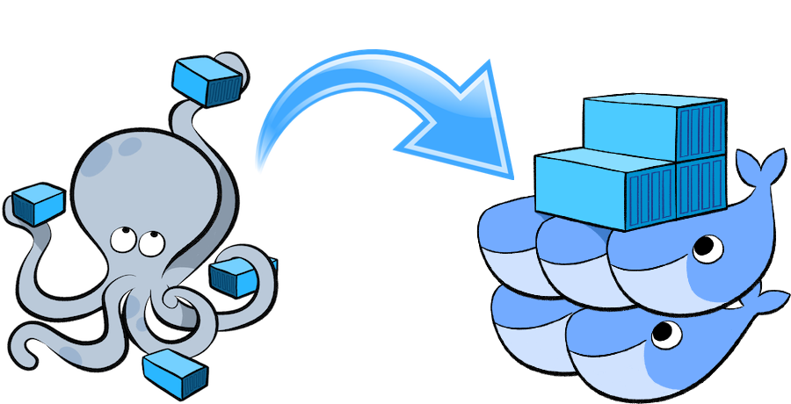
Multi-Container Application Using Swarm
This section will deploy an application that will provide a CRUD/REST interface on a data bucket in MySQL
This is achieved by using a Java EE application deployed on WildFly to access the database
Initialize Swarm
Initialize Swarm mode using the following command:
This starts a Swarm Manager!
$ docker swarm init
Notes:
BEWARE: TO DO THESE EXERCISES, YOU NEED TO CLONE:
git@Docker/labs
This section will deploy an application that will provide a CRUD/REST interface on a data bucket in MySQL.
This is achieved by using a Java EE application deployed on WildFly to access the database.
Initialize Swarm
Initialize Swarm mode using the following command:
docker swarm init
This starts a Swarm Manager.
SHARE:
By default, a manager node is also a worker but can be configured to be a manager-only.

Slide 218
Multi-Container Application Using Swarm
Find some information about this one-node cluster using the command docker info
The log output is large, and gives extensive information as we’ve already seen:
This cluster has 1 node, and that is a manager
By default, the manager node is also a worker node
This means the containers can run on this node
Reference: cs_09-info.bash
Notes:
Initialize Swarm
Find some information about this one-node cluster using the command docker info
cs_09-info.bash
This cluster has 1 node, and that is a manager.
By default, the manager node is also a worker node.
This means the containers can run on this node.

Slide 219
Multi-Container Application Using Swarm
This section describes how to deploy a multi-container application using Docker Compose to Swarm mode use Docker CLI
Create a new directory and cd to it:
Create a new Compose definition docker-compose.yml using our previous configuration file:
$ mkdir webapp
$ cd webapp
Reference: cs_09-35.yaml
Notes:
Multi-container application
This section describes how to deploy a multi-container application using Docker Compose to Swarm mode use Docker CLI.
Create a new directory and cd to it:
mkdir webapp
cd webapp
Create a new Compose definition docker-compose.yml using Reference: cs_09-35.yaml

Slide 220
Multi-Container Application Using Swarm
This application can be started as:
This shows the output as:
WildFly Swarm and MySQL services are started on this node
A new overlay network is created
$ docker stack deploy --compose-file=docker-compose.yml webapp
Ignoring deprecated options:
container_name: Setting the container name is not supported.
Creating network webapp_default
Creating service webapp_db
Creating service webapp_web
Notes:
Multi-container application
This application can be started as:
docker stack deploy --compose-file=docker-compose.yml webapp
This shows the output as:
Ignoring deprecated options:
container_name: Setting the container name is not supported.
Creating network webapp_default
Creating service webapp_db
Creating service webapp_web
WildFly Swarm and MySQL services are started on this node.
SHARE:
Each service has a single container. If the Swarm mode is enabled on multiple nodes then the containers will be distributed across them.
A new overlay network is created.
SHARE:
This can be verified using the command docker network ls. This network allows multiple containers on different hosts to communicate with each other.

Slide 221
Verify Service and Containers in Application
Based on our previous work with Compose, how can we verify our service and containers application?
Verify that the WildFly and MySQL services are running using docker service ls
More details about the service can be obtained using docker service inspect webapp_web
Logs for the service can be seen using docker service logs -f webapp_web
Notes:
Verify service and containers in application
SHARE:
Verify that the WildFly and MySQL services are running using docker service ls:
ID NAME MODE REPLICAS IMAGE PORTS
j21lwelj529f webapp_db replicated 1/1 mysql:8 *:3306->3306/tcp m0m44axt35cg webapp_web replicated 1/1 arungupta/docker-javaee:dockerconeu17 *:8080->8080/tcp,*:9990->9990/tcp
More details about the service can be obtained using docker service inspect webapp_web:
cs_09-inspect.bash
Logs for the service can be seen using docker service logs -f webapp_web:
cs_09-logs.bash
Make sure to wait for the last log statement to show.

Slide 222
Access Application
Now that the WildFly and MySQL servers have been configured, let’s access the application
You need to specify IP address of the host where WildFly is running
The endpoint can be accessed in this case as:
The output is shown as:
This shows all employees stored in the database!
$ curl -v http://localhost:8080/resources/employees
Reference: cs_09-curl.bash
Notes:
Access application
Now that the WildFly and MySQL servers have been configured, let’s access the application.
You need to specify IP address of the host where WildFly is running (localhost in our case).
The endpoint can be accessed in this case as: curl -v http://localhost:8080/resources/employees
The output is shown as:
cs_09-curl.bash
This shows all employees stored in the database.

Slide 223
Multi-Container Application Using Swarm
If you only want to stop the application temporarily while keeping any networks that were created as part of this application, you can:
...the recommended way is to set the amount of service replicas to 0
It shows the output:
$ docker service scale webapp_db=0 webapp_web=0
webapp_db scaled to 0
webapp_web scaled to 0
Since --detach=false was not specified, tasks will be scaled in the background.
In a future release, --detach=false will become the default.
Notes:
Stop application
If you only want to stop the application temporarily while keeping any networks that were created as part of this application, the recommended way is to set the amount of service replicas to 0.
docker service scale webapp_db=0 webapp_web=0
It shows the output:
webapp_db scaled to 0
webapp_web scaled to 0
Since --detach=false was not specified, tasks will be scaled in the background.
In a future release, --detach=false will become the default.
SHARE:
This is especially useful if the stack contains volumes and you want to keep the data. It allows you to simply start the stack again with setting the replicas to a number higher than 0.

Slide 224
Multi-Container Application Using Swarm
Shutdown the application using docker stack rm webapp:
Output:
This stops the container in each service and removes the services. It also deletes any networks that were created as part of this application
Removing service webapp_db
Removing service webapp_web
Removing network webapp_default
Notes:
Remove application completely
Shutdown the application using docker stack rm webapp:
Removing service webapp_db
Removing service webapp_web
Removing network webapp_default
This stops the container in each service and removes the services. It also deletes any networks that were created as part of this application.

Slide 225
Hands-on Exercise(s)

Slide 226
End of Chapter

Slide 227
Docker on the Cloud
manage builds, swarms, Infrastructure, and nodes

Slide 228
Introduction to Docker Cloud

Slide 229
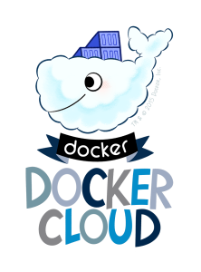
Introduction to Docker Cloud
Docker says:
“Docker Cloud provides a hosted service with build and testing
facilities for Dockerized application images; tools to help you
set up and manage host infrastructure; and application
lifecycle features to automate deploying services created
from images.”
Notes:
Docker Cloud provides a hosted registry service with build and testing facilities for Dockerized application images;
tools to help you set up and manage host infrastructure;
and application lifecycle features to automate deploying (and redeploying) services created from images.

Slide 230
What is a node?
A node is an individual Linux host used to deploy and run your applications
Docker Cloud does not provide hosting services, so all of your applications, services, and containers run on your own hosts
Your hosts can come from several different sources, including physical servers, virtual machines or cloud providers
Notes:
Introducing Docker Cloud
What is a node?
A node is an individual Linux host used to deploy and run your applications.
Docker Cloud does not provide hosting services, so all of your applications, services, and containers run on your own hosts.
Your hosts can come from several different sources, including physical servers, virtual machines or cloud providers.

Slide 231

What is a node cluster?
When launching a node from a cloud provider you actually create a node cluster
Node Clusters are groups of nodes of the same type and from the same cloud provider
Node clusters allow you to scale the infrastructure by provisioning more nodes with a drag of a slider
Pretty cool, huh?
Notes:
What is a node cluster?
When launching a node from a cloud provider you actually create a node cluster.
Node Clusters are groups of nodes of the same type and from the same cloud provider.
Node clusters allow you to scale the infrastructure by provisioning more nodes with a drag of a slider.

Slide 232
What is a node cluster?
Use cloud service providers
Docker Cloud makes it easy to provision nodes from existing cloud providers
You can provision new nodes directly from within Docker Cloud
Native support for AWS, DigitalOcean, Azure, Packet.net, and IBM SoftLayer.
Use your own hosts (“Bring your own nodes”)
You can also provide your own node or nodes
This means you can use any Linux host connected to the Internet as a Docker Cloud node as long as you can install a Cloud agent
The agent registers itself with your Docker account, and allows you to use Docker Cloud to deploy containerized applications
Notes:
Use cloud service providers
Docker Cloud makes it easy to provision nodes from existing cloud providers.
If you already have an account with an infrastructure as a service provider, you can provision new nodes directly from within Docker Cloud.
Today we have native support for Amazon Web Services, DigitalOcean, Microsoft Azure, Packet.net, and IBM SoftLayer.
Use your own hosts (“Bring your own nodes”)
You can also provide your own node or nodes.
This means you can use any Linux host connected to the Internet as a Docker Cloud node as long as you can install a Cloud agent.
The agent registers itself with your Docker account, and allows you to use Docker Cloud to deploy containerized applications.

Slide 233
What is a service?
Services are logical groups of containers from the same image
Services make it simple to scale your application across different nodes
In Docker Cloud you drag a slider to increase or decrease the availability, performance, and redundancy of the application
Services can also be linked one to another even if they are deployed on different nodes, regions, or even cloud providers
Notes:
What is a service?
Services are logical groups of containers from the same image.
Services make it simple to scale your application across different nodes.
In Docker Cloud you drag a slider to increase or decrease the availability, performance, and redundancy of the application.
Services can also be linked one to another even if they are deployed on different nodes, regions, or even cloud providers.

Slide 234
Docker ID
Docker Cloud uses your Docker ID for access and access control, and this allows you to link your Hub and Cloud accounts.
If you already have an account on Docker Hub, you can use the same credentials to log in to Docker Cloud.
If you don’t have a Docker ID yet, you can sign up for one from the Cloud website
Or using the docker login command in the Docker CLI.
The name you choose for your Docker ID becomes part of your account namespace
Notes:
SHARE:
Let’s get started! To work with Docker Cloud we first need a Docker ID.
(These are the same credentials you used for Docker Hub if you had an account there.)
DOCKER ID
Docker Cloud uses your Docker ID for access and access control, and this allows you to link your Hub and Cloud accounts.
If you already have an account on Docker Hub, you can use the same credentials to log in to Docker Cloud.
If you don’t have a Docker ID yet, you can sign up for one from the Cloud website
Or using the docker login command in the Docker CLI.
The name you choose for your Docker ID becomes part of your account namespace.

Slide 235
Advantages of Docker on the Cloud

Slide 236
Images, Builds, and Testing
Docker Cloud uses the hosted Docker Cloud Registry
Allowing you to publish Dockerized images online, either publicly or privately
Docker Cloud can also store pre-built images
Or, link to your source code so it can build the code into Docker images
Optionally testing the resulting images before pushing them to a repository
Notes:
ADVANTAGE: 1
Images, Builds, and Testing
Docker Cloud uses the hosted Docker Cloud Registry,
which allows you to publish Dockerized images on the internet either publicly or privately.
Docker Cloud can also store pre-built images,
or link to your source code so it can build the code into Docker images,
and optionally test the resulting images before pushing them to a repository.

Slide 237
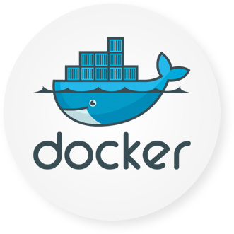
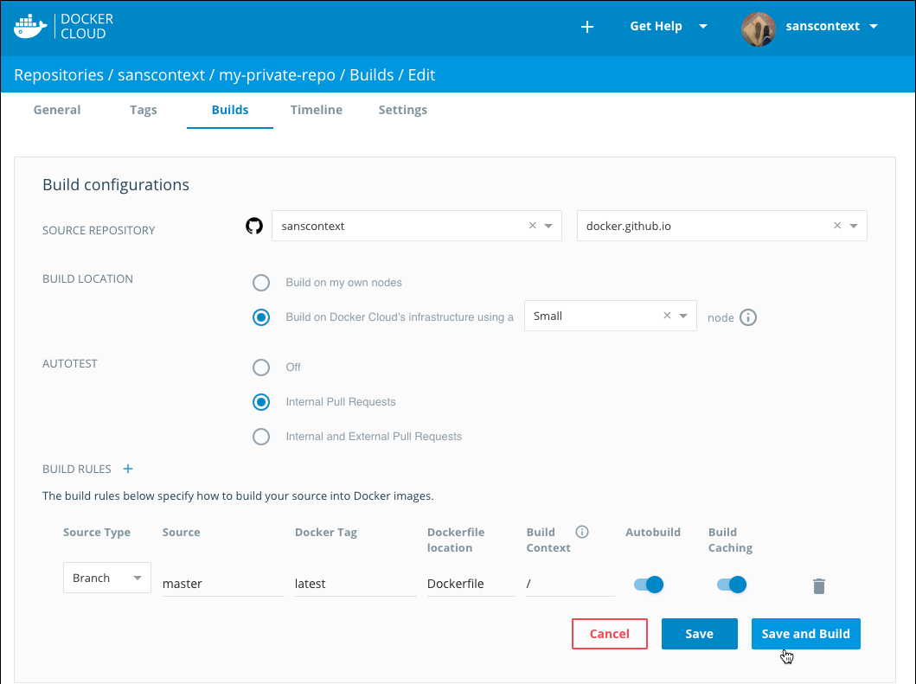
Images, Builds, and Testing
Notes:
ADVANTAGE: 1
Images, Builds, and Testing
Docker Cloud uses the hosted Docker Cloud Registry,
which allows you to publish Dockerized images on the internet either publicly or privately.
Docker Cloud can also store pre-built images,
or link to your source code so it can build the code into Docker images,
and optionally test the resulting images before pushing them to a repository.

Slide 238
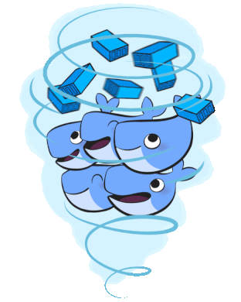
Swarm Management (Beta Swarm Mode)
With Beta Swarm Mode, you can create new swarms from within Docker Cloud
You can register existing swarms to Docker Cloud, or provision swarms to your cloud providers
Your Docker ID authenticates and securely accesses personal or team swarms
Docker Cloud allows you to connect your local Docker Engine to any swarm you have access to in Docker Cloud
Notes:
ADVANTAGE: 2
Swarm Management (Beta Swarm Mode)
With Beta Swarm Mode, you can create new swarms from within Docker Cloud,
register existing swarms to Docker Cloud, or provision swarms to your cloud providers.
Your Docker ID authenticates and securely accesses personal or team swarms.
Docker Cloud allows you to connect your local Docker Engine to any swarm you have access to in Docker Cloud.

Slide 239
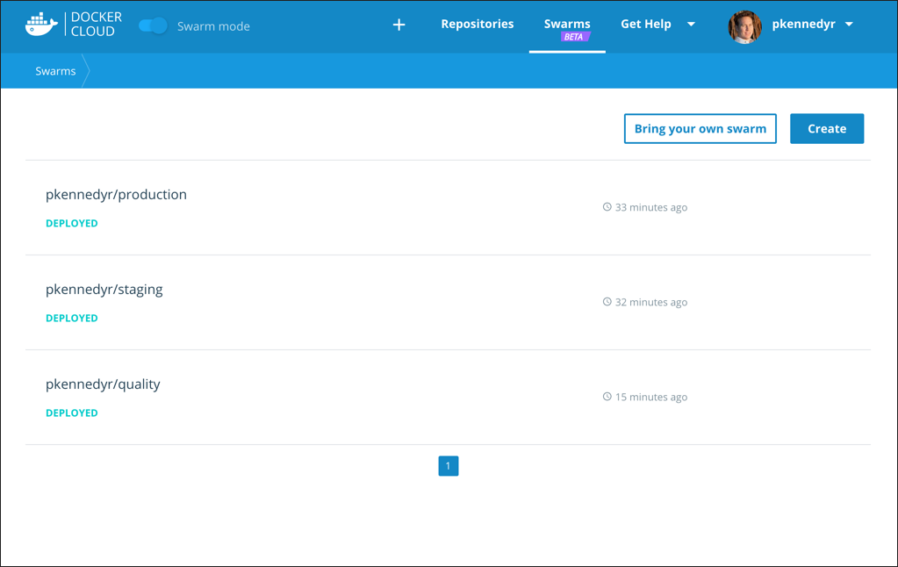
Swarm Management (Beta Swarm Mode)
Notes:
ADVANTAGE: 2
Swarm Management (Beta Swarm Mode)
With Beta Swarm Mode, you can create new swarms from within Docker Cloud,
register existing swarms to Docker Cloud, or provision swarms to your cloud providers.
Your Docker ID authenticates and securely accesses personal or team swarms.
Docker Cloud allows you to connect your local Docker Engine to any swarm you have access to in Docker Cloud.

Slide 240
Infrastructure management (Standard Mode)
Before doing anything with your images, you need somewhere to run them
Docker Cloud allows you to link to your infrastructure
Or, like to your cloud services provider so you can provision new nodes automatically
Once you have nodes set up, you can deploy images directly from Docker Cloud repositories
Notes:
ADVANTAGE: 2
Infrastructure management (Standard Mode)
Before you can do anything with your images, you need somewhere to run them.
Docker Cloud allows you to link to your infrastructure
cloud services provider so you can provision new nodes automatically.
Once you have nodes set up, you can deploy images directly from Docker Cloud repositories.

Slide 241
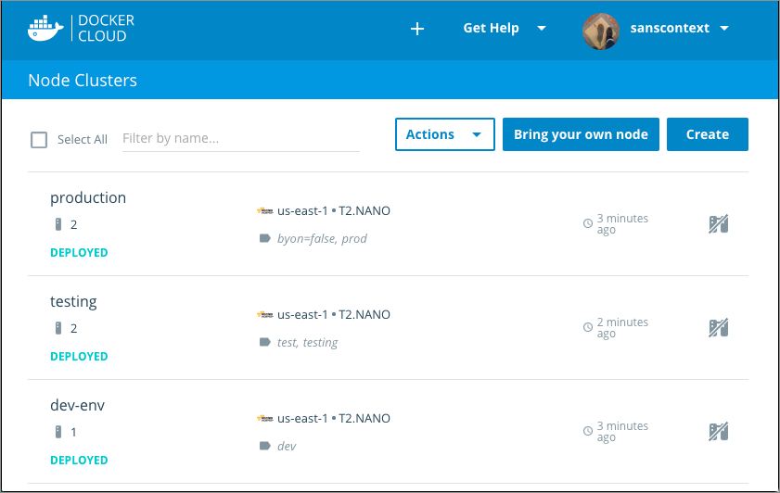
Infrastructure management (Standard Mode)
Notes:
ADVANTAGE: 2
Infrastructure management (Standard Mode)
Before you can do anything with your images, you need somewhere to run them.
Docker Cloud allows you to link to your infrastructure
cloud services provider so you can provision new nodes automatically.
Once you have nodes set up, you can deploy images directly from Docker Cloud repositories.

Slide 242
Services, Stacks, and Applications (Standard Mode)
Images are just one layer in containerized applications
Once you’ve built an image, you can use it to deploy services
Or, use Docker Cloud’s stackfiles to combine it with other services and microservices, to form a full application
Notes:
ADVANTAGE: 4 (Final one)
Services, Stacks, and Applications (Standard Mode)
Images are just one layer in containerized applications.
Once you’ve built an image, you can use it to deploy services (which are composed of one or more containers created from an image),
or use Docker Cloud’s stackfiles to combine it with other services and microservices, to form a full application.

Slide 243
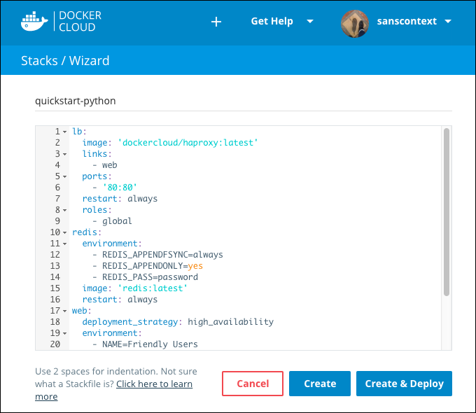
Services, Stacks, and Applications (Standard Mode)
Notes:
ADVANTAGE: 4 (Final one)
Services, Stacks, and Applications (Standard Mode)
Images are just one layer in containerized applications.
Once you’ve built an image, you can use it to deploy services (which are composed of one or more containers created from an image),
or use Docker Cloud’s stackfiles to combine it with other services and microservices, to form a full application.

Slide 244
Manage Builds & Images
Notes:
(1) Manage builds and images
Manage swarms (beta swarm mode)
Manage Infrastructure (standard mode)
Manage nodes and apps (standard mode)

Slide 245
Manage Builds & Images
Docker Cloud provides a hosted registry service where you can create repositories to store your Docker images
You can choose to push images to the repositories, or link to your source code and build them directly in Docker Cloud
You can build images manually, or set up automated builds to rebuild your Docker image on each git push to the source code
You can also create automated tests, and when the tests pass use autoredeploy to automatically update your running services when a build passes its tests
Notes:
Docker Cloud provides a hosted registry service where you can create repositories to store your Docker images.
You can choose to push images to the repositories, or link to your source code and build them directly in Docker Cloud.
You can build images manually, or set up automated builds to rebuild your Docker image on each git push to the source code.
You can also create automated tests, and when the tests pass use autoredeploy to automatically update your running services when a build passes its tests.
Repositories in Docker Cloud
Push images to Docker Cloud
Link to a source code repository
Automated builds
Docker Security Scanning
Automated repository tests
Advanced options for Autobuild and Autotest
THERE IS MORE TO DRAW FROM AT:
https://docs.docker.com/docker-cloud/builds/

Slide 246
Docker Cloud - Automated Builds
When you set up autobuilds, you create a list of branches and tags that you want to build into Docker images
When you push code to a source code branch for one of those listed image tags, the push uses a webhook to trigger a new build
The built image is then pushed to the Docker Cloud registry or to an external registry
Notes:
SHARE:
Docker Cloud can automatically build images from source code in an external repository and automatically push the built image to your Docker repositories.
When you set up automated builds (also called autobuilds), you create a list of branches and tags that you want to build into Docker images.
When you push code to a source code branch (for example in Github) for one of those listed image tags,
the push uses a webhook to trigger a new build, which produces a Docker image.
The built image is then pushed to the Docker Cloud registry or to an external registry.
SOURCE:
https://docs.docker.com/docker-cloud/builds/automated-build/

Slide 247
Docker Cloud - Automated Builds
If you have automated tests configured, these run after building but before pushing to the registry
Use these tests to create a CI workflow where a build that fails its tests does not push the built image
Automated tests do not push images to the registry on their own.
You can also just use docker push to push pre-built images to these repositories, even if you have automatic builds set up
Here’s a look at the Docker Cloud build dashboard...
Next,
Slide!
Notes:
If you have automated tests configured, these run after building but before pushing to the registry.
You can use these tests to create a continuous integration workflow where a build that fails its tests does not push the built image.
Automated tests do not push images to the registry on their own.
You can also just use docker push to push pre-built images to these repositories, even if you have automatic builds set up.
IMAGE:
build-dashboard.png
Configure automated build settings
You can configure repositories in Docker Cloud so that they automatically build an image each time you push new code to your source provider. If you have automated tests configured, the new image is only pushed when the tests succeed.
Before you set up automated builds you need to create a repository to build, and link to your source code provider.
1. From the Repositories section, click into a repository to view its details.
2. Click the Builds tab.
3. If you are setting up automated builds for the first time, select the code repository service where the image’s source code is stored.
Otherwise, if you are editing the build settings for an existing automated build, click Configure automated builds.
4. Select the source repository to build the Docker images from.
You might need to specify an organization or user (the namespace) from the source code provider. Once you select a namespace, its source code repositories appear in the Select repository dropdown list.
5. Choose where to run your build processes.
You can either run the process on your own infrastructure and optionally set up specific nodes to build on, or select Build on Docker Cloud’s infrastructure you can use the hosted build service offered on Docker Cloud’s infrastructure. If you use Docker’s infrastructure, select a builder size to run the build process on. This hosted build service is free while it is in Beta.
IMAGE:
edit-repository-builds.png
6. If in the previous step you selected Build on Docker Cloud’s infrastructure, then you are given the option to select the Docker Version used to build this repository. You can choose between the Stable and Edge versions of Docker.
Selecting Edge lets you to take advantage of multi-stage builds. For more information and examples, see the topic on how to use multi-stage builds.
You can learn more about stable and edge channels in the Install Docker overview and the Docker CE Edge topics.
7. Optionally, enable autotests.
8. Review the default Build Rules, and optionally click the plus sign to add and configure more build rules.
Build rules control what Docker Cloud builds into images from the contents of the source code repository, and how the resulting images are tagged within the Docker repository.
A default build rule is set up for you, which you can edit or delete. This default set builds from the Branch in your source code repository called master, and creates a Docker image tagged with latest.
9. For each branch or tag, enable or disable the Autobuild toggle.
Only branches or tags with autobuild enabled are built, tested, and have the resulting image pushed to the repository. Branches with autobuild disabled are built for test purposes (if enabled at the repository level), but the built Docker image is not pushed to the repository.
10. For each branch or tag, enable or disable the Build Caching toggle.
Build caching can save time if you are building a large image frequently or have many dependencies. You might want to leave build caching disabled to make sure all of your dependencies are resolved at build time, or if you have a large layer that is quicker to build locally.
11. Click Save to save the settings, or click Save and build to save and run an initial test.
A webhook is automatically added to your source code repository to notify Docker Cloud on every push. Only pushes to branches that are listed as the source for one or more tags trigger a build.
SOURCE:
https://docs.docker.com/docker-cloud/builds/automated-build/

Slide 248
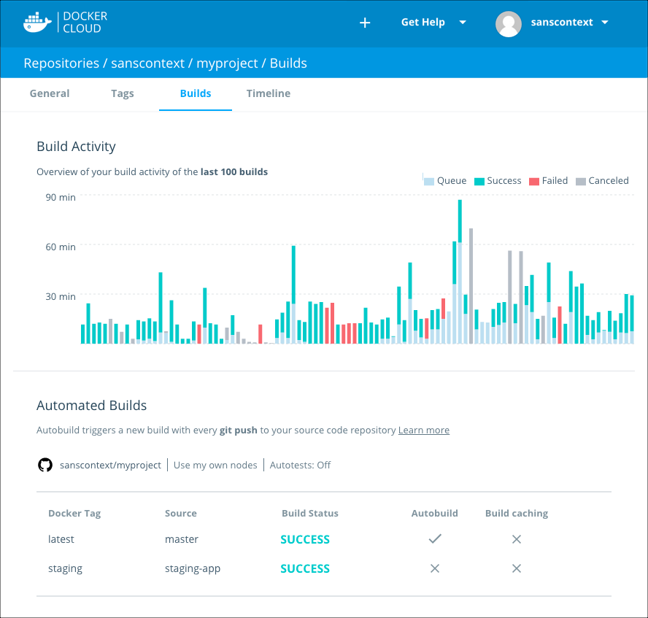
Docker Cloud – Automated Builds
Notes:
IMAGE:
build-dashboard.png
---- EXTRA - Possibly add in the future, or SHARE---
Configure automated build settings
You can configure repositories in Docker Cloud so that they automatically build an image each time you push new code to your source provider. If you have automated tests configured, the new image is only pushed when the tests succeed.
Before you set up automated builds you need to create a repository to build, and link to your source code provider.
1. From the Repositories section, click into a repository to view its details.
2. Click the Builds tab.
3. If you are setting up automated builds for the first time, select the code repository service where the image’s source code is stored.
Otherwise, if you are editing the build settings for an existing automated build, click Configure automated builds.
4. Select the source repository to build the Docker images from.
You might need to specify an organization or user (the namespace) from the source code provider. Once you select a namespace, its source code repositories appear in the Select repository dropdown list.
5. Choose where to run your build processes.
You can either run the process on your own infrastructure and optionally set up specific nodes to build on, or select Build on Docker Cloud’s infrastructure you can use the hosted build service offered on Docker Cloud’s infrastructure. If you use Docker’s infrastructure, select a builder size to run the build process on. This hosted build service is free while it is in Beta.
IMAGE:
edit-repository-builds.png
6. If in the previous step you selected Build on Docker Cloud’s infrastructure, then you are given the option to select the Docker Version used to build this repository. You can choose between the Stable and Edge versions of Docker.
Selecting Edge lets you to take advantage of multi-stage builds. For more information and examples, see the topic on how to use multi-stage builds.
You can learn more about stable and edge channels in the Install Docker overview and the Docker CE Edge topics.
7. Optionally, enable autotests.
8. Review the default Build Rules, and optionally click the plus sign to add and configure more build rules.
Build rules control what Docker Cloud builds into images from the contents of the source code repository, and how the resulting images are tagged within the Docker repository.
A default build rule is set up for you, which you can edit or delete. This default set builds from the Branch in your source code repository called master, and creates a Docker image tagged with latest.
9. For each branch or tag, enable or disable the Autobuild toggle.
Only branches or tags with autobuild enabled are built, tested, and have the resulting image pushed to the repository. Branches with autobuild disabled are built for test purposes (if enabled at the repository level), but the built Docker image is not pushed to the repository.
10. For each branch or tag, enable or disable the Build Caching toggle.
Build caching can save time if you are building a large image frequently or have many dependencies. You might want to leave build caching disabled to make sure all of your dependencies are resolved at build time, or if you have a large layer that is quicker to build locally.
11. Click Save to save the settings, or click Save and build to save and run an initial test.
A webhook is automatically added to your source code repository to notify Docker Cloud on every push. Only pushes to branches that are listed as the source for one or more tags trigger a build.
SOURCE:
https://docs.docker.com/docker-cloud/builds/automated-build/

Slide 249
Manage Swarms
Notes:
Manage builds and images
(2) Manage swarms (beta swarm mode)
Manage Infrastructure (standard mode)
Manage nodes and apps (standard mode)

Slide 250
Manage Swarms
Docker Cloud now allows you to connect to clusters of Docker Engines in swarm mode
With Beta Swarm Mode in Docker Cloud, you can provision swarms to popular cloud providers, or register existing swarms to Docker Cloud
Use your Docker ID to authenticate and securely access personal or team swarms
Notes:
Docker Cloud now allows you to connect to clusters of Docker Engines in swarm mode.
With Beta Swarm Mode in Docker Cloud, you can provision swarms to popular cloud providers, or register existing swarms to Docker Cloud.
Use your Docker ID to authenticate and securely access personal or team swarms.
Using Swarm Mode with Docker Cloud
Swarm Mode and organizations
Register existing swarms
Create a new swarm on AWS in Docker Cloud
Create a new swarm on Microsoft Azure in Docker Cloud
Connect to a swarm through Docker Cloud
Link Amazon Web Services to Docker Cloud
Link Microsoft Azure Cloud Services to Docker Cloud
Set up SSH keys

Slide 251
Create a New Swarm on Azure in Docker Cloud
You can now create new Docker Swarms from within Docker Cloud as well as register existing swarms
When you create a swarm, Docker Cloud connects to the Cloud provider on your behalf, and uses the provider’s APIs and a provider-specific template to launch Docker instances
The instances are then joined to a swarm and the swarm is configured using your input
When you access the swarm from Docker Cloud, the system forwards your commands directly to the Docker instances running in the swarm
Notes:
Create a new swarm on Microsoft Azure in Docker Cloud
You can now create new Docker Swarms from within Docker Cloud as well as register existing swarms.
When you create a swarm, Docker Cloud connects to the Cloud provider on your behalf, and uses the provider’s APIs and a provider-specific template to launch Docker instances.
The instances are then joined to a swarm and the swarm is configured using your input.
When you access the swarm from Docker Cloud, the system forwards your commands directly to the Docker instances running in the swarm.

Slide 252
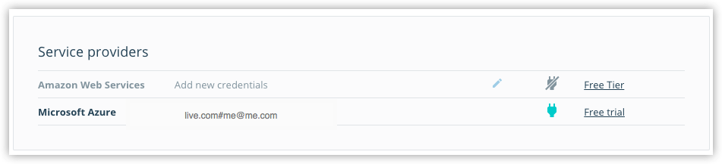
Create a New Swarm on Azure in Docker Cloud
To create a swarm, you need to give Docker Cloud permission to deploy swarm nodes on your behalf in your cloud services provider account
If you haven’t yet linked Docker Cloud to Azure, you’ll first need to follow those steps
Once it’s linked, it shows up on the Swarms -> Create page as a connected service provider
Notes:
Link Docker Cloud to your service provider
To create a swarm, you need to give Docker Cloud permission to deploy swarm nodes on your behalf in your cloud services provider account.
If you haven’t yet linked Docker Cloud to Azure,
follow the steps in Link Microsoft Azure Cloud Services to Docker Cloud.
Once it’s linked, it shows up on the Swarms -> Create page as a connected service provider.
IMAGE:
azure-creds-cloud.png
SHARE:
Note: If you are using a Microsoft Azure Visual Studio MSDN subscription, you need to enable programmatic deployments on the Docker CE VM Azure Marketplace item.
See the Microsoft Azure blog post on Working with Marketplace Images on Azure Resource Manager for instructions on how to do this.

Slide 253
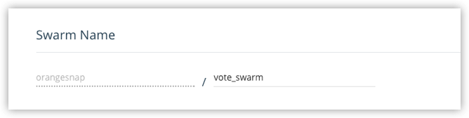
Create a Swarm
Here’s the quick rundown:
If necessary, log in to Docker Cloud and switch to Swarm Mode.
Click Swarms in the top navigation, then click Create.
Enter a name for the new swarm.
Notes:
Create a swarm
1. If necessary, log in to Docker Cloud and switch to Swarm Mode
2. Click Swarms in the top navigation, then click Create.
SHARE:
Alternatively, you can select + -> Swarm from the top navigation to get to the same page.
3. Enter a name for the new swarm.
SHARE:
Your Docker ID is pre-populated. In the example, our swarm name is “vote_swarm”.
IMAGE:
azure-create-swarm-1-name.png
SHARE:
Tip: Use all lower case letters for swarm names. No spaces, capitalized letters, or special characters other than ., _, or - are allowed.

Slide 254
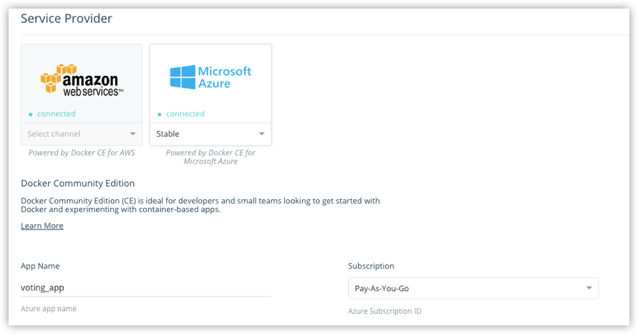
Create a Swarm
Select Microsoft Azure as the service provider, select a channel (Stable or Edge) from the drop-down menu, provide an App name, and select the Azure Subscription you want to use.
Notes:
Create a swarm
4. Select Microsoft Azure as the service provider, select a channel (Stable or Edge) from the drop-down menu, provide an App name, and select the Azure Subscription you want to use.
SHARE:
You can learn more about stable and edge channels in the Install Docker overview and the Docker CE Edge topics.
In this example, we use the Stable channel, our app name is “voting_app” and we’ve selected a Pay-As-You-Go subscription.
IMAGE:
azure-create-swarm-0.png

Slide 255
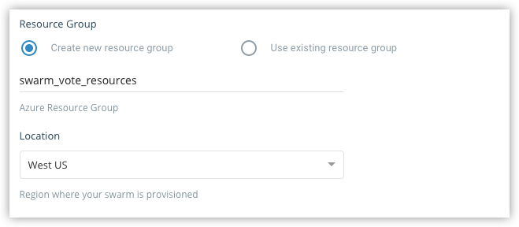
Create a Swarm
Make sure that Create new resource group is selected, provide a name for the group, and select a location from the drop-down menu.
Notes:
Create a swarm
5. Make sure that Create new resource group is selected, provide a name for the group, and select a location from the drop-down menu.
SHARE:
Our example app is called swarm_vote_resources, and it is located in West US.
IMAGE:
azure-create-swarm-3-resource-group.png
SHARE:
Tip: Be sure to create a new resource group for a swarm. If you choose to use an existing group, the swarm fails as Azure does not currently support this.

Slide 256
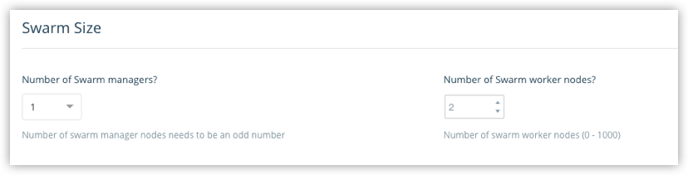
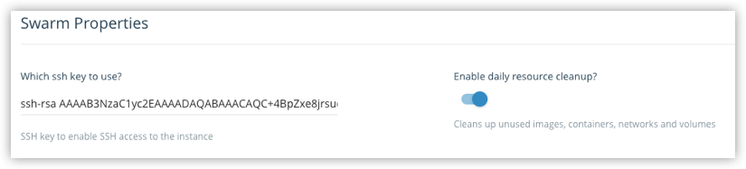
Create a Swarm
Choose how many swarm managers and worker nodes to deploy.
Configure swarm properties, SSH key and resource cleanup.
Notes:
Create a swarm
6. Choose how many swarm managers and worker nodes to deploy.
SHARE:
Here, we create one manager and two worker nodes. (This maps nicely to the Swarm tutorial setup and the voting app sample in Docker Labs.)
IMAGE:
cloud-create-swarm-4-size.png
7. Configure swarm properties, SSH key and resource cleanup.
SHARE:
Copy-paste the public SSH key you want to use to connect to the nodes.
(Provide the one for which you have the private key locally.)
IMAGE:
azure-create-swarm-5-properties.png
SHARE:
To list existing SSH keys: ls -al ~/.ssh
To copy the public SSH key to your clipboard: pbcopy < ~/.ssh/id_rsa.pub
Choose whether to provide daily resource cleanup.
(Enabling this option helps avoid charges for resources that you are no longer using.)

Slide 257
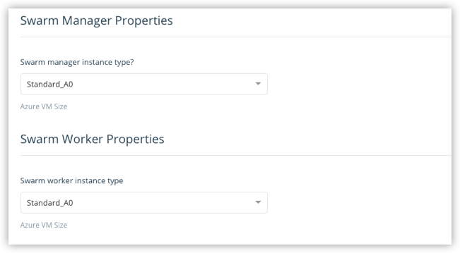
Create a Swarm
Select the machine sizes for the managers, and for the worker.
Notes:
8. Select the machine sizes for the managers, and for the workers.
IMAGE:
azure-create-swarm-6-manager-worker.png
SHARE:
The larger your swarm, the larger the machine size you should use.
To learn more about resource setup, see configuration options in the Docker for Azure topics.

Slide 258
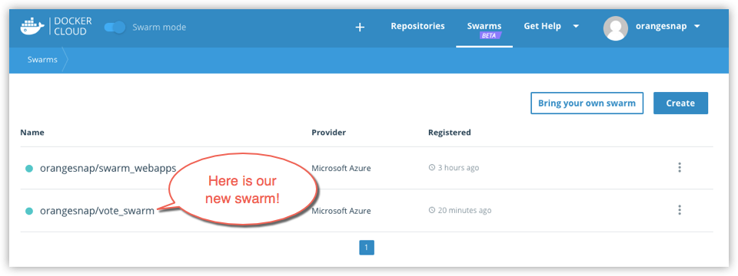
Create a Swarm
Pretty cool, if you ask me!
Click Create.
Here’s our swarm!
Notes:
9. Click Create.
SHARE:
Docker for Azure bootstraps all of the recommended infrastructure to start using Docker on Azure automatically.
You don’t need to worry about rolling your own instances, security groups, or load balancers when using Docker for Azure.
This takes a few minutes. When the swarm is ready, its indicator on the Swarms page shows steady green.
IMAGE:
azure-create-swarm-7-list.png
SHARE:
Note: At this time, you cannot add nodes to a swarm from within Docker Cloud. To add new nodes to an existing swarm, log in to your Azure account, and add nodes manually. (You can unregister or dissolve swarms directly from Docker Cloud.)

Slide 259
Manage Infrastructure
Notes:
Manage builds and images
Manage swarms (beta swarm mode)
(3) Manage Infrastructure (standard mode)
Manage nodes and apps (standard mode)

Slide 260
Manage Infrastructure (standard mode)
Cloud uses an agent and system containers to deploy and manage nodes (hosts) on your behalf
All nodes accessible to your account are connected by an overlay or mesh network
Deploy nodes from Docker Cloud
When you use Docker Cloud to deploy nodes on a hosted provider, the service stores your cloud provider credentials
And then deploys nodes for you using the services’ API to perform actions on your behalf
Notes:
Docker Cloud infrastructure overview (Standard Mode)
Cloud uses an agent and system containers to deploy and manage nodes (hosts) on your behalf.
All nodes accessible to your account are connected by an overlay or mesh network,
SHARE:
regardless of host or cloud service provider.
Deploy nodes from Docker Cloud
When you use Docker Cloud to deploy nodes on a hosted provider, the service stores your cloud provider credentials
and then deploys nodes for you using the services’ API to perform actions on your behalf.
SOURCE:
https://docs.docker.com/docker-cloud/infrastructure/

Slide 261
Manage Infrastructure (standard mode)
Bring your own host
If you are using Bring Your Own Host, Docker Cloud provides a script that:
installs the Docker Cloud Agent on the host
downloads and installs the latest Docker CS Engine version and the AUFS storage driver
sets up TLS certificates and the Docker security configuration
registers the host with Docker Cloud under your user account
Once this connection is established, the Docker Cloud Agent manages the node and performs updates when the user requests them
And it can also create and maintain a reverse tunnel to Docker Cloud if firewall restrictions prevent a direct connection
Notes:
Bring your own host
If you are using Bring Your Own Host, Docker Cloud provides a script that:
- installs the Docker Cloud Agent on the host
- downloads and installs the latest Docker CS Engine version and the AUFS storage driver
- sets up TLS certificates and the Docker security configuration
- registers the host with Docker Cloud under your user account
Once this connection is established, the Docker Cloud Agent manages the node and performs updates when the user requests them,
and can also create and maintain a reverse tunnel to Docker Cloud if firewall restrictions prevent a direct connection.
SOURCE:
https://docs.docker.com/docker-cloud/infrastructure/

Slide 262
Manage Infrastructure (standard mode)
Internal networking
Docker Cloud communicates with the Docker daemon running in the node using the following IPs, on port 2375/tcp
52.204.126.235/32
52.6.30.174/32
52.205.192.142/32
52.205.2.114/32
If the port is not accessible, Docker Cloud creates a secure reverse tunnel from the nodes to Docker Cloud
When you add a node on Docker Cloud, the node joins the Weave private overlay network for containers in other nodes by connecting on ports 6783/tcp and 6783/udp
Notes:
Internal networking
Docker Cloud communicates with the Docker daemon running in the node using the following IPs, on port 2375/tcp.
52.204.126.235/32
52.6.30.174/32
52.205.192.142/32
52.205.2.114/32
If the port is not accessible, Docker Cloud creates a secure reverse tunnel from the nodes to Docker Cloud.
When you add a node on Docker Cloud, the node joins the Weave private overlay network for containers in other nodes by connecting on ports 6783/tcp and 6783/udp.
SHARE:
(You should make sure these ports are open.)

Slide 263
Manage Infrastructure (standard mode)
Internal Overlay Network
Docker Cloud creates a per-user overlay network which connects all containers across all of the user’s hosts
This network connects all of your containers on the 10.7.0.0/16 subnet, and gives every container a local IP
This IP persists on each container even if the container is redeployed and ends up on a different host
Every container can reach any other container on any port within the subnet
Notes:
Internal overlay network
Docker Cloud creates a per-user overlay network which connects all containers across all of the user’s hosts.
This network connects all of your containers on the 10.7.0.0/16 subnet, and gives every container a local IP.
This IP persists on each container even if the container is redeployed and ends up on a different host.
Every container can reach any other container on any port within the subnet.
SOURCE:
https://docs.docker.com/docker-cloud/infrastructure/

Slide 264

Manage Infrastructure (standard mode)
External Access
The easiest way to access nodes is to ensure that your public ssh key is available to them
You can quickly copy your public key to all of the nodes in your Docker Cloud account by running the authorizedkeys container
Notes:
External access
The easiest way to access nodes is to ensure that your public ssh key is available to them.
You can quickly copy your public key to all of the nodes in your Docker Cloud account by running the authorizedkeys container.
SOURCE:
https://docs.docker.com/docker-cloud/infrastructure/
--- SHOULD WE ADD ANY OF THE FOLLOWING
Further subject covered – possibly to add
SSH into a Docker Cloud-managed node
Read more about Deployment strategies
Learn how to Upgrade Docker Engine on a node
Use the Docker Cloud Agent to Bring your Own Host
Link to Amazon Web Services hosts
Using Docker Cloud on AWS FAQ
Link to DigitalOcean hosts
Link to Microsoft Azure hosts
Link to Packet hosts
Using Docker Cloud and Packet FAQ
Link to SoftLayer hosts

Slide 265
Manage Nodes and Apps
Notes:
Manage builds and images
Manage swarms (beta swarm mode)
Manage Infrastructure (standard mode)
(4) Manage nodes and apps (standard mode)

Slide 266
Manage Nodes and Apps (standard mode)
These topics cover the traditional, pre-Swarm model for deploying and managing nodes, services, and applications in Docker Cloud
Applications in Docker Cloud
Applications in Docker Cloud are usually several Services linked together using the specifications from a Stackfile or a Compose file
You can also create individual services using the Docker Cloud Services wizard
And you can attach Volumes to use as long-lived storage for your services
If you are using autobuild and autotest features, you can also se autoredeploy to automatically redeploy the application
Notes:
These topics cover the traditional, pre-Swarm model for deploying and managing nodes, services, and applications in Docker Cloud.
Getting started with Docker Cloud
Applications in Docker Cloud
Cloud stack file YAML reference
Applications in Docker Cloud are usually several Services linked together using the specifications from a Stackfile or a Compose file.
You can also create individual services using the Docker Cloud Services wizard,
and you can attach Volumes to use as long-lived storage for your services.
If you are using Docker Cloud’s autobuild and autotest features, you can also use autoredeploy to automatically redeploy the application
each time its underlying services are updated.

Slide 267
Docker Machine

Slide 268
Docker Machine Overview
Docker Machine is a tool that lets you install Docker Engine on virtual hosts, and manage the hosts with docker-machine commands.
You can use Machine to create Docker hosts on your local Mac or Windows box.
Also, on your company network, in your data center, or on cloud providers like AWS or Digital Ocean.
Notes:
We have two good ways to group components for development purposes and then clean them up when you want to start over.
This approach works fine for local development and grouping. In shared environments the best approach is to properly label your components (services, RCs, pods, etc) and delete them using labels, as above.

Slide 269
Docker Machine Overview
Using docker-machine commands, you can:
Start
Inspect
Stop
Restart a managed host
Upgrade the Docker client and daemon
Configure a Docker client to talk to your host.
Notes:
We have two good ways to group components for development purposes and then clean them up when you want to start over.
This approach works fine for local development and grouping. In shared environments the best approach is to properly label your components (services, RCs, pods, etc) and delete them using labels, as above.

Slide 270
Setting Machine Environment
Point the Machine CLI at a running, managed host, and you can run docker commands directly on that host.
For example, run docker-machine env default to point to a host called default.
NOTE: You may have to name the VM specifically, like this:
docker-machine env <name>
Notes:
We have two good ways to group components for development purposes and then clean them up when you want to start over.
This approach works fine for local development and grouping. In shared environments the best approach is to properly label your components (services, RCs, pods, etc) and delete them using labels, as above.

Slide 271
Setting Machine Environment
Once you follow the on-screen instructions to complete the env setup, you can run docker ps, docker run hello-world, and so forth.
Output:
export DOCKER_TLS_VERIFY="1"
export DOCKER_HOST="tcp://XXX.XXX.XX.XXX:XXXX"
export DOCKER_CERT_PATH= <PATH>
export DOCKER_MACHINE_NAME= <NAME>
# Run this command to configure your shell:
# eval $(docker-machine env dev)
Notes:
We have two good ways to group components for development purposes and then clean them up when you want to start over.
This approach works fine for local development and grouping. In shared environments the best approach is to properly label your components (services, RCs, pods, etc) and delete them using labels, as above.

Slide 272

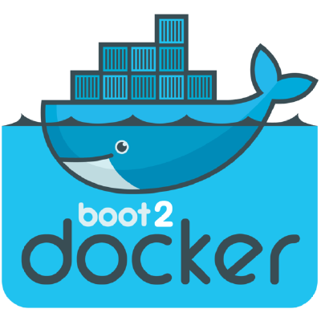
The Good Old Days
Machine was the only way to run Docker on Mac or Windows previous to Docker v1.12.
Docker for Mac & Docker for Windows are available as native apps now and are the better choice for this use case on newer desktops and laptops.
The installers for Docker for Mac and Docker for Windows include Docker Machine, along with Docker Compose.
So, no more need for confusion.
Notes:
We have two good ways to group components for development purposes and then clean them up when you want to start over.
This approach works fine for local development and grouping. In shared environments the best approach is to properly label your components (services, RCs, pods, etc) and delete them using labels, as above.

Slide 273
Why Use It, Now?
Docker Machine enables you to provision multiple remote Docker hosts on various flavors of Linux.
Additionally, Machine allows you to run Docker on older Mac or Windows systems, as described in the previous topic.
Basically, Docker Machine has two broad use cases:
Notes:
We have two good ways to group components for development purposes and then clean them up when you want to start over.
This approach works fine for local development and grouping. In shared environments the best approach is to properly label your components (services, RCs, pods, etc) and delete them using labels, as above.

Slide 274
Why Use It, Now?
#1 - You own an older desktop system and want to run Docker on Mac or Windows
docker –version
docker run hello-world
...
docker –version
docker run hello-world
...
Docker Machine for Mac
Docker Machine for Windows
Notes:
We have two good ways to group components for development purposes and then clean them up when you want to start over.
This approach works fine for local development and grouping. In shared environments the best approach is to properly label your components (services, RCs, pods, etc) and delete them using labels, as above.

Slide 275
The Older Desktop Option
If the computer doesn’t meet the requirements for DockerforMac and Docker for Windows apps, then you need Docker Machine in order to run Docker Engine locally.
Installing Docker Machine on a Mac or Windows box with the Docker Toolbox installer, provisions a local virtual machine with Docker Engine.
This gives you the ability to connect it, and run docker commands.
Notes:
We have two good ways to group components for development purposes and then clean them up when you want to start over.
This approach works fine for local development and grouping. In shared environments the best approach is to properly label your components (services, RCs, pods, etc) and delete them using labels, as above.

Slide 276

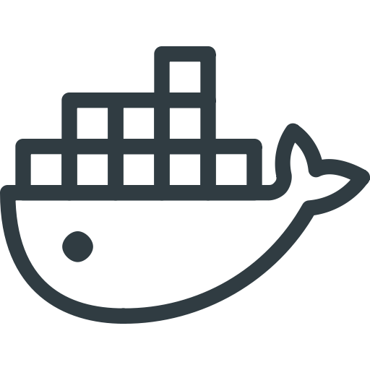

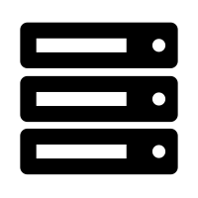
Why Use It, Now?
#2 - You want to provision Docker hosts on remote systems
...
...
docker <command>
...
Notes:
We have two good ways to group components for development purposes and then clean them up when you want to start over.
This approach works fine for local development and grouping. In shared environments the best approach is to properly label your components (services, RCs, pods, etc) and delete them using labels, as above.

Slide 277
Remote Host Option
Rememeber, Docker Engine runs natively on Linux systems.
If you have a Linux box as your primary system, and want to run Docker commands, all you need to do is download and install Docker Engine.
However, if you want an efficient way to provision multiple Docker hosts on a network, in the cloud or even locally, you need Docker Machine.
Notes:
We have two good ways to group components for development purposes and then clean them up when you want to start over.
This approach works fine for local development and grouping. In shared environments the best approach is to properly label your components (services, RCs, pods, etc) and delete them using labels, as above.

Slide 278
Remote Host Option
Whether your primary system is Mac, Windows, or Linux, you can install Docker Machine on it and use docker-machine commands to provision and manage large numbers of Docker hosts.
Machine automatically creates hosts, installs Docker Engine on them, then configures the Docker clients. Each managed host (machine) is the combination of a Docker host and a configured client.
Notes:
We have two good ways to group components for development purposes and then clean them up when you want to start over.
This approach works fine for local development and grouping. In shared environments the best approach is to properly label your components (services, RCs, pods, etc) and delete them using labels, as above.

Slide 279
Docker Engine vs. Docker Machine
When people say “Docker” they typically mean Docker Engine
Engine, the client-server application consist of:
the Docker daemon
a REST API that specifies interfaces for interacting with the daemon
a command line interface (CLI) client that talks to the daemon (through the REST API wrapper)
Client
docker CLI
REST API
Server
docker daemon
Notes:
We have two good ways to group components for development purposes and then clean them up when you want to start over.
This approach works fine for local development and grouping. In shared environments the best approach is to properly label your components (services, RCs, pods, etc) and delete them using labels, as above.

Slide 280
Docker Engine vs. Docker Machine
Docker Engine accepts docker commands from the CLI, such as docker run <image>, docker ps to list running containers, docker images to list images, and so on
Docker Machine is a tool for provisioning and managing your Dockerized hosts (hosts with Docker Engine on them).
Typically, you install Docker Machine on your local system. Docker Machine has its own command line client docker-machine
You can use Machine to install Docker Engine on one or more virtual systems. These virtual systems can be local (as when you use Machine to install and run Docker Engine in VirtualBox on Mac or Windows) or remote (as when you use Machine to provision Dockerized hosts on cloud providers). The Dockerized hosts themselves can be thought of, and are sometimes referred to as, managed “machines”.
Notes:
We have two good ways to group components for development purposes and then clean them up when you want to start over.
This approach works fine for local development and grouping. In shared environments the best approach is to properly label your components (services, RCs, pods, etc) and delete them using labels, as above.

Slide 281
Docker Engine vs. Docker Machine
Docker Engine accepts docker commands from the CLI, such as docker run <image>, docker ps to list running containers, docker images to list images, and so on
Docker Machine is a tool for provisioning and managing your Dockerized hosts (hosts with Docker Engine on them).
Typically, you install Docker Machine on your local system. Docker Machine has its own command line client docker-machine
Notes:
We have two good ways to group components for development purposes and then clean them up when you want to start over.
This approach works fine for local development and grouping. In shared environments the best approach is to properly label your components (services, RCs, pods, etc) and delete them using labels, as above.

Slide 282
Docker Engine vs. Docker Machine
You can use Machine to install Docker Engine on one or more virtual systems.
Virtual systems can be local (as when you use Machine to install and run Docker Engine in VirtualBox on Mac or Windows)
Or, they can be remote (as when you use Machine to provision Dockerized hosts on cloud providers).
The Dockerized hosts themselves can be thought of, and are sometimes referred to as, managed “machines”.
Notes:
We have two good ways to group components for development purposes and then clean them up when you want to start over.
This approach works fine for local development and grouping. In shared environments the best approach is to properly label your components (services, RCs, pods, etc) and delete them using labels, as above.

Slide 283
Remote Machine Host Diagram
Client
docker-machine
REST API
Client
docker CLI
server
docker daemon
REST API
docker-machine create
...
...
docker run <image>
Notes:
We have two good ways to group components for development purposes and then clean them up when you want to start over.
This approach works fine for local development and grouping. In shared environments the best approach is to properly label your components (services, RCs, pods, etc) and delete them using labels, as above.

Slide 284

Getting Started Using Local VM
Let’s take a look at using docker-machine to create, use and manage a Docker host inside of a local virtual machine.
Notes:
We have two good ways to group components for development purposes and then clean them up when you want to start over.
This approach works fine for local development and grouping. In shared environments the best approach is to properly label your components (services, RCs, pods, etc) and delete them using labels, as above.

Slide 285
Docker Machine Rust
With the advent of Docker for Mac and Docker for Windows as replacements for Docker Toolbox, we recommend that you use these for your primary Docker workflows.
You can use these applications to run Docker natively on your local system without using Docker Machine at all.
Notes:
We have two good ways to group components for development purposes and then clean them up when you want to start over.
This approach works fine for local development and grouping. In shared environments the best approach is to properly label your components (services, RCs, pods, etc) and delete them using labels, as above.

Slide 286
Docker Machine Rust
However, if you want to create multiple local machines, you still need Docker Machine to create and manage machines for multi-node experimentation.
Both Docker for Mac and Docker for Windows include the newest version of Docker Machine, so when you install either of these, you get docker-machine.
Notes:
We have two good ways to group components for development purposes and then clean them up when you want to start over.
This approach works fine for local development and grouping. In shared environments the best approach is to properly label your components (services, RCs, pods, etc) and delete them using labels, as above.

Slide 287
Prerequisite Information
Keep the following considerations in mind when using Machine to create local VMs.
Docker for Windows - You can use docker-machine create with the hyperv driver to create additional local machines.
Docker for Mac - You can use docker-machine create with the virtualbox driver to create additional local machines.
Notes:
We have two good ways to group components for development purposes and then clean them up when you want to start over.
This approach works fine for local development and grouping. In shared environments the best approach is to properly label your components (services, RCs, pods, etc) and delete them using labels, as above.

Slide 288
Windows Prerequisite Information
Docker for Windows
Docker for Windows uses Microsoft Hyper-V for virtualization, and Hyper-V is not compatible with Oracle VirtualBox.
Therefore, you cannot run the two solutions simultaneously.
But you can still use docker-machine to create more local VMs by using the Microsoft Hyper-V driver.
Notes:
We have two good ways to group components for development purposes and then clean them up when you want to start over.
This approach works fine for local development and grouping. In shared environments the best approach is to properly label your components (services, RCs, pods, etc) and delete them using labels, as above.

Slide 289

Mac Prerequisite Information
Docker for Mac
Docker for Mac uses HyperKit, a lightweight macOS virtualization solution built on top of the Hypervisor.framework in macOS 10.10 Yosemite and higher.
Currently, there is no docker-machine create driver for HyperKit, so you will use virtualbox driver to create local machines.
You can run both HyperKit and Oracle VirtualBox on the same system.
Notes:
We have two good ways to group components for development purposes and then clean them up when you want to start over.
This approach works fine for local development and grouping. In shared environments the best approach is to properly label your components (services, RCs, pods, etc) and delete them using labels, as above.

Slide 290
Running Containers
To run a Docker container, you:
Create a new (or start an existing) Docker virtual machine.
Switch your environment to your new VM.
Use the docker client to create, load, and manage containers.
Once you create a machine, you can reuse it as often as you like.
Like any VirtualBox VM, it maintains its configuration between uses.
The examples here show how to create and start a machine, run Docker commands, and work with containers.
docker node ls
ID HOSTNAME STATUS AVAILABILITY MANAGER STATUS5re1humv246m6clujn0zng9jy docker Ready Activerbavg04vwiijyzzjwdjoc3io2 * docker Ready Active Leader
Notes:
We have two good ways to group components for development purposes and then clean them up when you want to start over.
This approach works fine for local development and grouping. In shared environments the best approach is to properly label your components (services, RCs, pods, etc) and delete them using labels, as above.

Slide 291
Machine Containers Example
Let’s look at how to create a new container, using Docker Machine.
First, open a command shell or terminal window.
Use docker-machine ls to list available machines:
Output (No machines have been created):
docker-machine ls
NAME ACTIVE DRIVER STATE URL SWARM DOCKER ERRORS
Notes:
We have two good ways to group components for development purposes and then clean them up when you want to start over.
This approach works fine for local development and grouping. In shared environments the best approach is to properly label your components (services, RCs, pods, etc) and delete them using labels, as above.

Slide 292
Machine Containers Example
To create a Machine, we’d need to start by following the steps below:
Run docker-machine create <command>
Pass the appropriate driver to the --driver flag and provide a machine name.
If this is your first machine, name it default as shown in the example.
If you already have a “default” machine, choose another name for this new machine.
If you are using Docker for Mac, use virtualbox as the driver, as shown in this example.
On Docker for Windows systems that support Hyper-V, use the hyperv driver
Notes:
We have two good ways to group components for development purposes and then clean them up when you want to start over.
This approach works fine for local development and grouping. In shared environments the best approach is to properly label your components (services, RCs, pods, etc) and delete them using labels, as above.

Slide 293
Creating a New Machine
So, our command should look something like this:
Output:
This downloads a lightweight Linux distribution boot2docker, with the Docker daemon installed, pluscreates and starts a VirtualBox.
docker-machine create --driver virtualbox default
Running pre-create checks...
Creating machine...
...
Notes:
We have two good ways to group components for development purposes and then clean them up when you want to start over.
This approach works fine for local development and grouping. In shared environments the best approach is to properly label your components (services, RCs, pods, etc) and delete them using labels, as above.

Slide 294
Print Newly Created Machine
To list available machines, we want to use docker-machine ls again.
This time we should find our container listed.
Output:
NAME ACTIVE DRIVER STATE URL ...
default * virtualbox Running tcp://XXX.XXX.XX.XXX:XXXX ...
Notes:
We have two good ways to group components for development purposes and then clean them up when you want to start over.
This approach works fine for local development and grouping. In shared environments the best approach is to properly label your components (services, RCs, pods, etc) and delete them using labels, as above.

Slide 295
Get Docker Machine Env Varibles
Let’s look at the environment variable for your new VM.
To do that, we will use the following command:
Output:
docker-machine env <machine-name>
export DOCKER_TLS_VERIFY=“..."
export DOCKER_HOST=“..."
export DOCKER_CERT_PATH=“..."
export DOCKER_MACHINE_NAME=“..."
# Run this command to configure your shell:
# eval "$(docker-machine env default)"
Notes:
We have two good ways to group components for development purposes and then clean them up when you want to start over.
This approach works fine for local development and grouping. In shared environments the best approach is to properly label your components (services, RCs, pods, etc) and delete them using labels, as above.

Slide 296
Connecting Env Settings
Now, we need to connect our shell to the new machine.
We’ll use the following command, which can be found in the output:
Okay! Now, our environment variables are set for the current shell that the Docker client will read which specify the TLS settings.
You need to do this each time you open a new shell or restart your machine.
You can now run Docker commands on this host.
eval "$(docker-machine env default)"
Notes:
We have two good ways to group components for development purposes and then clean them up when you want to start over.
This approach works fine for local development and grouping. In shared environments the best approach is to properly label your components (services, RCs, pods, etc) and delete them using labels, as above.

Slide 297
Experiment With Machine Containers
Run a container with docker run to verify your set up.
Use docker run to download and run busybox with a simple echo command, like this:
Output:
docker run busybox echo hello world
Unable to find image 'busybox' locally
Pulling repository busybox
e72ac664f4f0: Download complete
511136ea3c5a: Download complete
df7546f9f060: Download complete
e433a6c5b276: Download complete
hello world
Notes:
We have two good ways to group components for development purposes and then clean them up when you want to start over.
This approach works fine for local development and grouping. In shared environments the best approach is to properly label your components (services, RCs, pods, etc) and delete them using labels, as above.

Slide 298
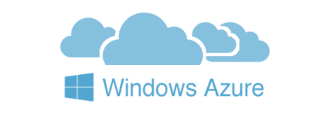


Introducing Machine Cloud Drivers
When you install Docker Machine, you get a set of drivers for various cloud providers.
Also available, Docker Machine driver plugins for use with other cloud platforms are available from 3rd party contributors.
NOTE: These are use-at-your-own-risk plugins, not maintained by or formally associated with Docker.
Notes:
We have two good ways to group components for development purposes and then clean them up when you want to start over.
This approach works fine for local development and grouping. In shared environments the best approach is to properly label your components (services, RCs, pods, etc) and delete them using labels, as above.

Slide 299
Exploring the Cloud
Docker Machine driver plugins are available for many cloud platforms, so you can use Machine to provision cloud hosts.
When you use Docker Machine for provisioning, you create cloud hosts with Docker Engine installed on them.
We’ll need to create an account with the cloud provider.
Notes:
We have two good ways to group components for development purposes and then clean them up when you want to start over.
This approach works fine for local development and grouping. In shared environments the best approach is to properly label your components (services, RCs, pods, etc) and delete them using labels, as above.

Slide 300
Exploring the Cloud
We will provide account verification, security credentials, and configuration options for the providers as flags to docker-machine create.
The flags are unique for each cloud-specific driver. For instance, to pass a Digital Ocean access token you use the --digitalocean-access-token flag.
Let’s look at some examples on the next slide...
Notes:
We have two good ways to group components for development purposes and then clean them up when you want to start over.
This approach works fine for local development and grouping. In shared environments the best approach is to properly label your components (services, RCs, pods, etc) and delete them using labels, as above.

Slide 301
Digital Ocean Example
For Digital Ocean, this command creates a Droplet (cloud host) called “docker-sandbox”:
docker-machine create --driver digitalocean --digitalocean-access-token xxx docker-sandbox
Notes:
We have two good ways to group components for development purposes and then clean them up when you want to start over.
This approach works fine for local development and grouping. In shared environments the best approach is to properly label your components (services, RCs, pods, etc) and delete them using labels, as above.

Slide 302
Amazon Web Services (AWS) Example
For AWS, this command creates an instance called “aws-sandbox” in EC2:
docker-machine create --driver amazonec2 --amazonec2-access-key AKI******* --amazonec2-secret-key 8T93C******* aws-sandbox
Notes:
We have two good ways to group components for development purposes and then clean them up when you want to start over.
This approach works fine for local development and grouping. In shared environments the best approach is to properly label your components (services, RCs, pods, etc) and delete them using labels, as above.

Slide 303
Docker Machine Swarm
Docker Machine can also provision Docker Swarm clusters.
This can be used with any driver and will be secured with TLS.
Notes:
We have two good ways to group components for development purposes and then clean them up when you want to start over.
This approach works fine for local development and grouping. In shared environments the best approach is to properly label your components (services, RCs, pods, etc) and delete them using labels, as above.

Slide 304
Start and Stop
If you are finished using a host for the time being, you can stop it with docker-machine stop and later start it again with docker-machine start.
Stop the machine, like this:
And we would start it back up, like this:
docker-machine stop <machine-name>
docker-machine start <machine-name>
Notes:
We have two good ways to group components for development purposes and then clean them up when you want to start over.
This approach works fine for local development and grouping. In shared environments the best approach is to properly label your components (services, RCs, pods, etc) and delete them using labels, as above.

Slide 305
Azure Support for Docker

Slide 306
Why Docker for Azure?
The Docker for Azure project was created and is being actively developed to ensure that Docker users can enjoy a fantastic out-of-the-box experience on Azure
It is now generally available and can now be used by everyone
As an informed user, you might be curious to know what this project offers you for running your development, staging, or production workloads
Notes:
Why Docker for Azure?
The Docker for Azure project was created and is being actively developed to ensure that Docker users can enjoy a fantastic out-of-the-box experience on Azure.
It is now generally available and can now be used by everyone.
As an informed user, you might be curious to know what this project offers you for running your development, staging, or production workloads.
SOURCE:
https://docs.docker.com/docker-for-azure/

Slide 307
Native for Docker
Docker for Azure provides a Docker-native solution that avoids operational complexity and adding unneeded additional APIs to the Docker stack
Docker for Azure allows you to interact with Docker instead of distracting you with the need to navigate extra layers on top of Docker
The skills that you’ve already learned, using Docker automatically carry over to using Docker on Azure
Notes:
Native to Docker
Docker for Azure provides a Docker-native solution that avoids operational complexity and adding unneeded additional APIs to the Docker stack.
Docker for Azure allows you to interact with Docker directly (including native Docker orchestration), instead of distracting you with the need to navigate extra layers on top of Docker. You can focus instead on the thing that matters most: running your workloads. This helps you and your team to deliver more value to the business faster, to speak one common “language”, and to have fewer details to keep in your head at once.
The skills that you and your team have already learned, and continue to learn, using Docker on the desktop or elsewhere automatically carry over to using Docker on Azure. The added consistency across clouds also helps to ensure that a migration or multi-cloud strategy is easier to accomplish in the future if desired.
SOURCE:
https://docs.docker.com/docker-for-azure/

Slide 308
Skip the Boilerplate and Maintenance
Docker for Azure bootstraps all of the recommended infrastructure to start using Docker on Azure automatically
You don’t need to worry about rolling your own instances, security groups, or load balancers when using Docker for Azure
Likewise, setting up and using Docker swarm mode functionality for container orchestration is managed across the cluster’s lifecycle when you use Docker for Azure. Docker has already coordinated the various bits of automation you would otherwise be gluing together on your own to bootstrap Docker swarm mode on these platforms. When the cluster is finished booting, you can jump right in and start running docker service commands.
We also provide a prescriptive upgrade path that helps users upgrade between various versions of Docker in a smooth and automatic way. Instead of experiencing “maintenance dread” as you ponder your future responsibilities upgrading the software you are using, you can easily upgrade to new versions when they are released.
Notes:
Skip the boilerplate and maintenance work
Docker for Azure bootstraps all of the recommended infrastructure to start using Docker on Azure automatically.
You don’t need to worry about rolling your own instances, security groups, or load balancers when using Docker for Azure.
Likewise, setting up and using Docker swarm mode functionality for container orchestration is managed across the cluster’s lifecycle when you use Docker for Azure.
Docker has already coordinated the various bits of automation you would otherwise be gluing together on your own to bootstrap Docker swarm mode on these platforms.
When the cluster is finished booting, you can jump right in and start running docker service commands.
We also provide a prescriptive upgrade path that helps users upgrade between various versions of Docker in a smooth and automatic way.
Instead of experiencing “maintenance dread” as you ponder your future responsibilities upgrading the software you are using, you can easily upgrade to new versions when they are released.
Minimal, Docker-focused base
The custom Linux distribution used by Docker for Azure is carefully developed and configured to run Docker well. Everything from the kernel configuration to the networking stack is customized to make it a favorable place to run Docker. For instance, we make sure that the kernel versions are compatible with the latest and greatest in Docker functionality, such as theoverlay2 storage driver.
Instead of facing the trade-offs of a general purpose operating system, Docker’s custom Linux distribution focuses on only one thing: providing the best Docker experience for you and your team.
Self-cleaning and self-healing
Even the most conscientious admin can be caught off guard by issues such as unexpectedly aggressive logging or the Linux kernel killing memory-hungry processes. In Docker for Azure, your cluster is resilient to a variety of such issues by default.
Log rotation native to the host is configured for you automatically, so chatty logs don’t use up all of your disk space.
Likewise, the “system prune” option allows you to ensure unused Docker resources such as old images are cleaned up automatically. The lifecycle of nodes is managed using auto-scaling groups or similar constructs, so that if a node enters an unhealthy state for unforeseen reasons, the node is taken out of load balancer rotation and/or replaced automatically and all of its container tasks are rescheduled.
These self-cleaning and self-healing properties are enabled by default and don’t need configuration, so you can breathe easier as the risk of downtime is reduced.
Logging native to the platforms
Centralized logging is a critical component of many modern infrastructure stacks. To have these logs indexed and searchable proves invaluable for debugging application and system issues as they come up. Out of the box, Docker for Azure forwards logs from containers to a native cloud provider abstraction (a storage account in the created resource group).
Next-generation Docker bug reporting tools
One common pain point in open source issue reporting is effectively communicating the current state of your infrastructure and the issues you are seeing to the upstream. In Docker for Azure, you receive new tools to communicate any issues you experience quickly and securely to Docker employees. The Docker for Azure shell includes a docker-diagnose script which, at your request, transmits detailed diagnostic information to Docker support staff to reduce the traditional “please-post-the-output-of-this-command” back and forth frequently encountered in bug reports.
SOURCE:
https://docs.docker.com/docker-for-azure/

Slide 309
Skip the Boilerplate and Maintenance
Docker for Azure bootstraps all of the recommended infrastructure to start using Docker on Azure automatically
You don’t need to worry about rolling your own instances, security groups, or load balancers when using Docker for Azure
Likewise, setting up and using Docker swarm mode functionality for container orchestration is managed across the cluster’s
When the cluster is finished booting, you can jump right in and start running docker service commands
Also provides a prescriptive upgrade path that helps users upgrade between various versions of Docker in a smooth and automatic way
Notes:
Skip the boilerplate and maintenance work
Docker for Azure bootstraps all of the recommended infrastructure to start using Docker on Azure automatically.
You don’t need to worry about rolling your own instances, security groups, or load balancers when using Docker for Azure.
Likewise, setting up and using Docker swarm mode functionality for container orchestration is managed across the cluster’s lifecycle when you use Docker for Azure.
SHARE:
Docker has already coordinated the various bits of automation you would otherwise be gluing together on your own to bootstrap Docker swarm mode on these platforms.
When the cluster is finished booting, you can jump right in and start running docker service commands.
We also provide a prescriptive upgrade path that helps users upgrade between various versions of Docker in a smooth and automatic way.
SHARE:
Instead of experiencing “maintenance dread” as you ponder your future responsibilities upgrading the software you are using, you can easily upgrade to new versions when they are released.
Minimal, Docker-focused base
The custom Linux distribution used by Docker for Azure is carefully developed and configured to run Docker well. Everything from the kernel configuration to the networking stack is customized to make it a favorable place to run Docker. For instance, we make sure that the kernel versions are compatible with the latest and greatest in Docker functionality, such as theoverlay2 storage driver.
Instead of facing the trade-offs of a general purpose operating system, Docker’s custom Linux distribution focuses on only one thing: providing the best Docker experience for you and your team.
Self-cleaning and self-healing
Even the most conscientious admin can be caught off guard by issues such as unexpectedly aggressive logging or the Linux kernel killing memory-hungry processes. In Docker for Azure, your cluster is resilient to a variety of such issues by default.
Log rotation native to the host is configured for you automatically, so chatty logs don’t use up all of your disk space.
Likewise, the “system prune” option allows you to ensure unused Docker resources such as old images are cleaned up automatically. The lifecycle of nodes is managed using auto-scaling groups or similar constructs, so that if a node enters an unhealthy state for unforeseen reasons, the node is taken out of load balancer rotation and/or replaced automatically and all of its container tasks are rescheduled.
These self-cleaning and self-healing properties are enabled by default and don’t need configuration, so you can breathe easier as the risk of downtime is reduced.
Logging native to the platforms
Centralized logging is a critical component of many modern infrastructure stacks. To have these logs indexed and searchable proves invaluable for debugging application and system issues as they come up. Out of the box, Docker for Azure forwards logs from containers to a native cloud provider abstraction (a storage account in the created resource group).
Next-generation Docker bug reporting tools
One common pain point in open source issue reporting is effectively communicating the current state of your infrastructure and the issues you are seeing to the upstream. In Docker for Azure, you receive new tools to communicate any issues you experience quickly and securely to Docker employees. The Docker for Azure shell includes a docker-diagnose script which, at your request, transmits detailed diagnostic information to Docker support staff to reduce the traditional “please-post-the-output-of-this-command” back and forth frequently encountered in bug reports.
SOURCE:
https://docs.docker.com/docker-for-azure/

Slide 310
Hands-on Exercise(s)

Slide 311
End of Chapter

Slide 312
Docker Swarm
Connecting and managing multiple containers

Slide 313
Overview

Slide 314
Recap Docker
Containers run on single Docker host
Containers are ephemeral
Containers can have external persistence
Containers do not contain
Operating system matters

Slide 315
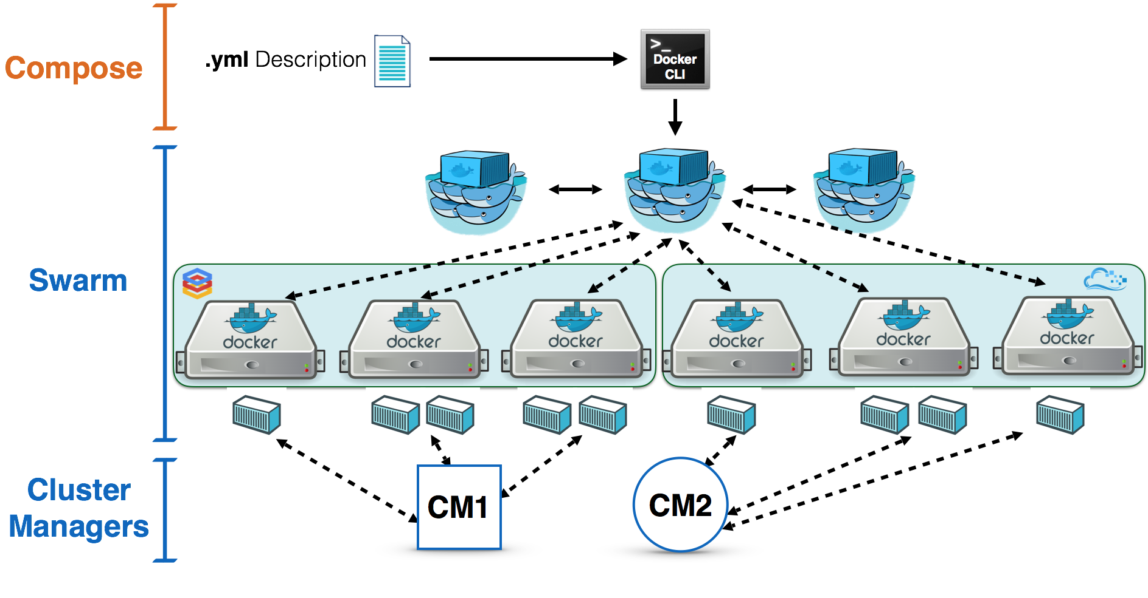
Swarm Overview
Describe swarm in a sentence of two, here.

Slide 316
Initialize Swarm Process
Turn single host Docker host into a Multi-host with Docker Swarm Mode.
All containers are only deployed onto the engine.
Swarm Mode turns it into a multi-host cluster-aware engine.
The first node to initialize the Swarm Mode becomes the manager.
As new nodes join the cluster, they can adjust their roles between managers or workers.
You should run 3-5 managers in a production environment to ensure high availability.

Slide 317
Create Swarm Mode Cluster
Swarm Mode is built into the Docker CLI. You can find an overview the possibility commands via:
The most important one is how to initialize Swarm Mode. Initialization is done via init, like this:
After running the command, the Docker Engine knows how to work with a cluster and becomes the manager.
The results of an initialization is a token used to add additional nodes in a secure fashion.
docker swarm --help
docker swarm init
Notes:
We have two good ways to group components for development purposes and then clean them up when you want to start over.
This approach works fine for local development and grouping. In shared environments the best approach is to properly label your components (services, RCs, pods, etc) and delete them using labels, as above.

Slide 318
Swarm Init Output
Once you initialize Docker Swarm, the token output will look something like this:
WSwarm initialized: current node (gpnnuxrri0tzaszblvhdrwqsh) is now a manager.
To add a worker to this swarm, run the following command:
docker swarm join \
--token SWMTKN-1-1xffnpg61r5wgel28ehuh8o3ip5z2iiwmplbemnksfho5akdqy-3zkn8ssrkcnjei34f5rmd4n3q \
172.17.0.65:2377
To add a manager to this swarm, run 'docker swarm join-token manager' and follow the instructions.
Notes:
We have two good ways to group components for development purposes and then clean them up when you want to start over.
This approach works fine for local development and grouping. In shared environments the best approach is to properly label your components (services, RCs, pods, etc) and delete them using labels, as above.

Slide 319
Creating a Cluster
With Swarm Mode enabled, it is possible to add additional nodes and issues commands across all of them.
If nodes happen to disappear, for example because of a crash, the containers which were running on those hosts will be automatically rescheduled onto other available nodes.
The rescheduling ensures you do not lose capacity and provides high-availability.
On each additional node, you wish to add to the cluster, use the Docker CLI to join the existing group.
Joining is done by pointing the other host to a current manager of the cluster.
Notes:
We have two good ways to group components for development purposes and then clean them up when you want to start over.
This approach works fine for local development and grouping. In shared environments the best approach is to properly label your components (services, RCs, pods, etc) and delete them using labels, as above.

Slide 320
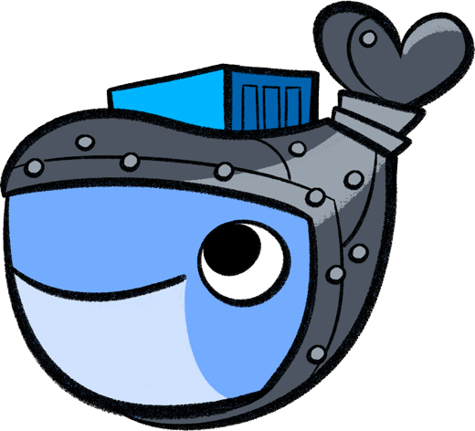
Creating a Cluster
Docker now uses an additional port, 2377, for managing the Swarm.
The port should be blocked from public access and only accessed by trusted users and nodes.
We recommend using VPNs or private networks to secure access.
Notes:
We have two good ways to group components for development purposes and then clean them up when you want to start over.
This approach works fine for local development and grouping. In shared environments the best approach is to properly label your components (services, RCs, pods, etc) and delete them using labels, as above.

Slide 321
Join Cluster
The first task is to obtain the token required to add a node to the cluster.
For demonstration purposes, we'll ask the manager what the token is via swarm join-token.
NOTE: In production, this token should be stored securely and only accessible by trusted individuals.
token=$(docker -H 172.17.0.65:2345 swarm join-token -q worker) && echo $token
Notes:
We have two good ways to group components for development purposes and then clean them up when you want to start over.
This approach works fine for local development and grouping. In shared environments the best approach is to properly label your components (services, RCs, pods, etc) and delete them using labels, as above.

Slide 322
Join Cluster
On the second host, join the cluster by requesting access via the manager.
The token is provided as an additional parameter, like this:
docker swarm join 172.17.0.65:2377 --token $token
Notes:
We have two good ways to group components for development purposes and then clean them up when you want to start over.
This approach works fine for local development and grouping. In shared environments the best approach is to properly label your components (services, RCs, pods, etc) and delete them using labels, as above.

Slide 323
Join Cluster
By default, the manager will automatically accept new nodes being added to the cluster.
You can view all nodes in the cluster using:
Output:
docker node ls
ID HOSTNAME STATUS AVAILABILITY MANAGER STATUS5re1humv246m6clujn0zng9jy docker Ready Activerbavg04vwiijyzzjwdjoc3io2 * docker Ready Active Leader
Notes:
We have two good ways to group components for development purposes and then clean them up when you want to start over.
This approach works fine for local development and grouping. In shared environments the best approach is to properly label your components (services, RCs, pods, etc) and delete them using labels, as above.

Slide 324

Overlay Network
Swarm Mode also introduces another networking model.
In previous versions, Docker required the use of an external key-value store, such as Consul, to ensure consistency across the network.
The need for consensus and KV has now been incorporated internally into Docker and no longer depends on external services.
Notes:
We have two good ways to group components for development purposes and then clean them up when you want to start over.
This approach works fine for local development and grouping. In shared environments the best approach is to properly label your components (services, RCs, pods, etc) and delete them using labels, as above.

Slide 325
Overlay Network
The improved networking approach follows the same syntax as previously.
The overlay network is used to enable containers on different hosts to communicate.
Under the covers, this is a Virtual Extensible LAN (VXLAN), designed for large scale cloud based deployments.
Notes:
We have two good ways to group components for development purposes and then clean them up when you want to start over.
This approach works fine for local development and grouping. In shared environments the best approach is to properly label your components (services, RCs, pods, etc) and delete them using labels, as above.

Slide 326
Overlay Network
The following command will create a new overlay network called skynet:
All containers registered to this network can communicate with each other, regardless of which node they are deployed onto.
docker network create -d overlay skynet
Notes:
We have two good ways to group components for development purposes and then clean them up when you want to start over.
This approach works fine for local development and grouping. In shared environments the best approach is to properly label your components (services, RCs, pods, etc) and delete them using labels, as above.

Slide 327

Deploy Service
By default, Docker uses a spread replication model for deciding which containers should run on which hosts.
The spread approach ensures that containers are deployed across the cluster evenly.
If one of the nodes are removed from the cluster, the containers running are spread across the other available nodes.
Notes:
We have two good ways to group components for development purposes and then clean them up when you want to start over.
This approach works fine for local development and grouping. In shared environments the best approach is to properly label your components (services, RCs, pods, etc) and delete them using labels, as above.

Slide 328
Deploy Service
The new Services concept is used to run containers across the cluster.
This is a higher-level concept than containers.
A service allows you to define how applications should be deployed at scale.
By updating the service, Docker updates the container required in a managed way.
Notes:
We have two good ways to group components for development purposes and then clean them up when you want to start over.
This approach works fine for local development and grouping. In shared environments the best approach is to properly label your components (services, RCs, pods, etc) and delete them using labels, as above.

Slide 329
Deployment
As an example, let’s deploy the Docker Image katacoda/docker-http-server.
We will give it a friendly name like, http.
And we will attach it to the newly created skynet network.
For ensuring replication and availability, we will run two instances of replicas, of the container across our cluster.
Notes:
We have two good ways to group components for development purposes and then clean them up when you want to start over.
This approach works fine for local development and grouping. In shared environments the best approach is to properly label your components (services, RCs, pods, etc) and delete them using labels, as above.

Slide 330
Deployment
Finally, we will load balance these two containers together on port 80.
Sending an HTTP request to any of the nodes in the cluster will process the request by one of the containers within the cluster.
NOTE: The node which accepts the request might not be the node where the container responses. Instead, Docker load-balances requests across all available containers.
So, what should our code look like?
Notes:
We have two good ways to group components for development purposes and then clean them up when you want to start over.
This approach works fine for local development and grouping. In shared environments the best approach is to properly label your components (services, RCs, pods, etc) and delete them using labels, as above.

Slide 331
Deployment
Here it is:
Assigned it to “skynet” network
Named it “http”
docker service create --name http --network skynet --replicas 2 -p 80:80 katacoda/docker-http-server
Exposed port 80
Created 2 replicas
Indicated which Image to use

Slide 332
Deployment Verification
You can view the services running on the cluster using the CLI command
Output:
docker service ls
ID NAME MODE REPLICAS IMAGE 4l4yr9hv663w http replicated 2/2 katacoda/docker-http- server:latest
Notes:
We have two good ways to group components for development purposes and then clean them up when you want to start over.
This approach works fine for local development and grouping. In shared environments the best approach is to properly label your components (services, RCs, pods, etc) and delete them using labels, as above.

Slide 333
Deployment Verification
As containers are started you will see them using the ps command. You should see one instance of the container on each host.
Listing containers on the first host using docker ps will produce:
Listing containers on the second host using docker ps produces:
CONTAINER ID IMAGE…
<host-1-id> Image:name
CONTAINER ID IMAGE…
<host-2-id> Image:name
Notes:
We have two good ways to group components for development purposes and then clean them up when you want to start over.
This approach works fine for local development and grouping. In shared environments the best approach is to properly label your components (services, RCs, pods, etc) and delete them using labels, as above.

Slide 334
Deployment Verification
If we issue an HTTP request to the public port, it will be processed by the two containers:
Output:
If we issue the same command again, what do you think the results will be?
curl <localhost>
<h1>This request was processed by host: “host-1-id”</h1>
Notes:
We have two good ways to group components for development purposes and then clean them up when you want to start over.
This approach works fine for local development and grouping. In shared environments the best approach is to properly label your components (services, RCs, pods, etc) and delete them using labels, as above.

Slide 335

Deployment Verification
Everything happens just like before, except this request was processed by host 2’s container instance:
<h1>This request was processed by host: “host-2-id”</h1>
Notice which container id is given. Again,
using ps we could verify this.
Notes:
We have two good ways to group components for development purposes and then clean them up when you want to start over.
This approach works fine for local development and grouping. In shared environments the best approach is to properly label your components (services, RCs, pods, etc) and delete them using labels, as above.

Slide 336
What if we do it again?

Slide 337
Health Inspection
The Service concept allows you to inspect the health and state of your cluster and the running applications.
You can view the list of all the tasks associated with a service across the cluster:
NOTE: In this case, each task is a container.
Output:
docker service ps http
ID NAME IMAGE NODE
<service-id-1> http.1 katacoda/docker-http-server:latest docker
<service-id-2> http.2 katacoda/docker-http-server:latest docker
Notes:
We have two good ways to group components for development purposes and then clean them up when you want to start over.
This approach works fine for local development and grouping. In shared environments the best approach is to properly label your components (services, RCs, pods, etc) and delete them using labels, as above.

Slide 338
Health Inspection
You can view more details and the configuration of a service by using:
Output:
docker service inspect --pretty http
ID: 9b60zdcri52tvo1sskwsta44f
Name: http
Service Mode: Replicated
Replicas: 2
...
Notes:
We have two good ways to group components for development purposes and then clean them up when you want to start over.
This approach works fine for local development and grouping. In shared environments the best approach is to properly label your components (services, RCs, pods, etc) and delete them using labels, as above.

Slide 339
Health Inspection
On each node, you can ask what tasks it is currently running.
NOTE: Self refers to the manager node Leader:
Output:
docker node ps self
ID NAME IMAGE NODE …
<service-id-1> http.2 katacoda/docker-http-server:latest docker …
Notes:
We have two good ways to group components for development purposes and then clean them up when you want to start over.
This approach works fine for local development and grouping. In shared environments the best approach is to properly label your components (services, RCs, pods, etc) and delete them using labels, as above.

Slide 340
Health Inspection
Using the ID of a node you can query individual hosts
Output:
docker node ps $(docker node ls -q | head -n1)
ID NAME IMAGE NODE …
<service-id-2> http.1 katacoda/docker-http-server:latest docker …
Notes:
We have two good ways to group components for development purposes and then clean them up when you want to start over.
This approach works fine for local development and grouping. In shared environments the best approach is to properly label your components (services, RCs, pods, etc) and delete them using labels, as above.

Slide 341

Scale Service
A Service also allows us to scale how many instances of a task is running across the cluster.
As it understands how to launch containers and which containers are running, it can easily start, or remove, containers as required.
At the moment the scaling is manual.
However, the API could be hooked up to an external system such as a metrics dashboard.
Notes:
We have two good ways to group components for development purposes and then clean them up when you want to start over.
This approach works fine for local development and grouping. In shared environments the best approach is to properly label your components (services, RCs, pods, etc) and delete them using labels, as above.

Slide 342
Scale Service
In our example, we had two load-balanced containers running, processing our requests curl docker.
Command below would scale our http service to be run across five containers:
On each host, you will see additional nodes being started.
The load balancer will automatically be updated.
Requests will now be processed across the new containers.
docker service scale http=5
Notes:
We have two good ways to group components for development purposes and then clean them up when you want to start over.
This approach works fine for local development and grouping. In shared environments the best approach is to properly label your components (services, RCs, pods, etc) and delete them using labels, as above.

Slide 343
Result Summary
The result of this scenario is a two-node Swarm cluster which can run load-balanced containers that can be scaled up and down.
Notes:
We have two good ways to group components for development purposes and then clean them up when you want to start over.
This approach works fine for local development and grouping. In shared environments the best approach is to properly label your components (services, RCs, pods, etc) and delete them using labels, as above.

Slide 344
Hands-on Exercise(s)

Slide 345
End of Chapter

